Slide 1
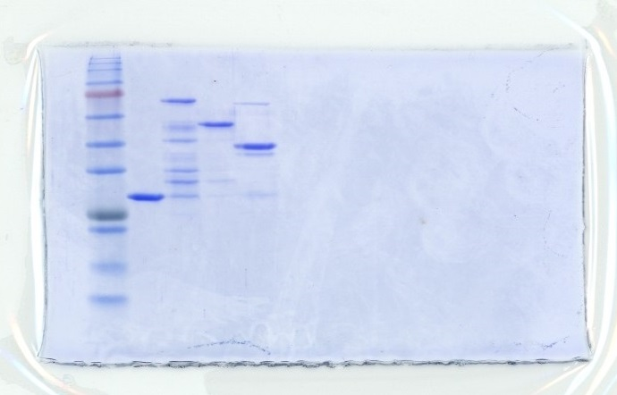
Figure 6A
GST
GST
Snf2C
AT-hook
Bromo
245
180
135
100
75
63
48
35
25
20
Cropped region
17
11
Figure 6 – source data 1
Uncropped and labelled gel image corresponding to Figure 6, panel A.

Slide 2
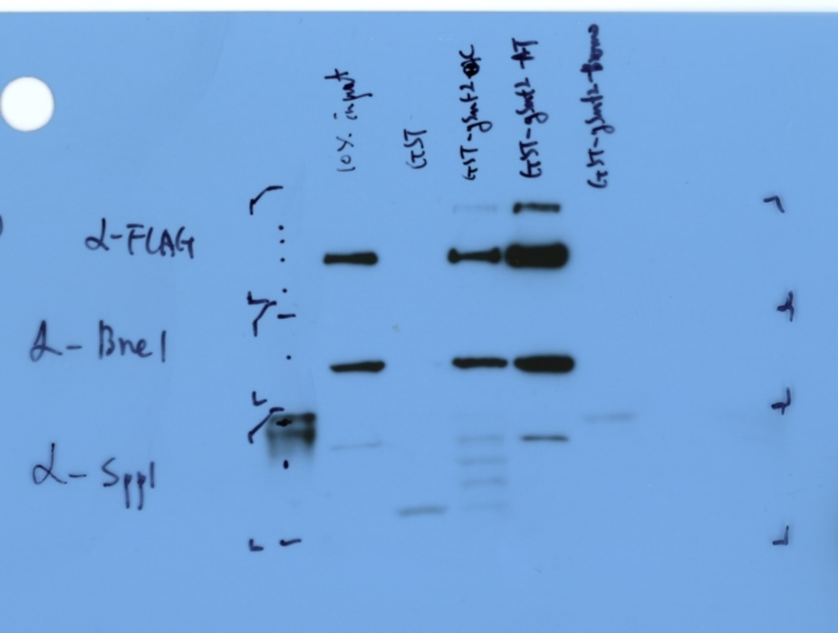
Figure 6B
Pull down: GST
10% input
GST
Snf2C
AT-hook
Bromo
245
180
Anti-FLAG (Set1)
135
100
75
63
Anti-Bre2
48
Anti-Spp1
35
Cropped region
Figure 6 – source data 2
Uncropped and labelled gel image corresponding to Figure 6, panel B.

Slide 3
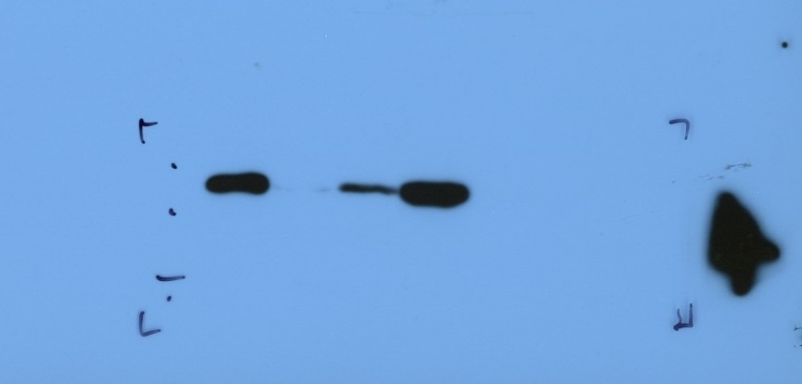
Figure 6C
Pull down: GST
10% input
GST
Snf2C
AT-hook
Bromo
48
Anti-FLAG (Set1-C762)
35
Cropped region
25
20
Figure 6 – source data 3
Uncropped and labelled gel image corresponding to Figure 6, panel C.

Slide 4
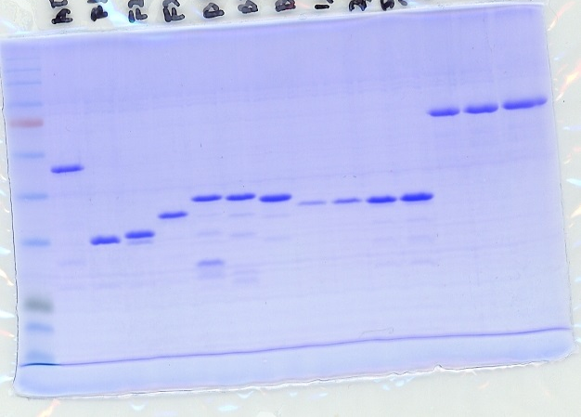
Figure 6D
GST-Snf2 fragments
F3
BSA
AT-hook
400ng
500ng
1μL
600ng
3μL
5μL
F1
7μL
F2
F3
B1
B2
B3
245
180
135
100
75
63
48
35
25
20
17
Cropped region
Figure 6 – source data 4
Uncropped and labelled gel image corresponding to Figure 6, panel D.

Slide 5
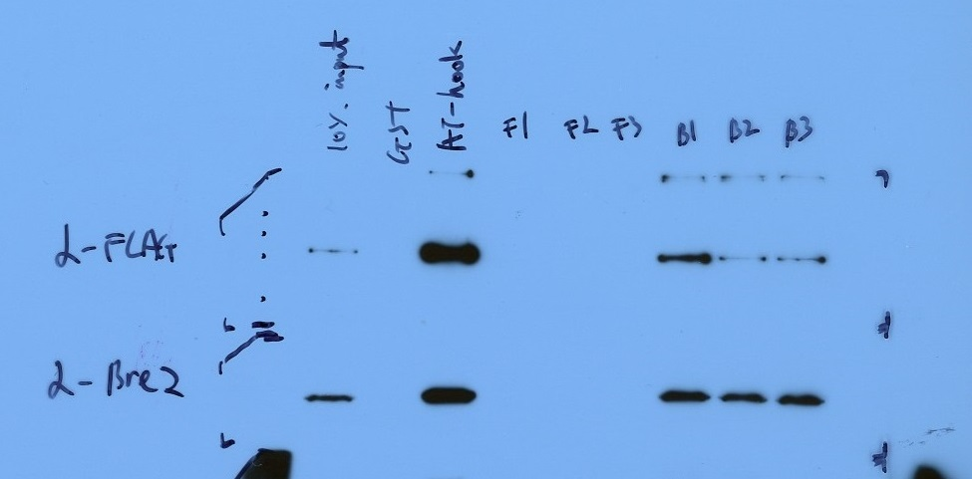
Figure 6E
Pull down: GST
10% input
GST
AT-hook
F1
F2
F3
B1
B2
B3
245
180
Anti-FLAG (Set1)
135
100
75
Anti-Bre2
Cropped region
Figure 6 – source data 5
Uncropped and labelled gel image corresponding to Figure 6, panel E.

