Slide 1

Set1C
245
180
135
100
75
63
48
35
25
20
17
Cropped region
Figure 6—figure supplement 1—source data 2
Uncropped and labelled gel image corresponding to Figure 6—figure supplement 1B.

Slide 2
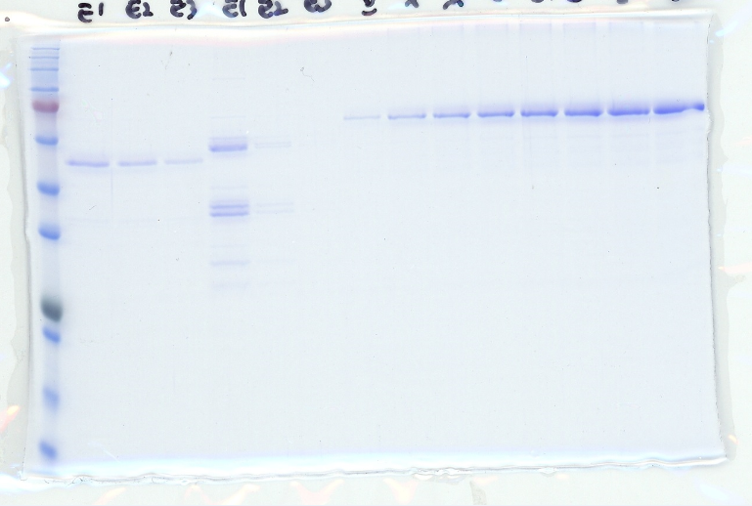
BSA
Pax6
100ng
200ng
300ng
400ng
500ng
600ng
700ng
800ng
Set1C-C762
245
180
135
100
75
63
48
35
25
20
17
11
Cropped region
Figure 6—figure supplement 1—source data 2
Uncropped and labelled gel image corresponding to Figure 6—figure supplement 1D.

Slide 3
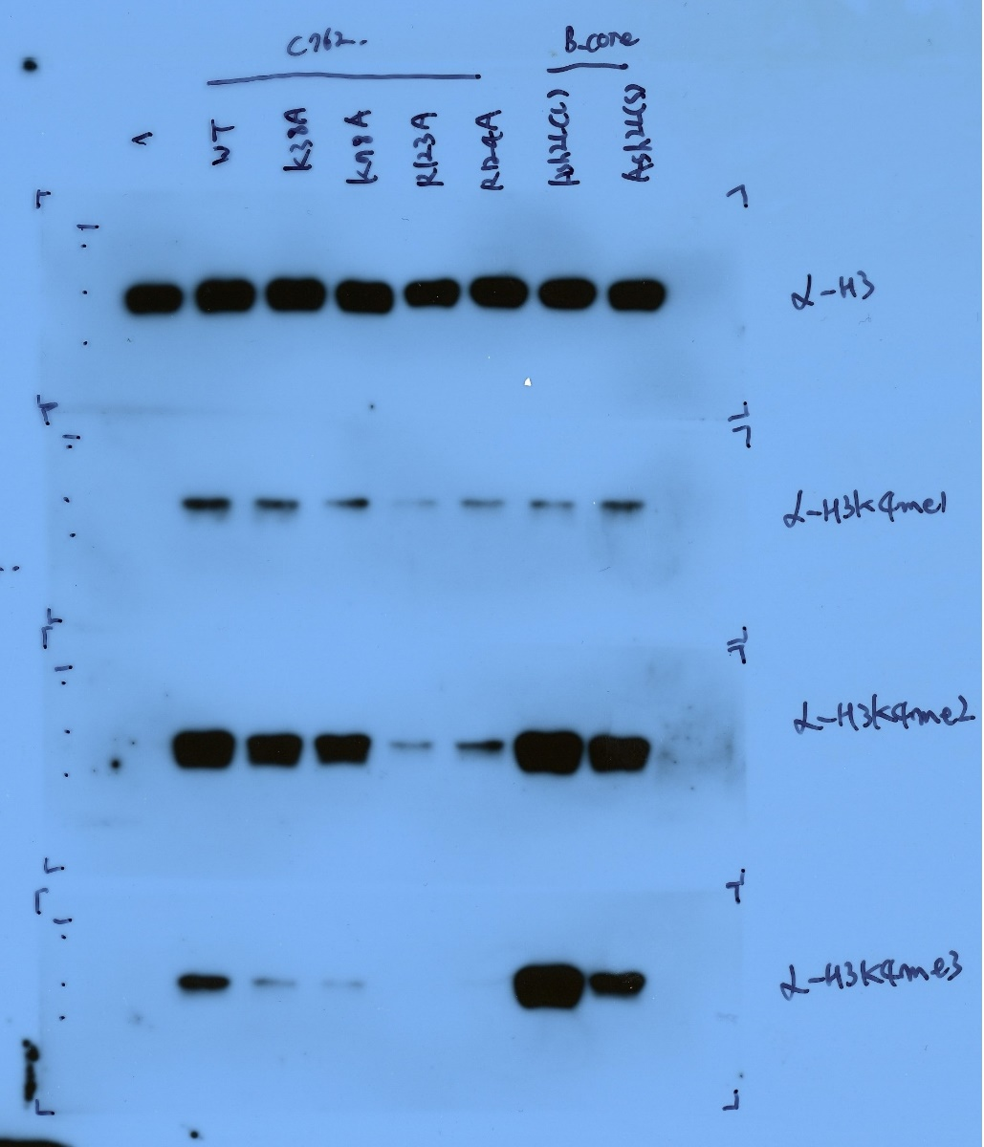
Set1B-Core
Set1C-C762
Ash2L(L)
WT
K38A
K78A
R123A
R124A
Ash2L(S)
-
25
20
17
Anti-H3
11
Cropped region
25
20
17
11
Anti-H3K4me1
Cropped region
25
20
17
Anti-H3K4me2
11
Cropped region
25
20
17
Anti-H3K4me3
11
Cropped region
Figure 6—figure supplement 1—source data 2
Uncropped and labelled gel image corresponding to Figure 6—figure supplement 1E.

