Slide 1
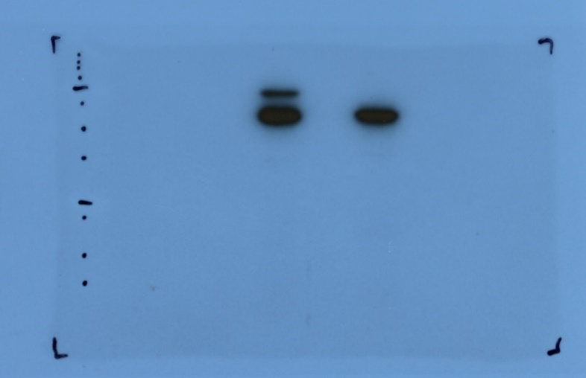
Figure 7A
-
Snf2C
Snf2-AT-hook
Snf2-Bromo
SET1C
+
-
+
-
+
-
+
245
180
135
100
75
63
48
35
25
20
17
Cropped region
11
Figure 7 – source data 1
Uncropped and labelled gel image corresponding to Figure 7, panel A.

Slide 2
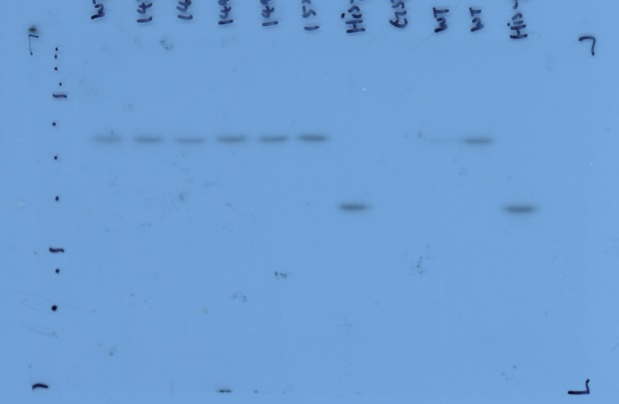
Figure 7B
Snf2+SET1C-RS
SET1C
GST-Snf2-AT
GST-Snf2-AT
WT
His-Snf2-AT
1456
1488
1494
1498
1526
His-Snf2-AT
GST
245
180
135
100
75
63
48
35
25
Cropped region
20
17
Figure 7 – source data 2
Uncropped and labelled gel image corresponding to Figure 7, panel B.

Slide 3
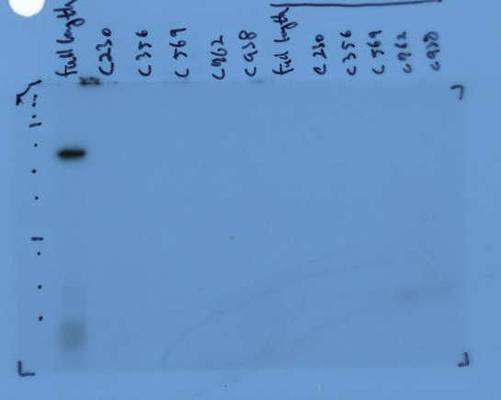
Figure 7C
GST-Snf2-AT hook
FL
C230
C356
C569
C762
C938
FL
C230
C356
C569
C762
SET1C
C938
245
180
135
100
75
63
48
Cropped region
35
25
20
17
11
Figure 7 – source data 3
Uncropped and labelled gel image corresponding to Figure 7, panel C.

Slide 4
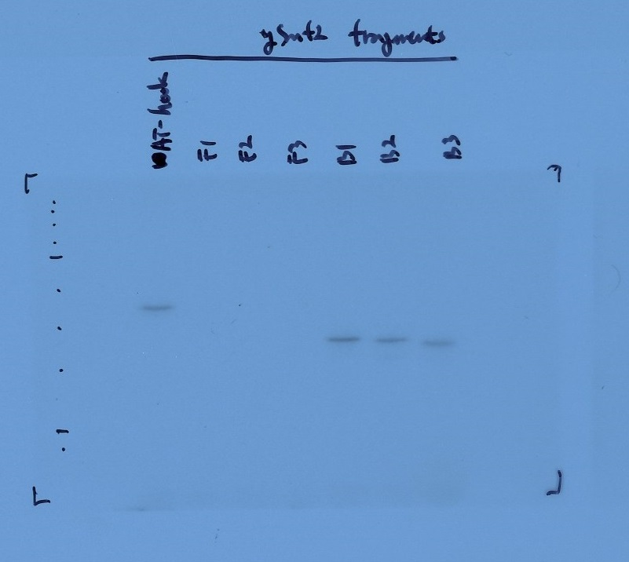
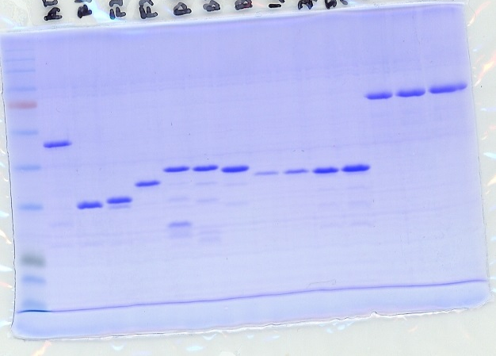
Figure 7E
GST-Snf2 fragments
F3
BSA
AT-hook
AT-hook
400ng
500ng
1μL
600ng
3μL
5μL
F1
7μL
F2
F3
B1
B2
F1
F2
F3
B1
B2
B3
B3
245
245
180
180
135
135
100
100
75
75
63
63
48
48
35
35
Cropped region
Cropped region
25
25
20
20
17
Figure 7 – source data 4
Uncropped and labelled gel image corresponding to Figure 7, panel E.

Slide 5
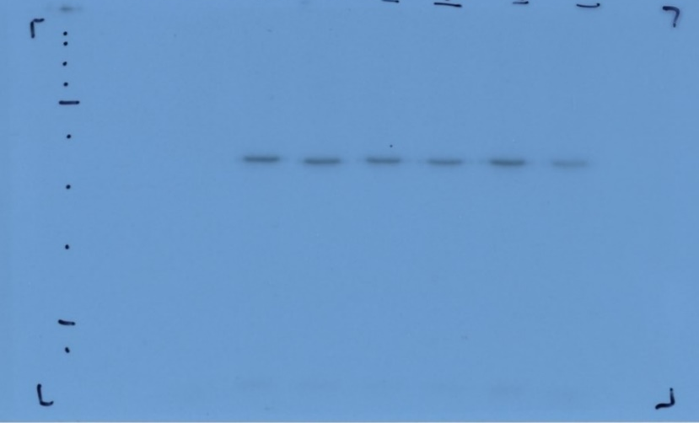
Figure 7F
GST-Snf2 AT-hook
WT
K1494R+K1498R
K1488R
k1494R
K1498R
-
K1526R
245
180
135
100
75
63
48
35
Cropped region
25
20
Figure 7 – source data 5
Uncropped and labelled gel image corresponding to Figure 7, panel F.

Slide 6
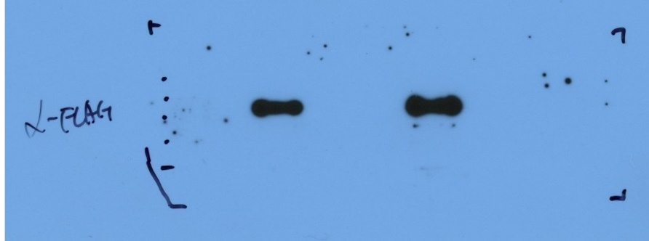
Figure 7H
Pull down: GST
10% input
GST
AT-hook
∆RG
245
180
Anti-FLAG (Set1)
135
100
Cropped region
75
Figure 7 – source data 6
Uncropped and labelled gel image corresponding to Figure 7, panel H.

Slide 7
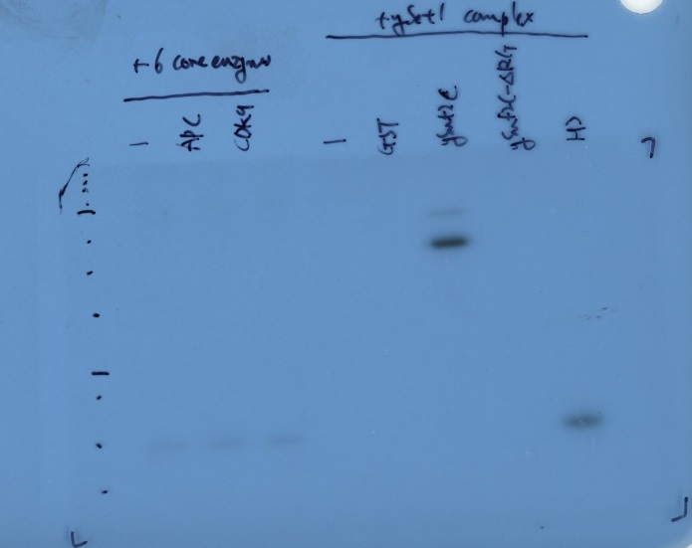
Figure 7I
+6 core enzymes
+SET1C
APC
GST
Snf2C
∆RG
CDK9
H3
-
-
245
180
135
100
75
63
48
35
25
20
17
11
Cropped region
Figure 7 – source data 7
Uncropped and labelled gel image corresponding to Figure 7, panel I.

