Slide 1
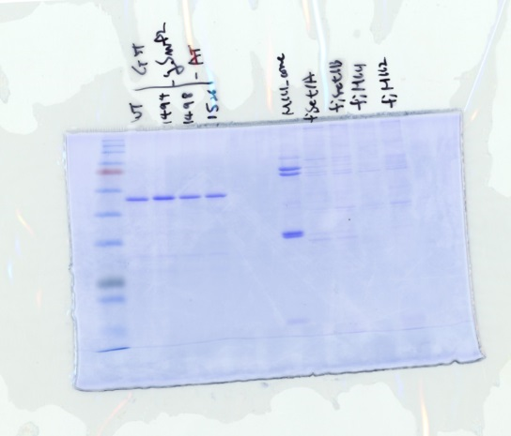
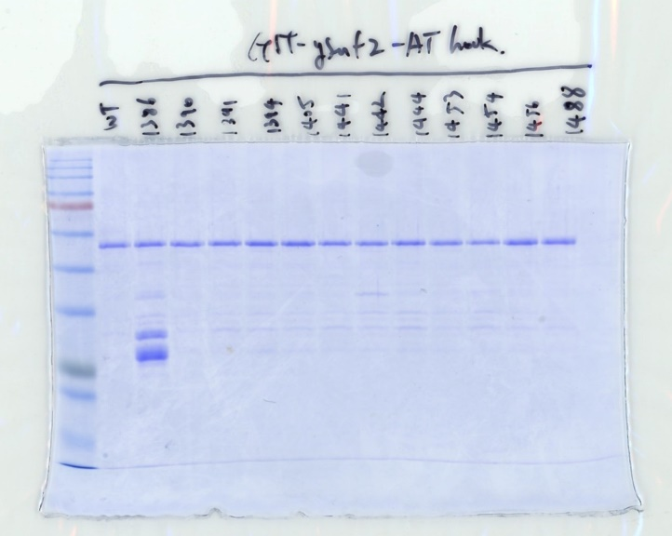
GST-Snf2-AT hook
GST-Snf2-AT hook
MLl1 core
Set1A
Set1B
MLl1
MLl2
WT
K1494R
K1498R
WT
K1526R
K1386R
K1390R
K1391R
K1394R
K1441R
K1442R
K1444R
K1453R
K1454R
K1456R
K1405R
K1488R
245
180
245
135
180
100
135
75
100
75
63
63
48
48
35
35
25
25
20
Cropped region
20
Cropped region
17
17
Figure 7—figure supplement 1—source data 2
Uncropped and labelled gel image corresponding to Figure 7—figure supplement 1, Coomassie.

Slide 2
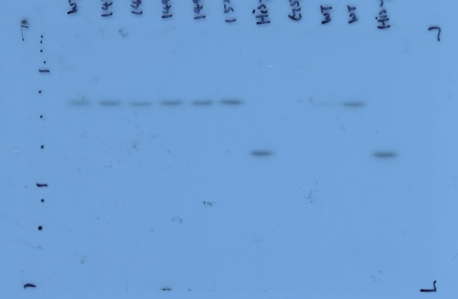
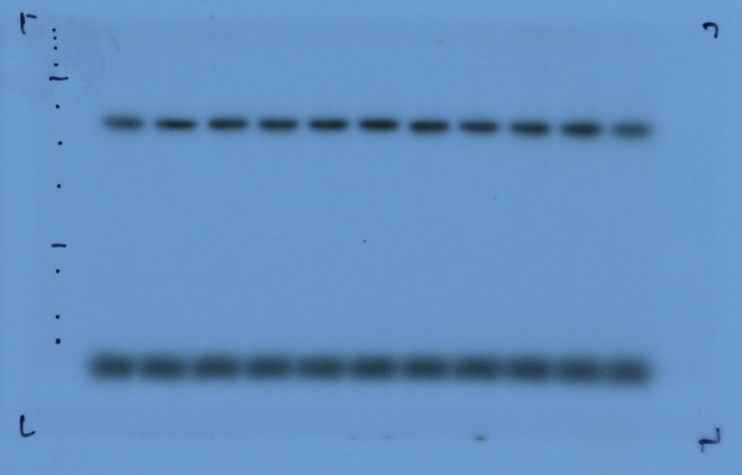
SET1C
Snf2+SET1C-RS
SET1C + GST-Snf2-AT hook
GST-Snf2-AT
GST-Snf2-AT
WT
His-Snf2-AT
1456
1488
1494
1498
1526
His-Snf2-AT
GST
WT
K1386R
K1390R
K1391R
K1394R
K1441R
K1442R
K1444R
K1453R
K1405R
K1454R
245
245
180
135
180
100
135
75
100
63
75
48
63
35
Cropped region
48
25
35
Cropped region
20
17
25
11
20
17
Figure 7—figure supplement 1—source data 2
Uncropped and labelled gel image corresponding to Figure 7—figure supplement 1, methyltransferase assay.

