Slide 1
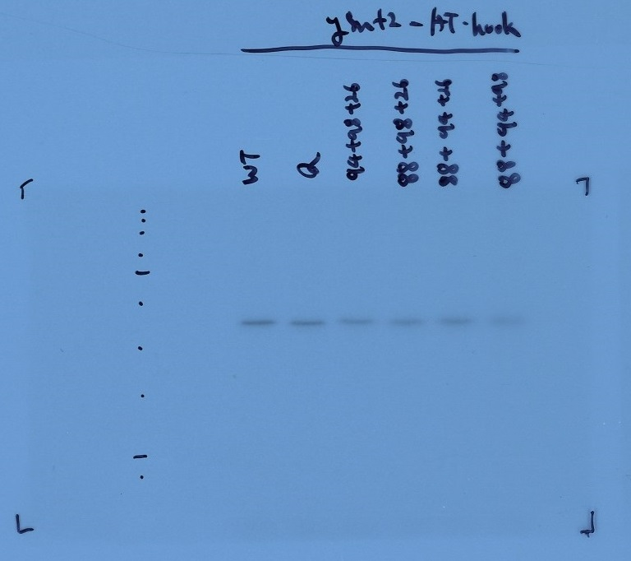
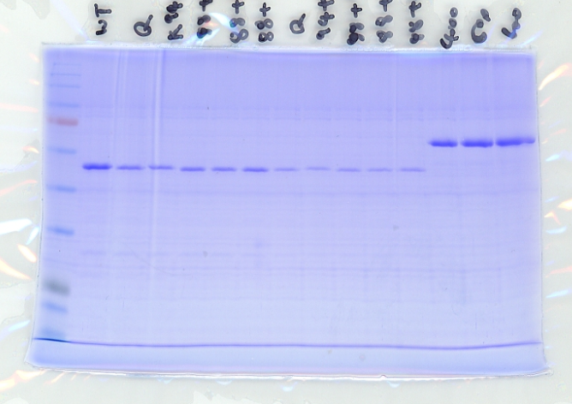
GST-Snf2 AT-hook (5μL)
GST-Snf2 AT-hook (2μL)
SET1C
+ GST-Snf2-AT hook
BSA
WT
Q
K1488
K1494
K1498
Q
K1488
K1494
K1498
400ng
600ng
K1526
K1526
800ng
WT
Q
K1488
K1494
K1498
K1526
245
180
135
100
245
75
180
135
63
100
75
48
63
35
Cropped region
48
35
Cropped region
25
20
25
17
20
Figure 7—figure supplement 2—source data 2
Uncropped and labelled gel image corresponding to Figure 7—figure supplement 2, methyltransferase assay.

