Slide 1
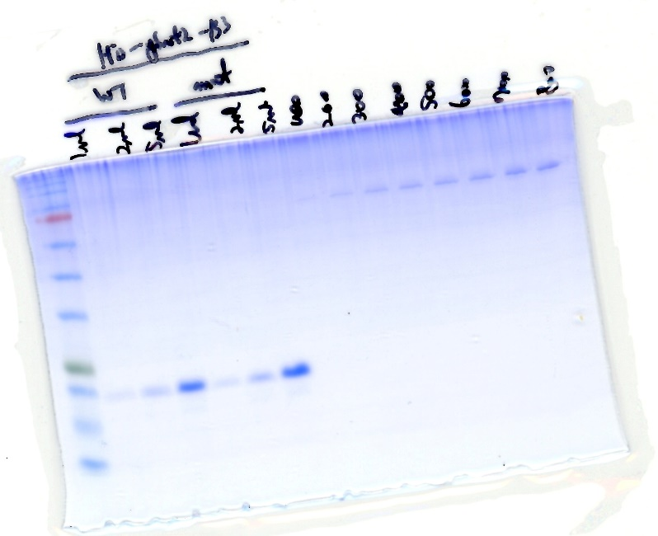
Figure 8B
WT-B3
BSA
MUT-B3
1μL
2μL
5μL
1μL
2μL
5μL
100ng
200ng
300ng
400ng
500ng
600ng
700ng
800ng
245
180
135
100
75
63
48
35
25
20
17
11
Cropped region
Figure 8 – source data 1
Uncropped and labelled gel image corresponding to Figure 8, panel B.

Slide 2
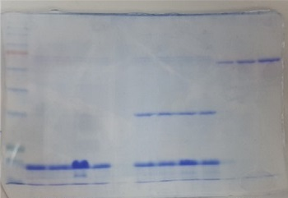
Figure 8D
BSA
SET1C+
Mut Snf2-B3
Mut Snf2-B3
200ng
400ng
600ng
245
180
135
100
75
63
48
35
25
20
17
Cropped region
Figure 8 – source data 2
Uncropped and labelled gel image corresponding to Figure 8, panel D.

