Slide 1
Figure 2-figure supplement 1-Source data
Figure 2-figure supplement 1A

Slide 2
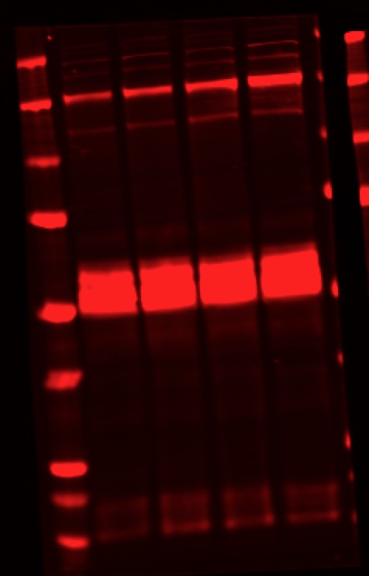
Figure 2-figure supplement 1-Source data
Figure 2-figure supplement 1D
p4EBP1
peIF4G
peIF4B

Slide 3
Figure 2-figure supplement 1-Source data
Figure 2-figure supplement 2D
p4EBP1
peIF4G
peIF4B

