Slide 1
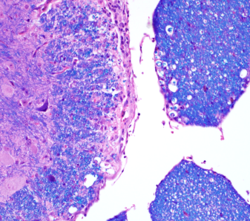
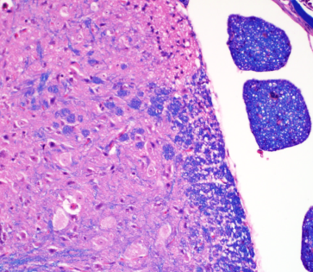
Sham
CLP
HE
LFB
Notes:
Figure X. Representative photomicrographs of the lumbar spine from mice with EAE which underwent sham surgery or cecal ligation procedure. Thick arrows indicate areas of inflammation which was scored on HE stained slides. Luxol fast blue (LFB) stains were also performed and there was very subtle demyelination and axonal sheath swelling in some of the sham treated animals (thin arrows). Bars = 200um (inset bars = 50um).

