Slide 1

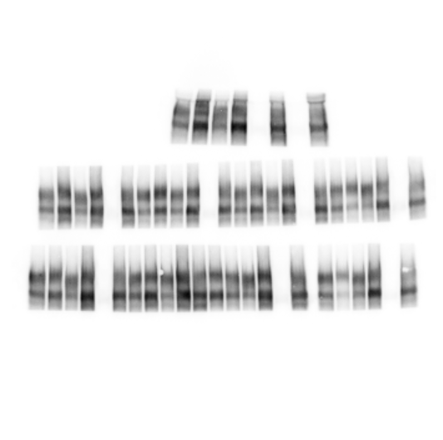
Figure 5 - Source data 3
β-actin 1:20000
Exposed 2s
NHE1 1:400
Exposed 2s
Calmodulin 1:500
Exposed 4s
Notes:
Marked in blue box are the samples shown in Fig 5b.

