Slide 1

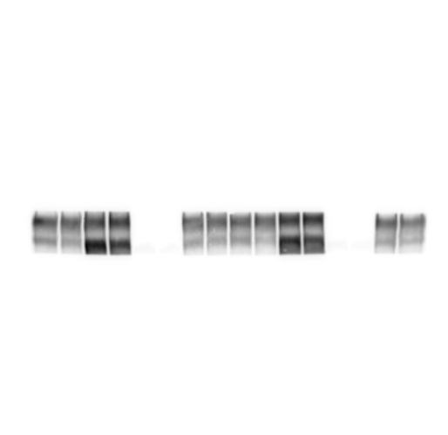
Fig 6g n3, n4
Figure 6 - Source data 2
p150 1:1000
Exposed 6s
Akt 1:700
Exposed 20s
pAkt 1:200
Exposed 16s
Calmodulin 1:500
Exposed 43s
NHE1 1:400
Exposed 3s
Notes:
The top row of p150 belongs to the gel run together with NHE1, Akt and CaM.
The bottom row of p150 belongs to the gel run together with pAkt.
In blue box are the samples shown in Fig 6g.

Slide 2
Fig 6g n1, n2
Figure 6 - Source data 2
Akt 1:700
Exposed 10s
pAkt 1:200
Exposed 1min
p150 1:1000
Exposed 4s
Calmodulin 1:500
Exposed 6s
NHE1 1:500
Exposed 3s
Notes:
The top row of p150 belongs to the gel run together with NHE1, Akt and CaM.
The bottom row of p150 belongs to the gel run together with pAkt.

