Slide 1
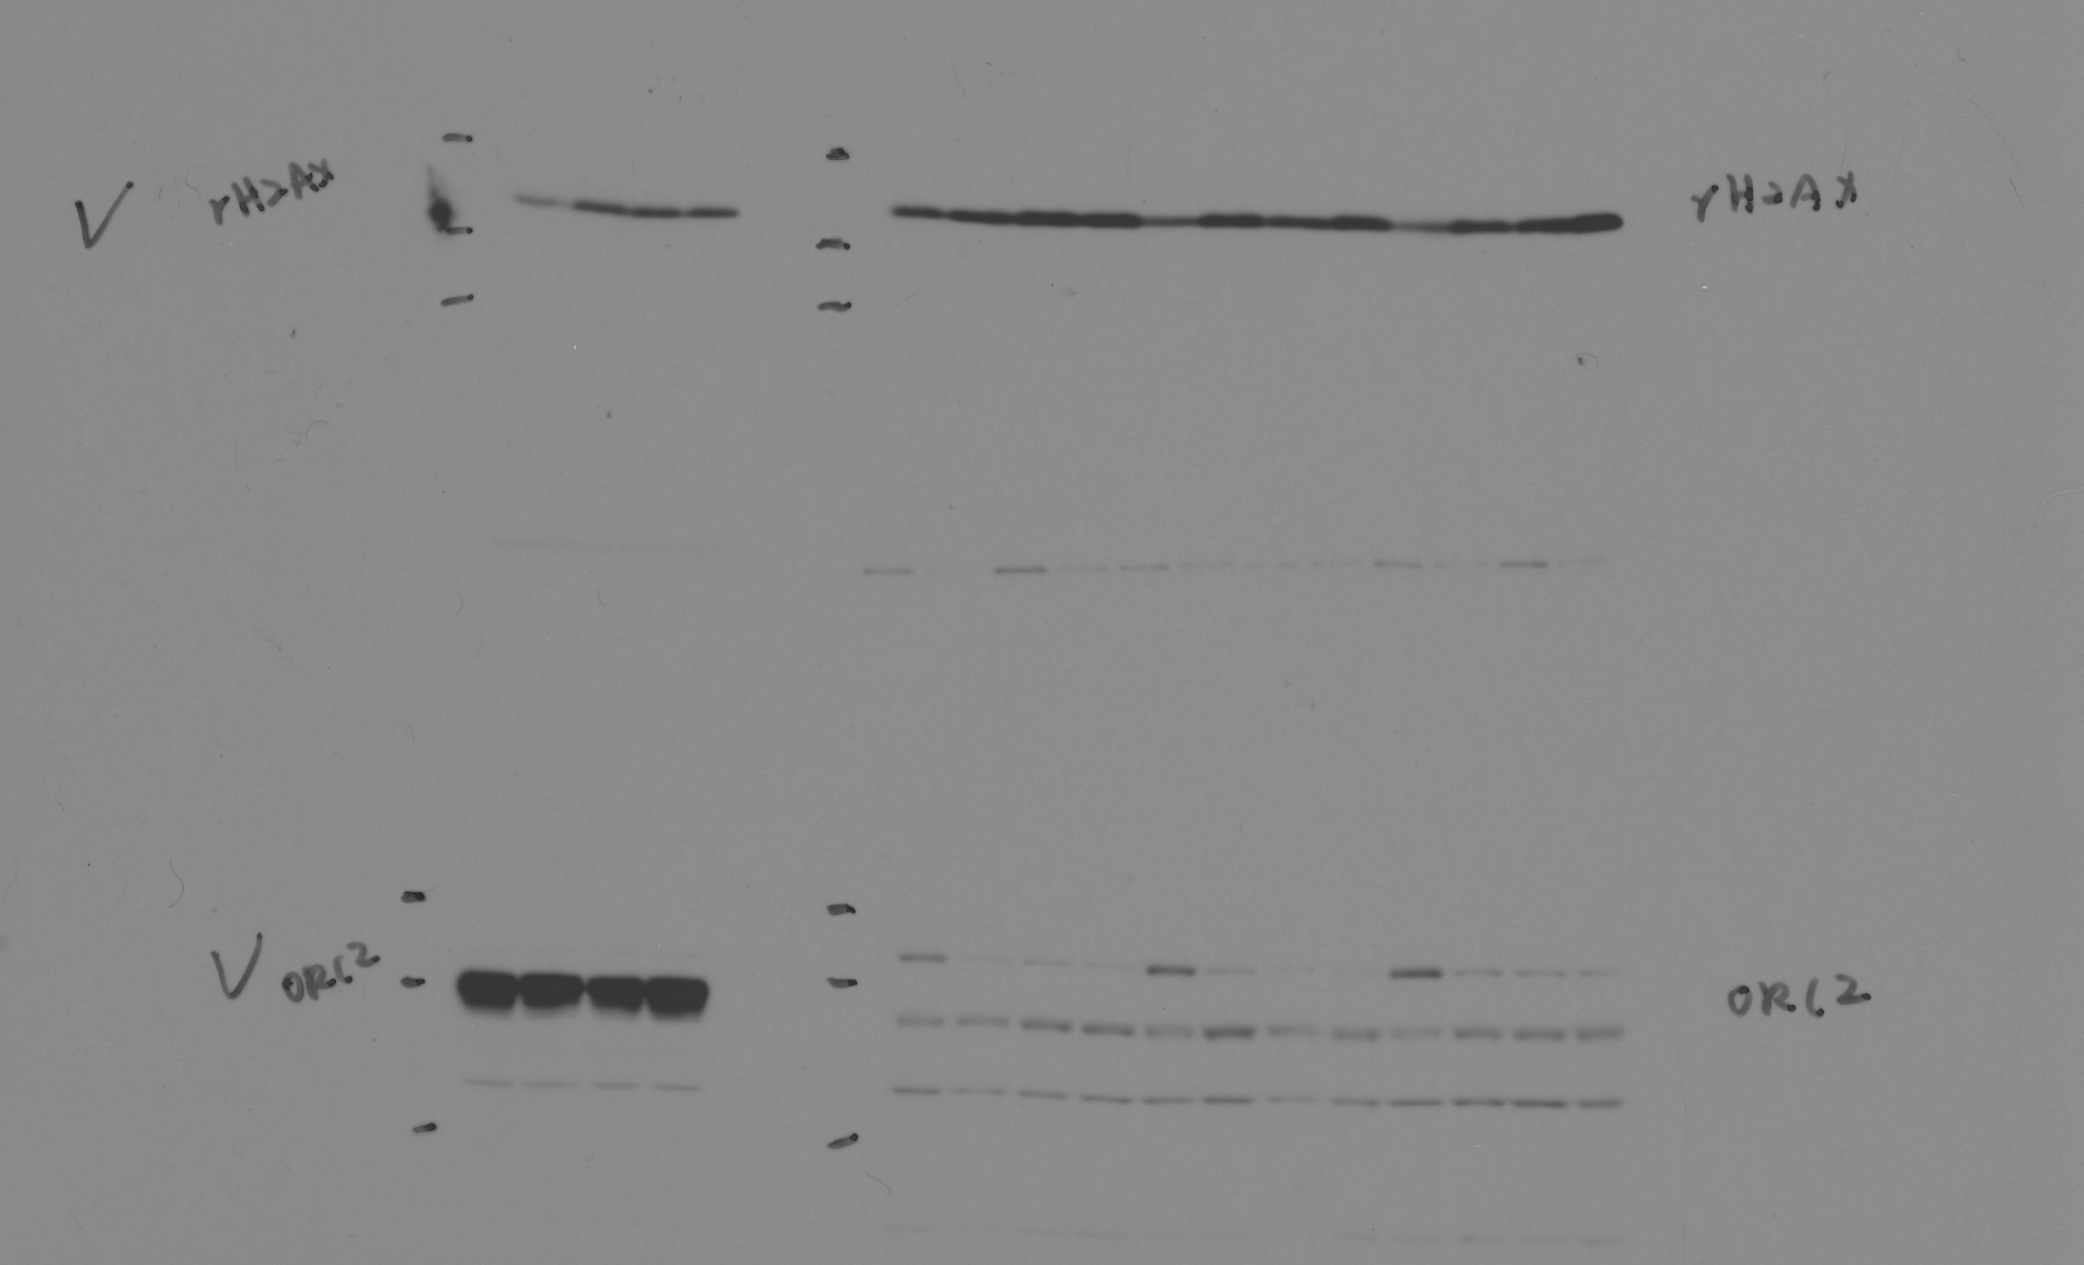
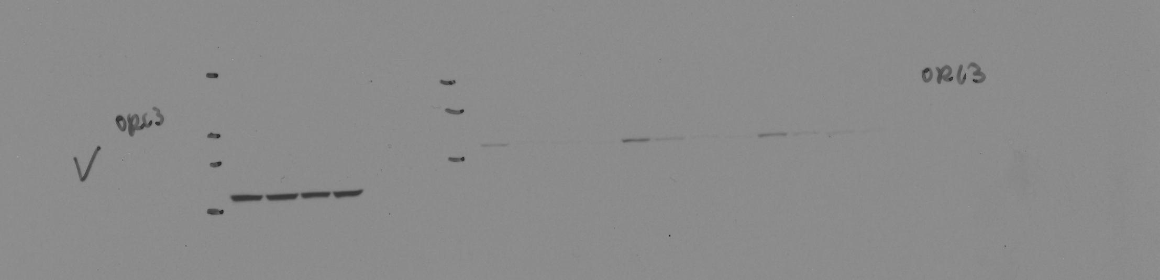
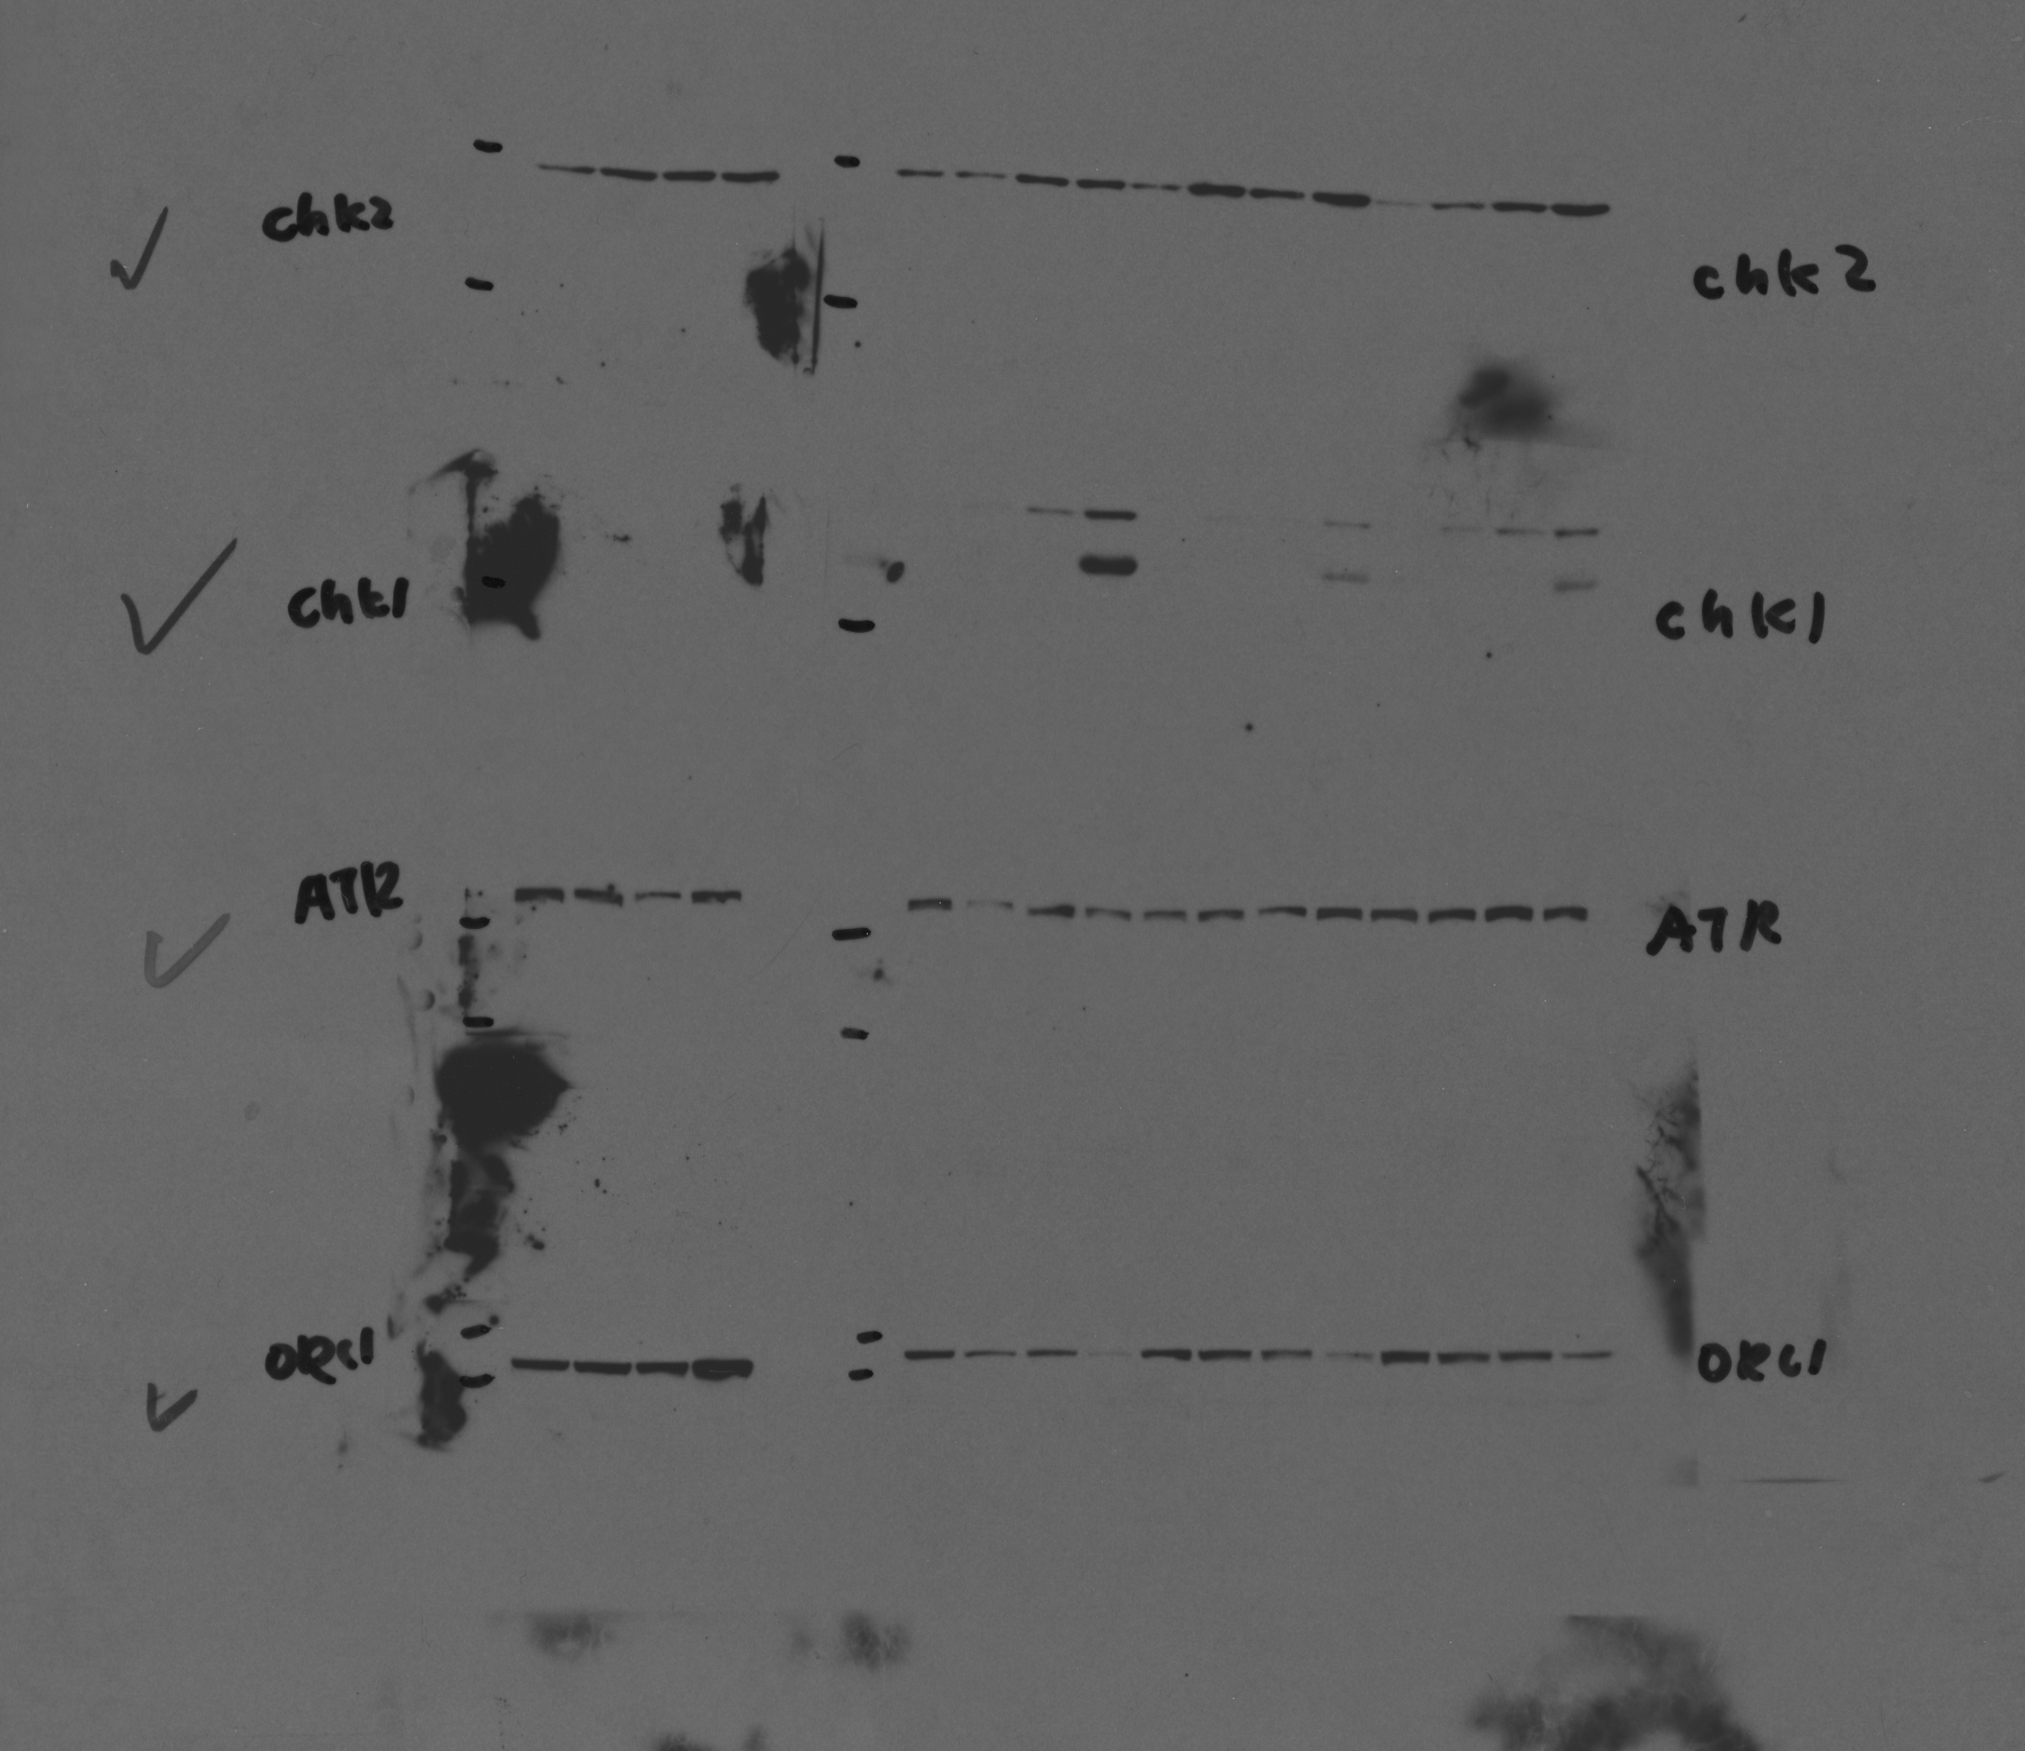
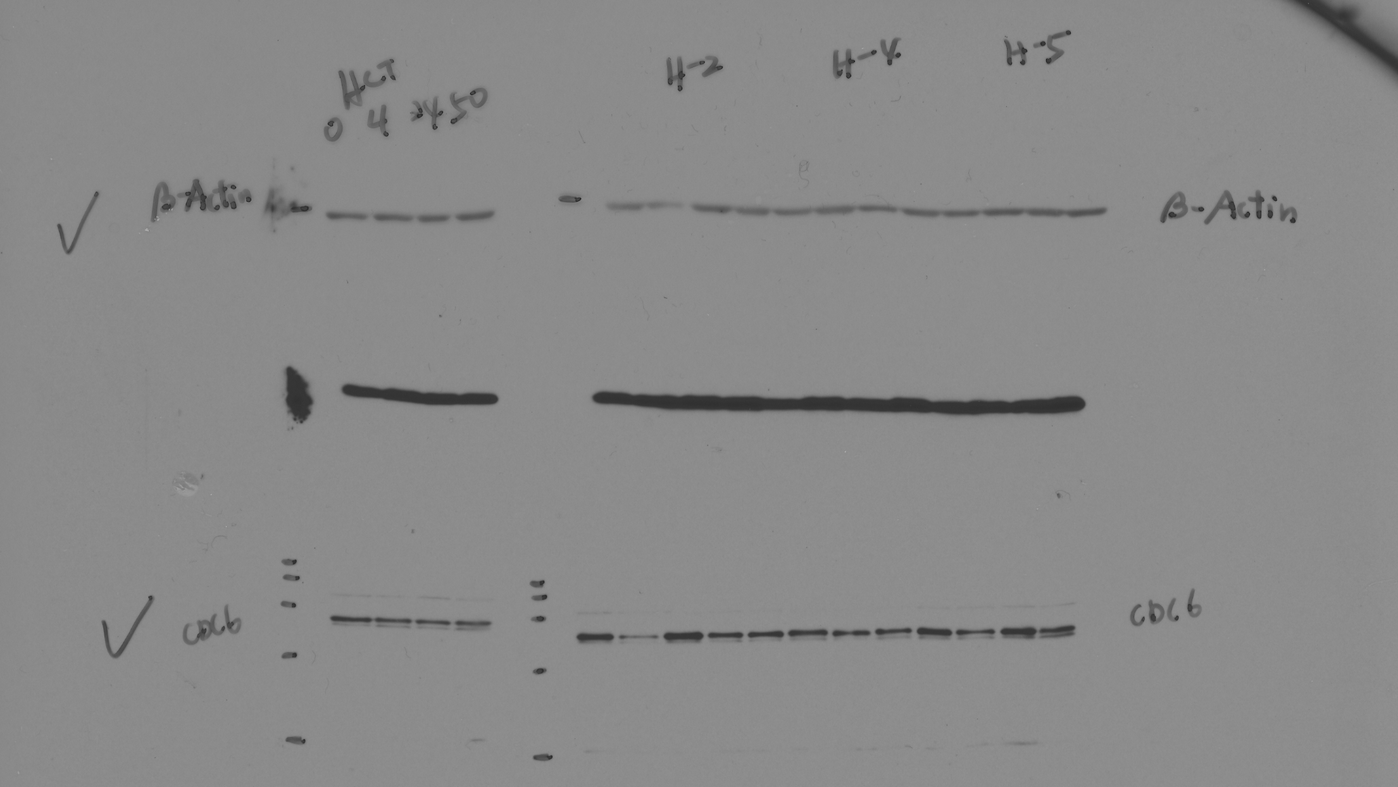
ORC2
ORC3
ORC1
CDC6

Slide 2
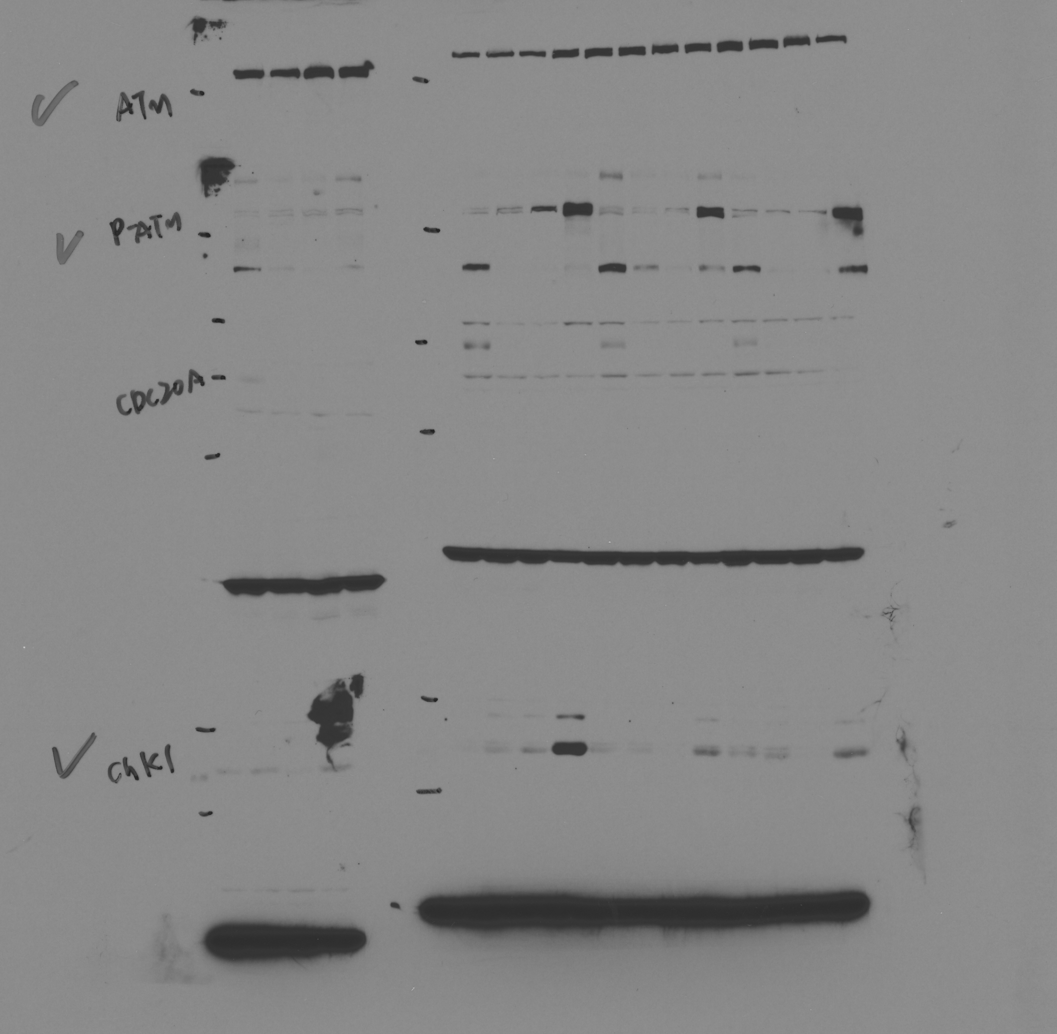
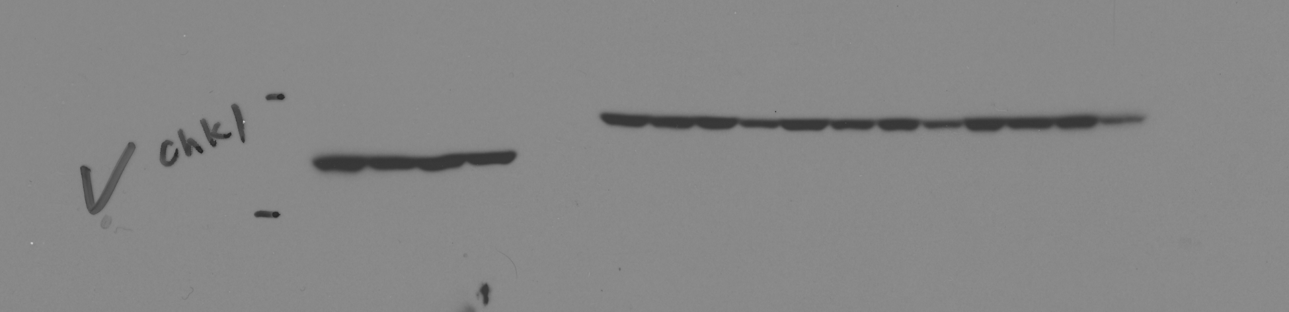
ATM
P-ATM(S1981)
CHK1
P-CHK1(S345)

Slide 3
P-CHK2(T68)
𝝲H2AX
Β-Actin

