Slide 1
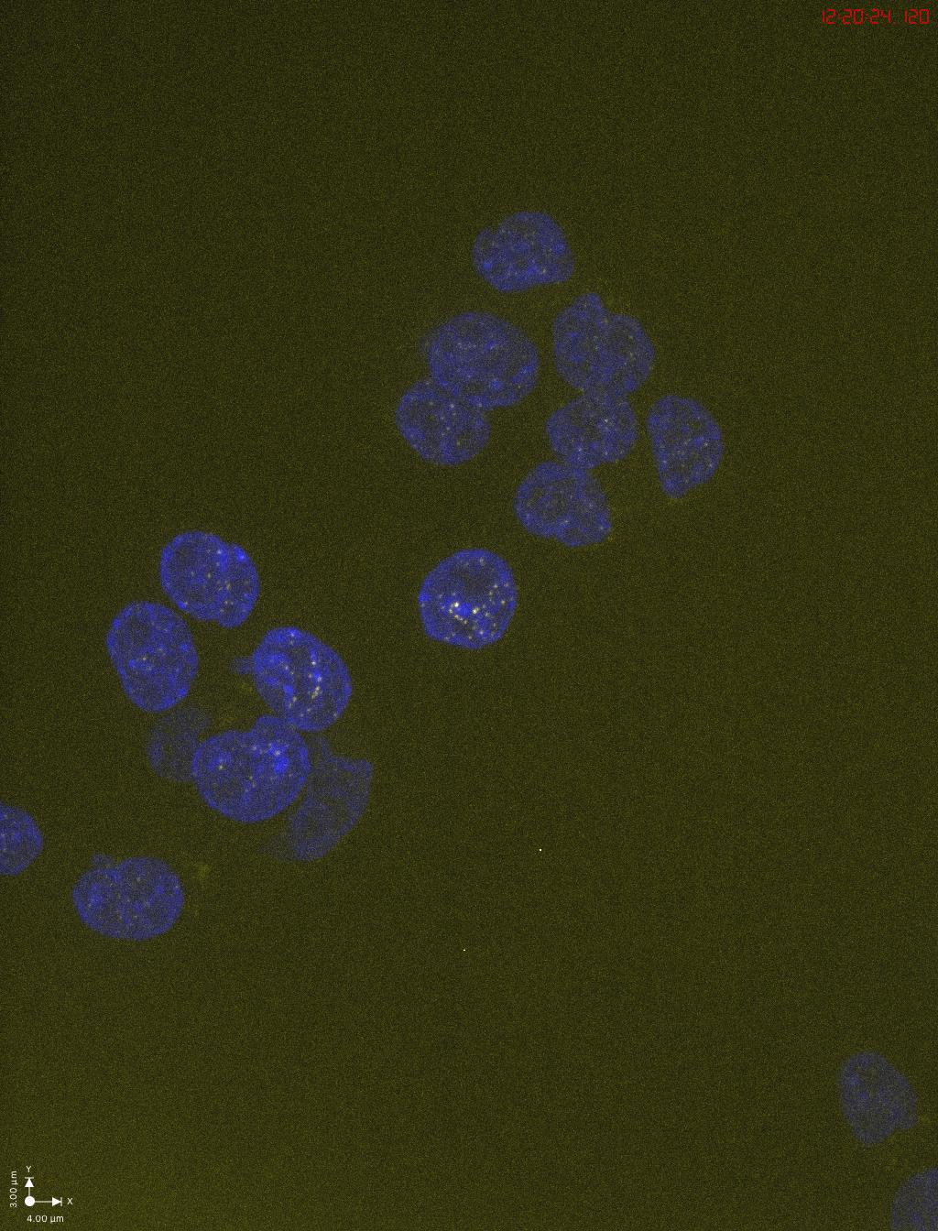
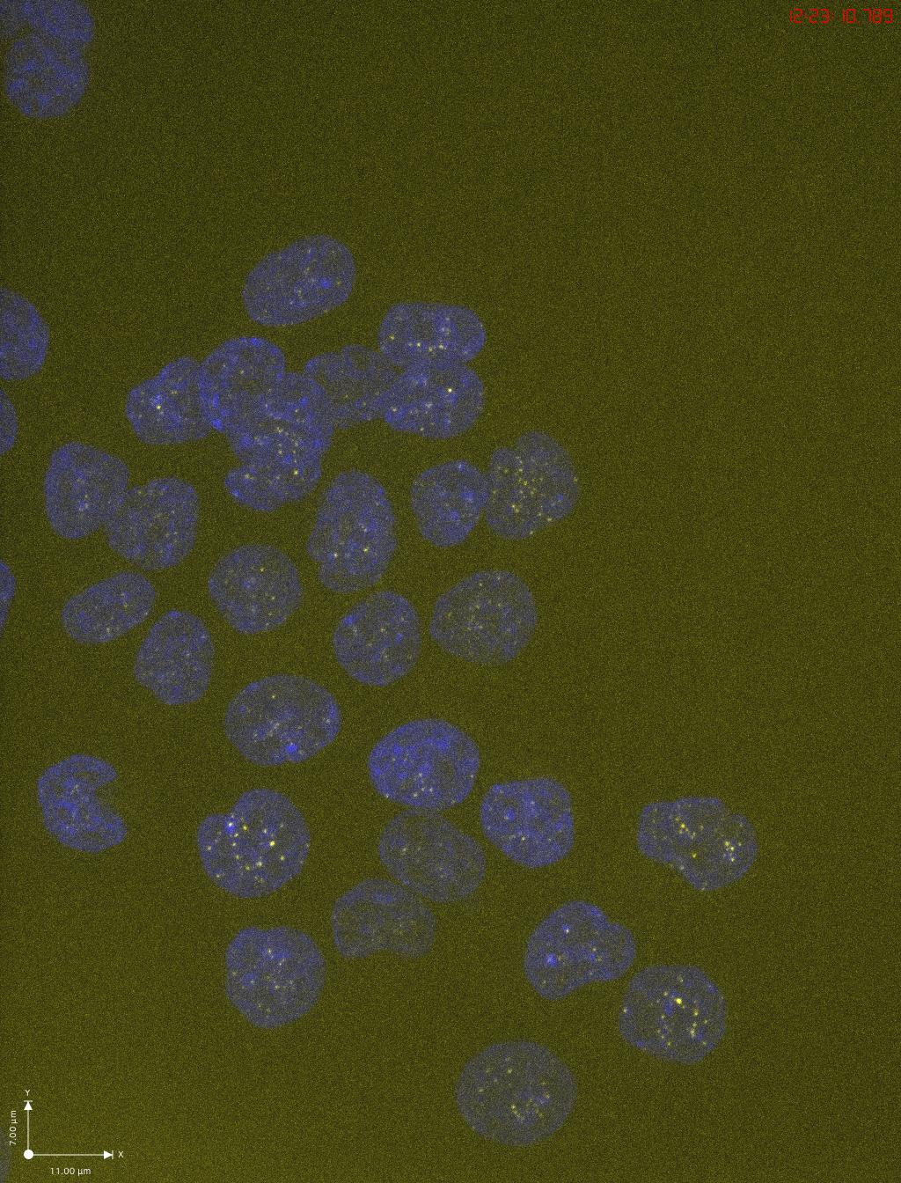
TO-HCT116 no treatment_p-𝝲H2AX(S139)
TO-HCT116 Dox+auxin_p-𝝲H2AX(S139)

Slide 2
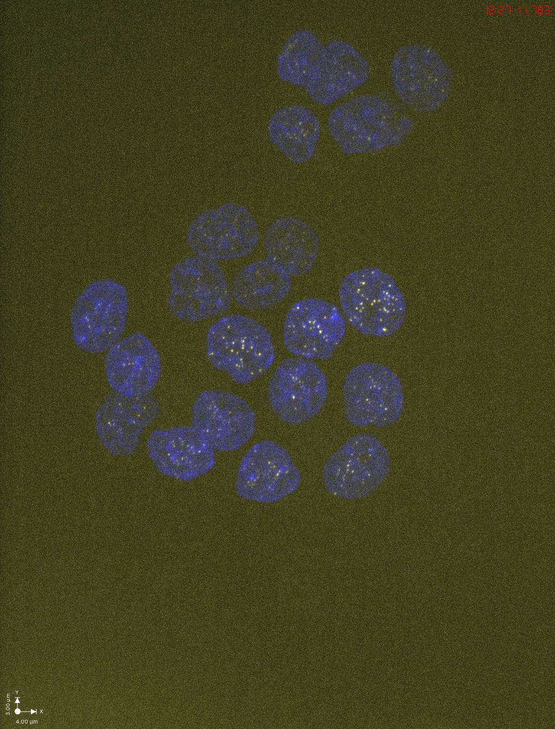
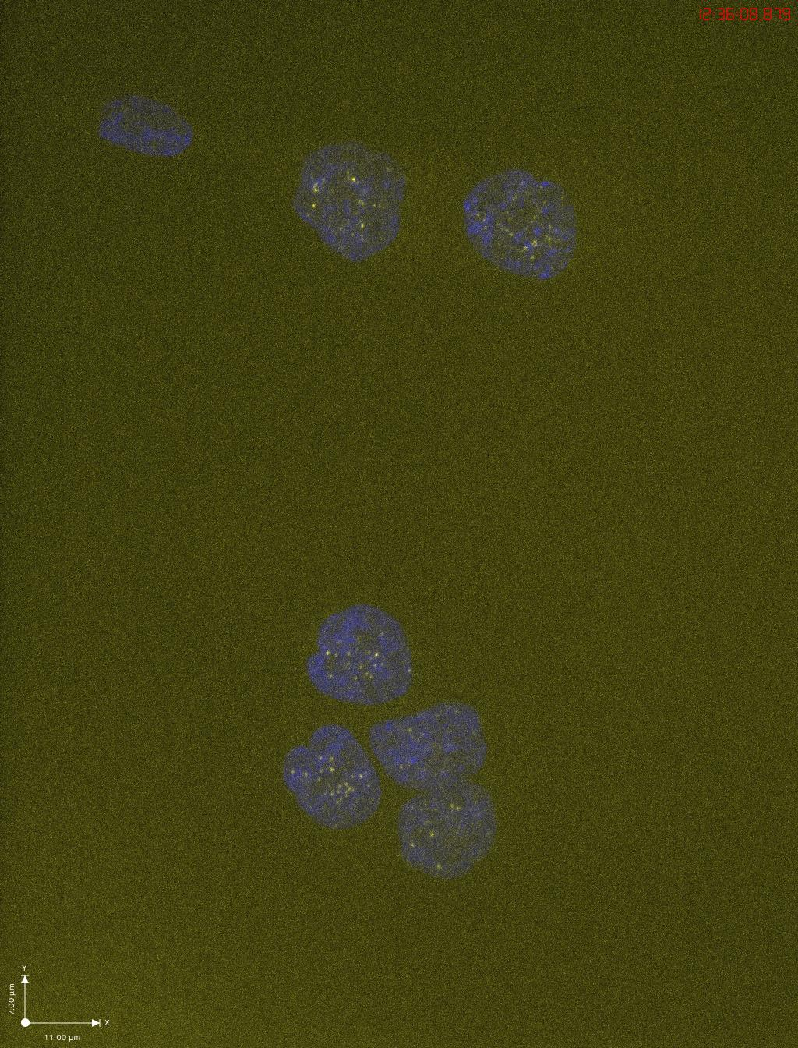
ORC2_H-2 no treatment_p-𝝲H2AX(S139)
ORC2_H-2 Dox+auxin_p-𝝲H2AX(S139)

Slide 3
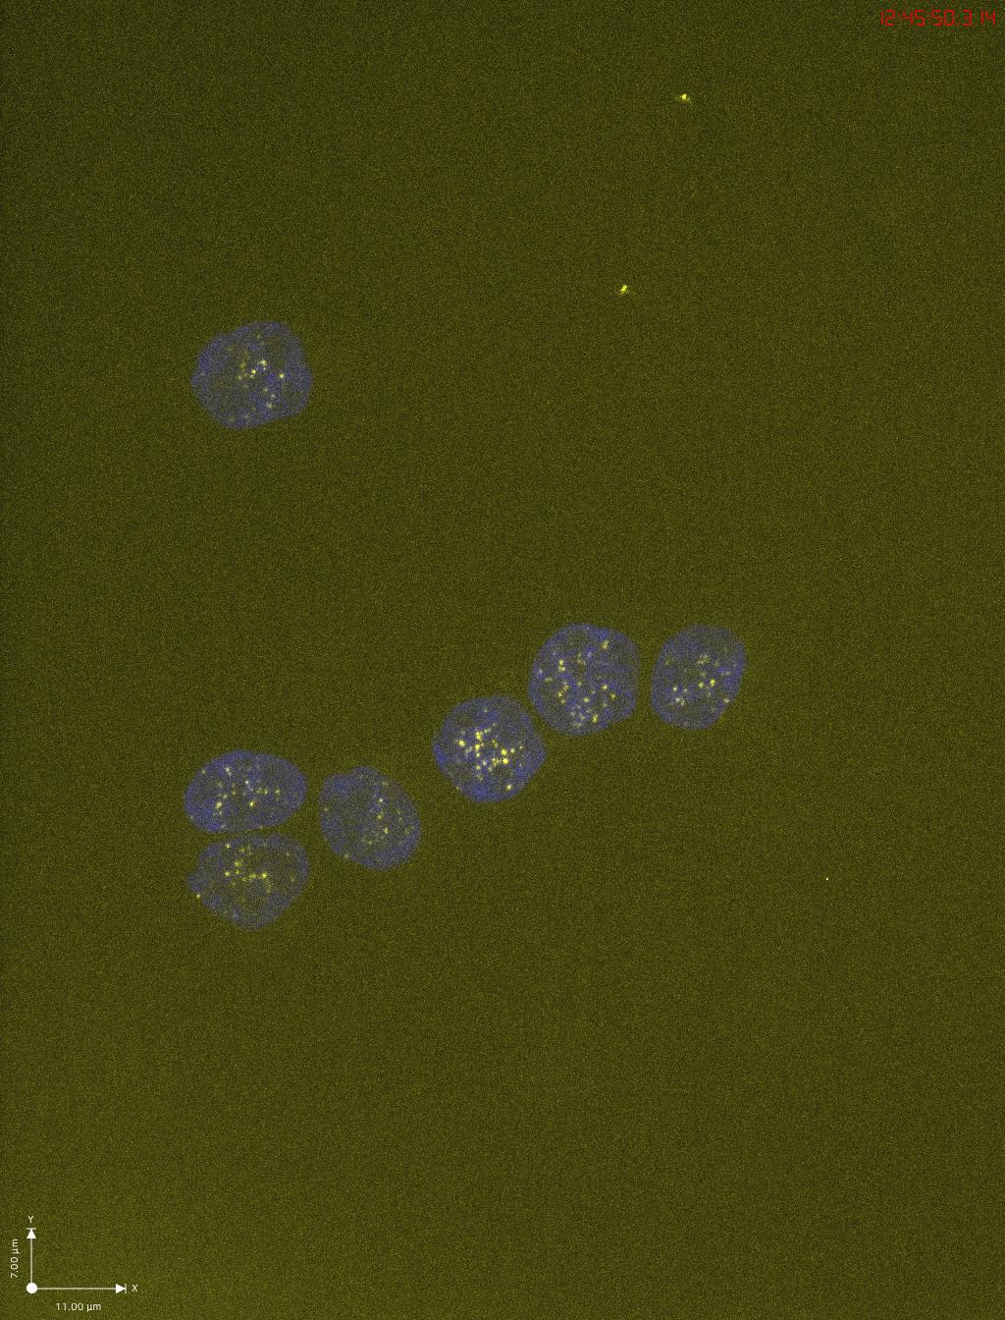
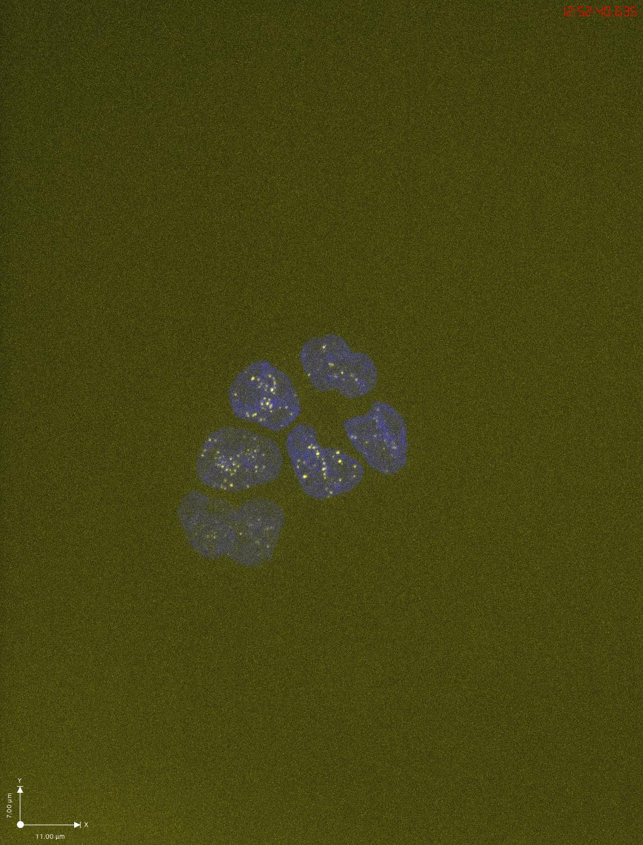
ORC2_H-4 no treatment_p-𝝲H2AX(S139)
ORC2_H-4 Dox+auxin_p-𝝲H2AX(S139)

Slide 4
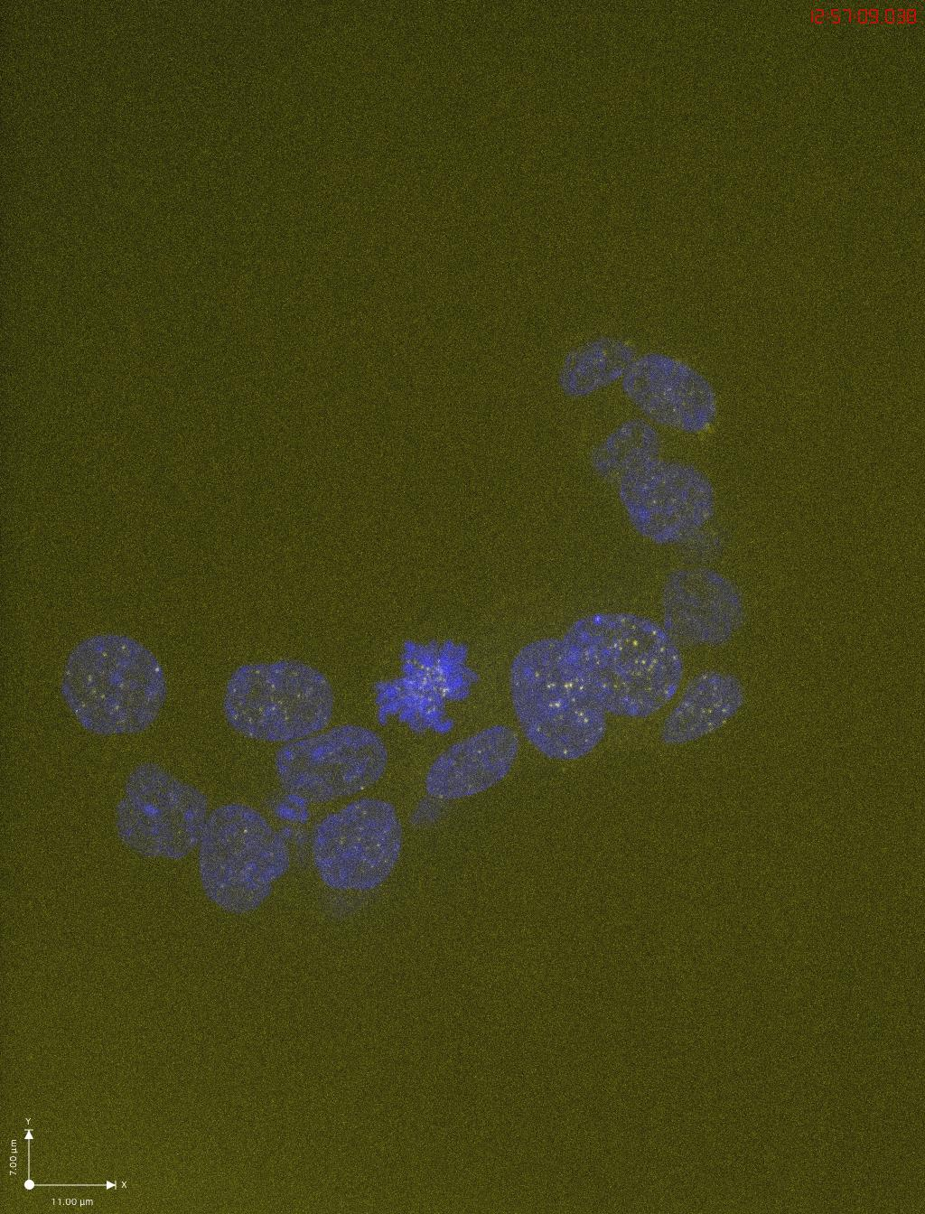
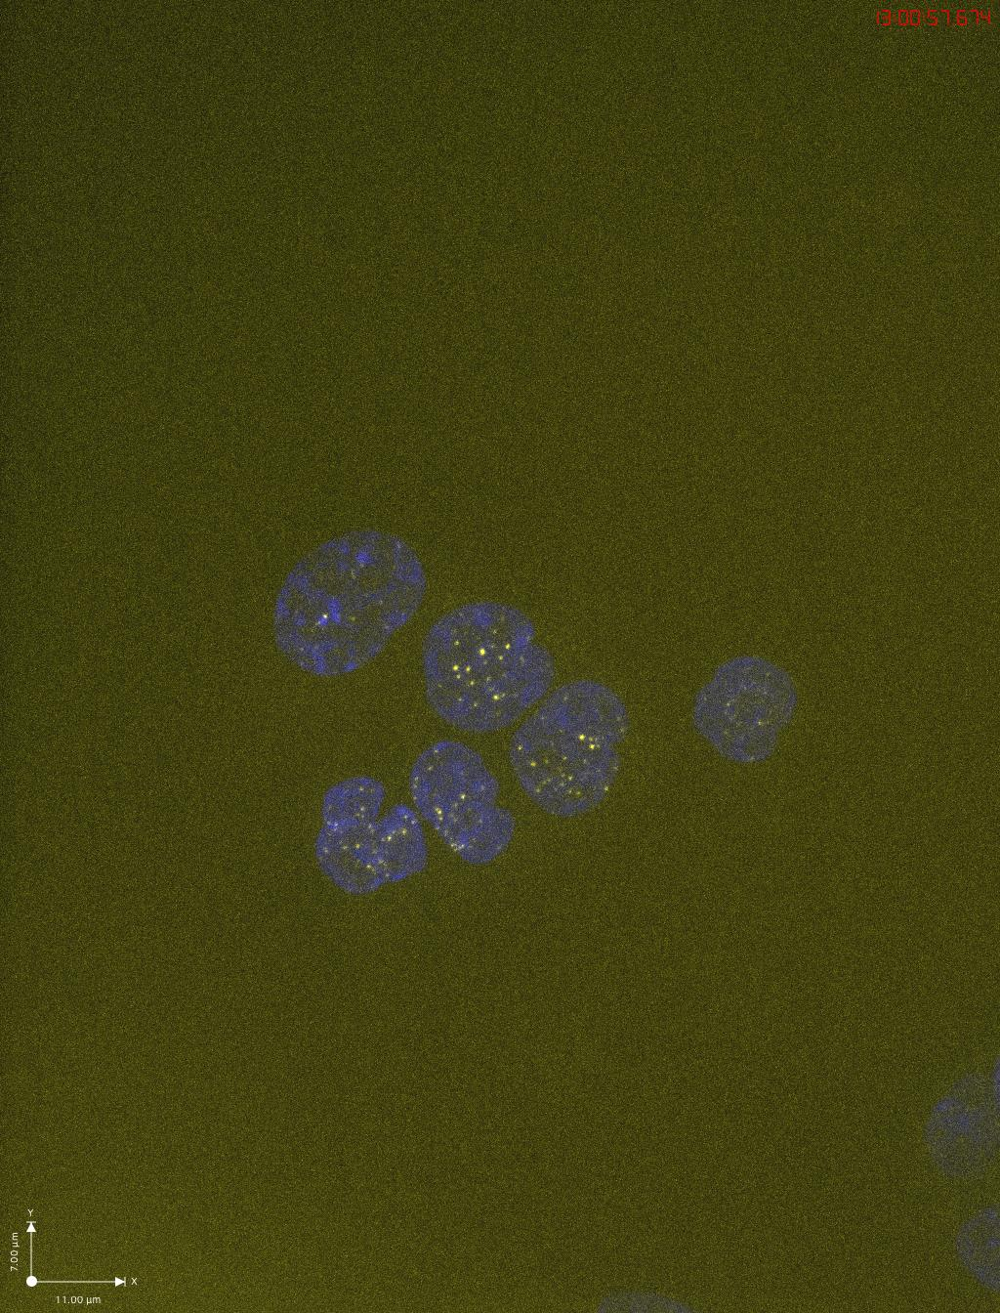
ORC2_H-5 no treatment_p-𝝲H2AX(S139)
ORC2_H-5 Dox+auxin_p-𝝲H2AX(S139)

