Slide 1
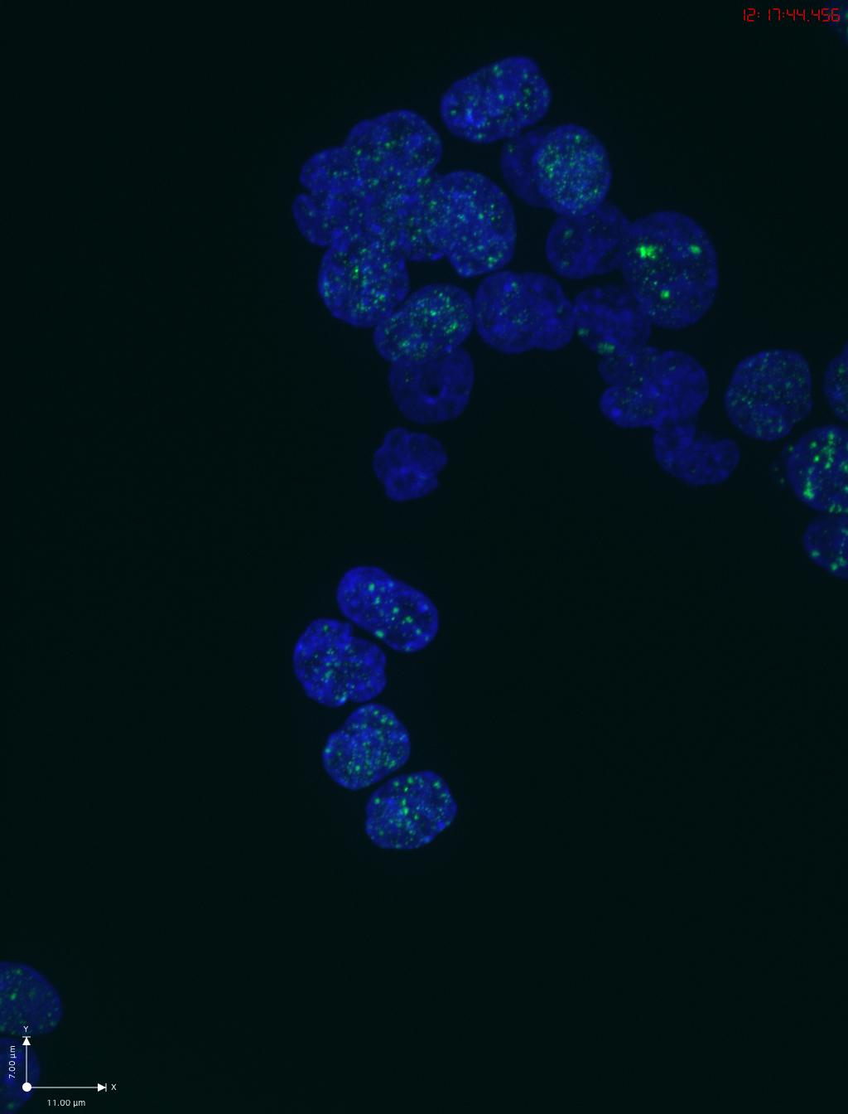
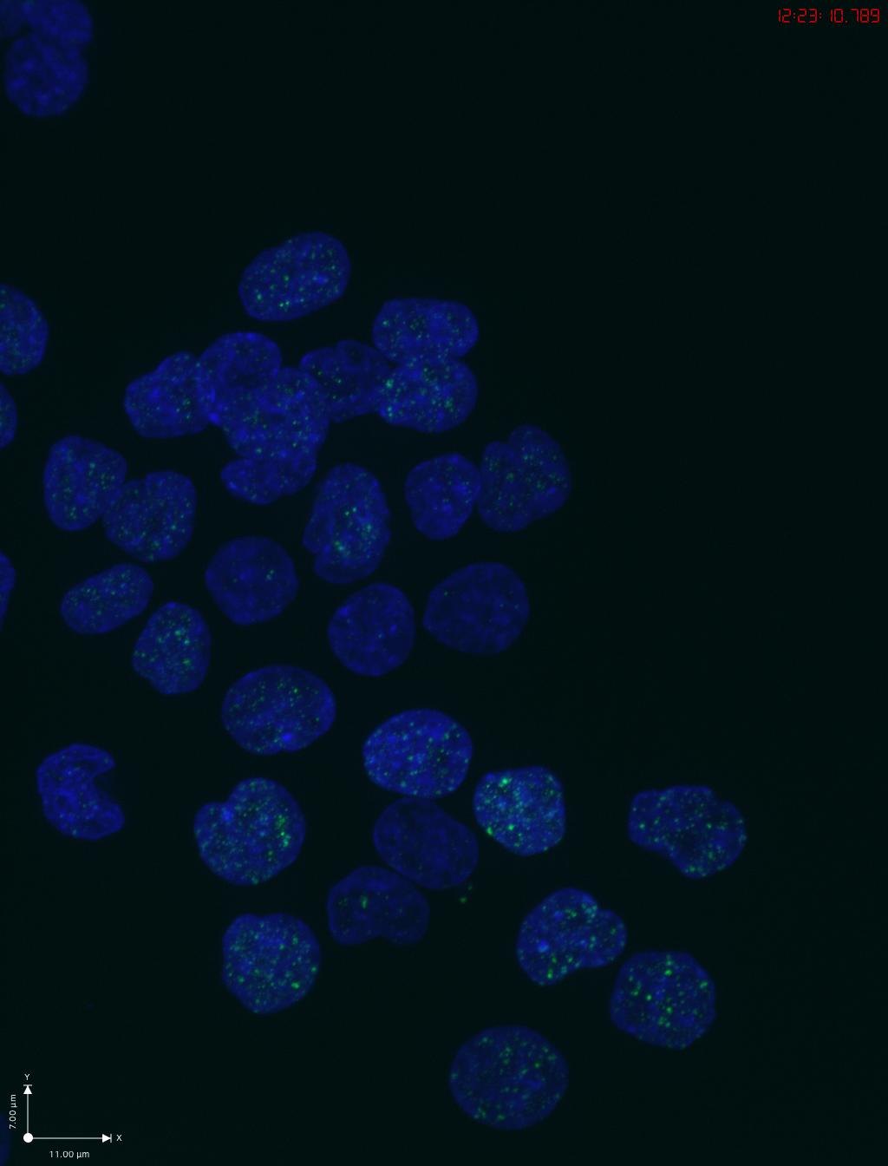
TO-HCT116 no treatment_CENPC
TO-HCT116 Dox+auxin_CENPC

Slide 2
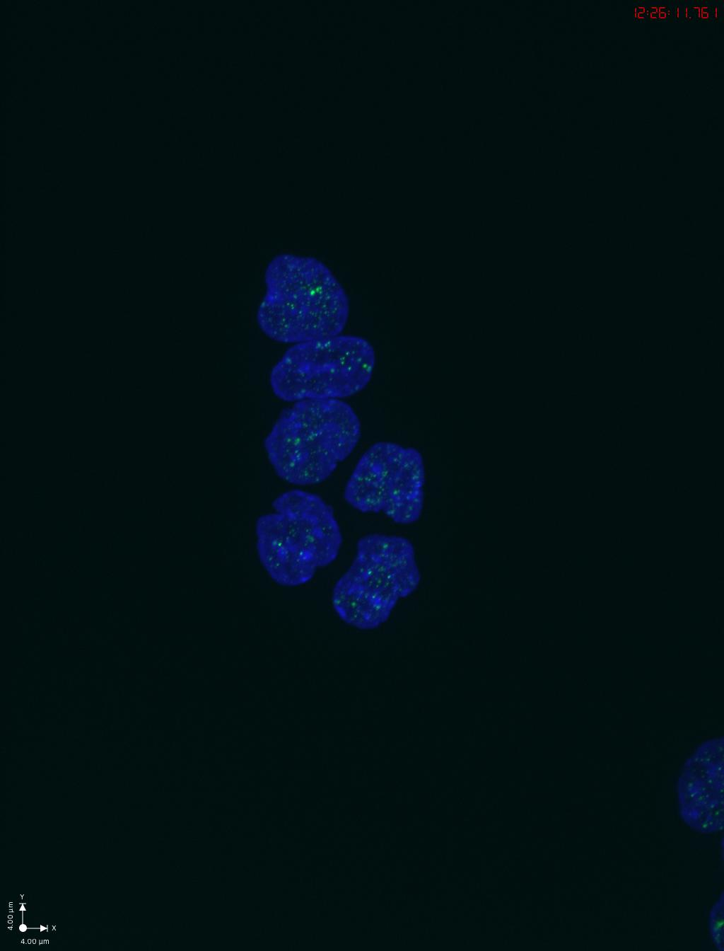
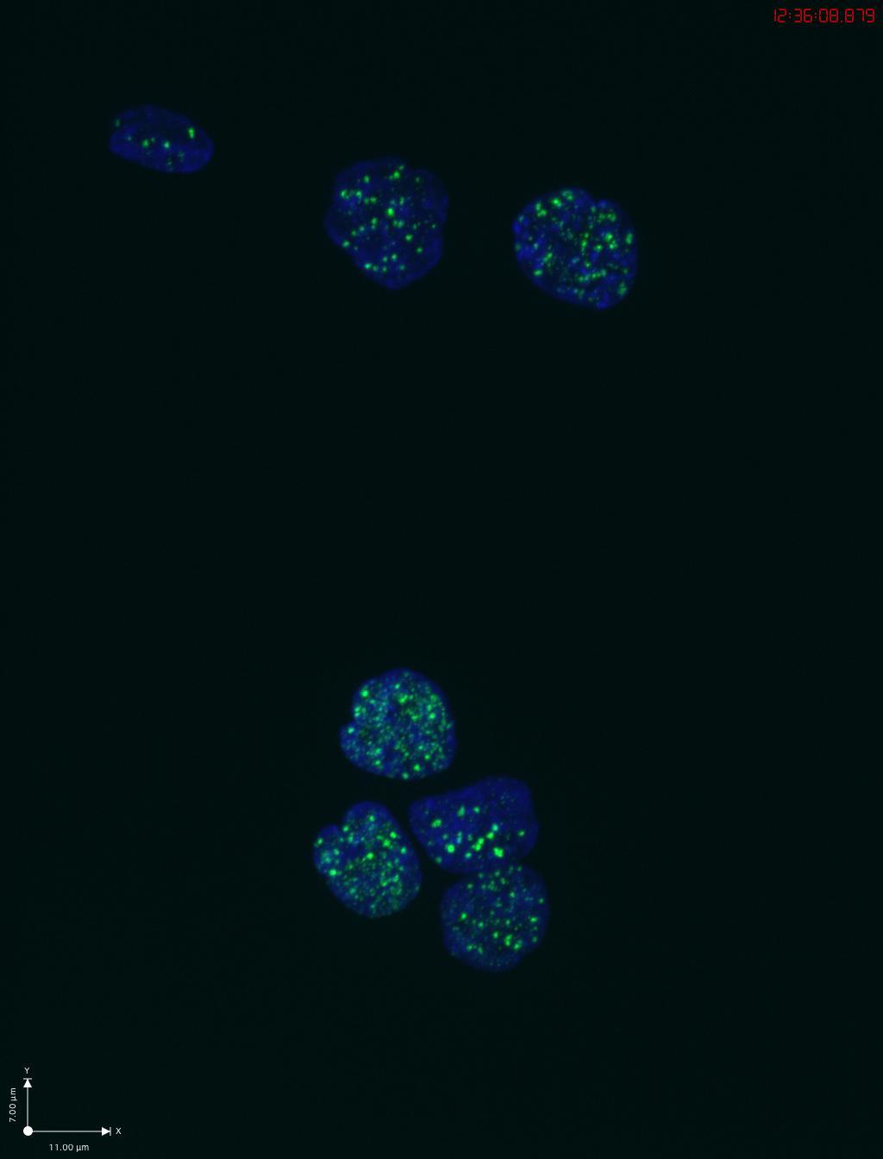
ORC2_H-2 no treatment_CENPC
ORC2_H-2 Dox+auxin_CENPC

Slide 3
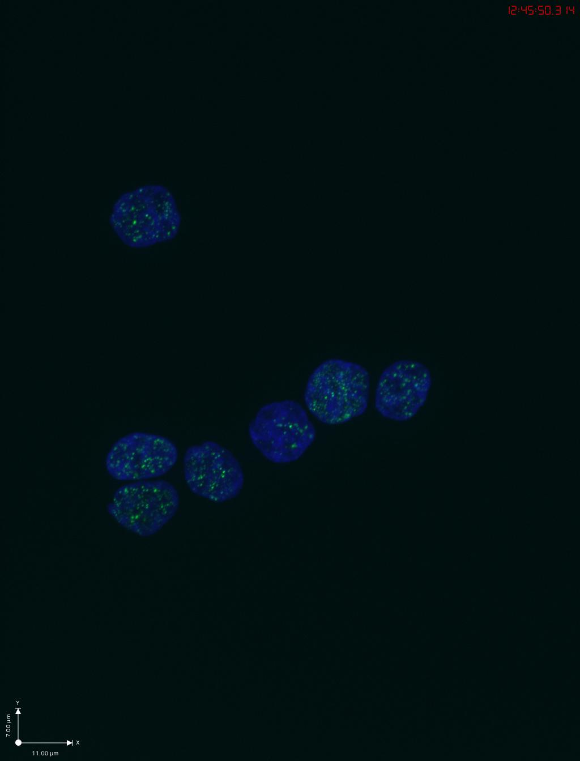
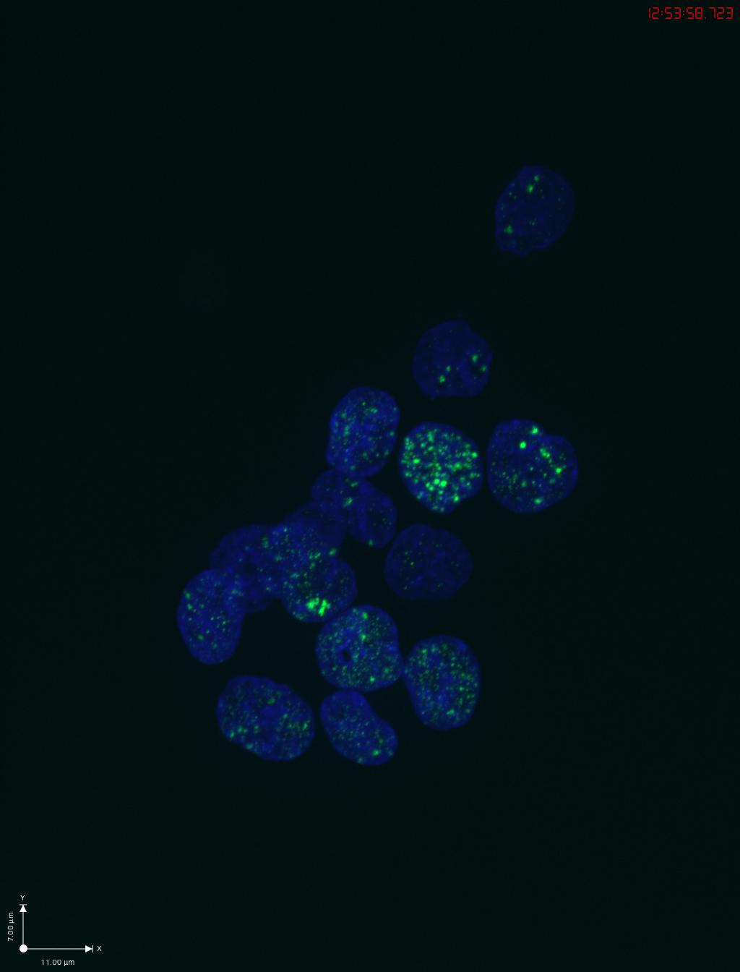
ORC2_H-4 no treatment_CENPC
ORC2_H-4 Dox+auxin_CENPC

Slide 4
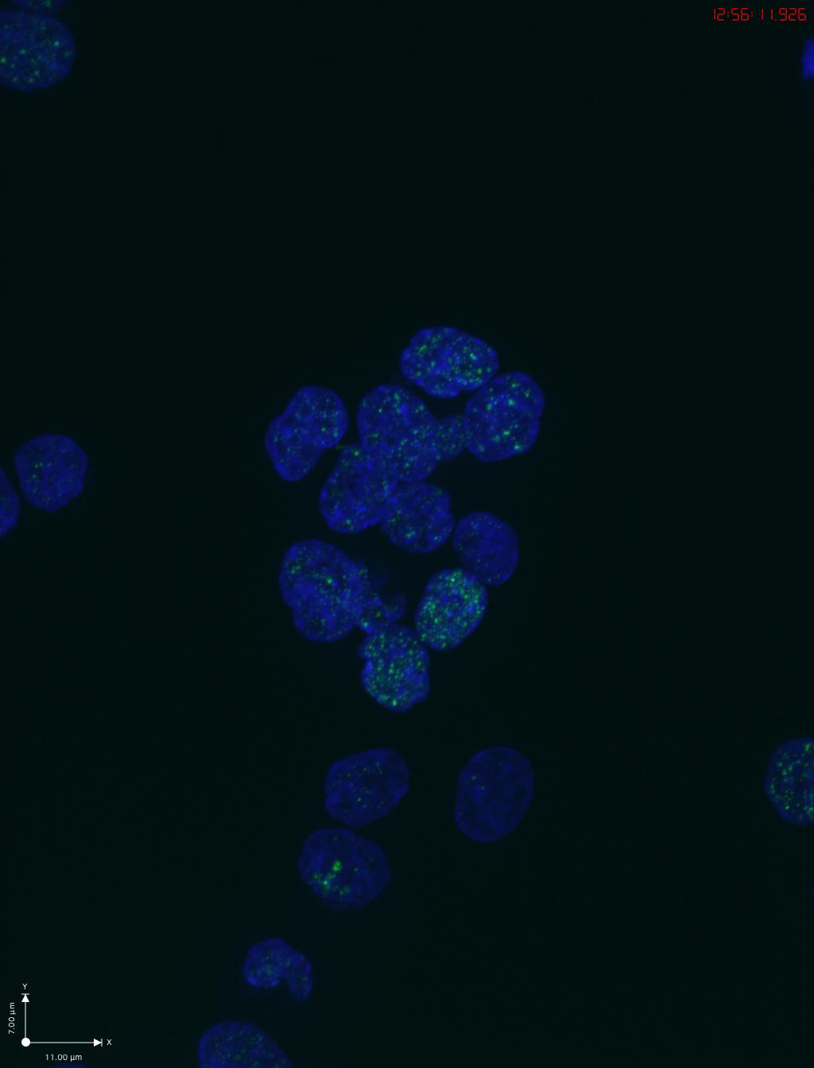
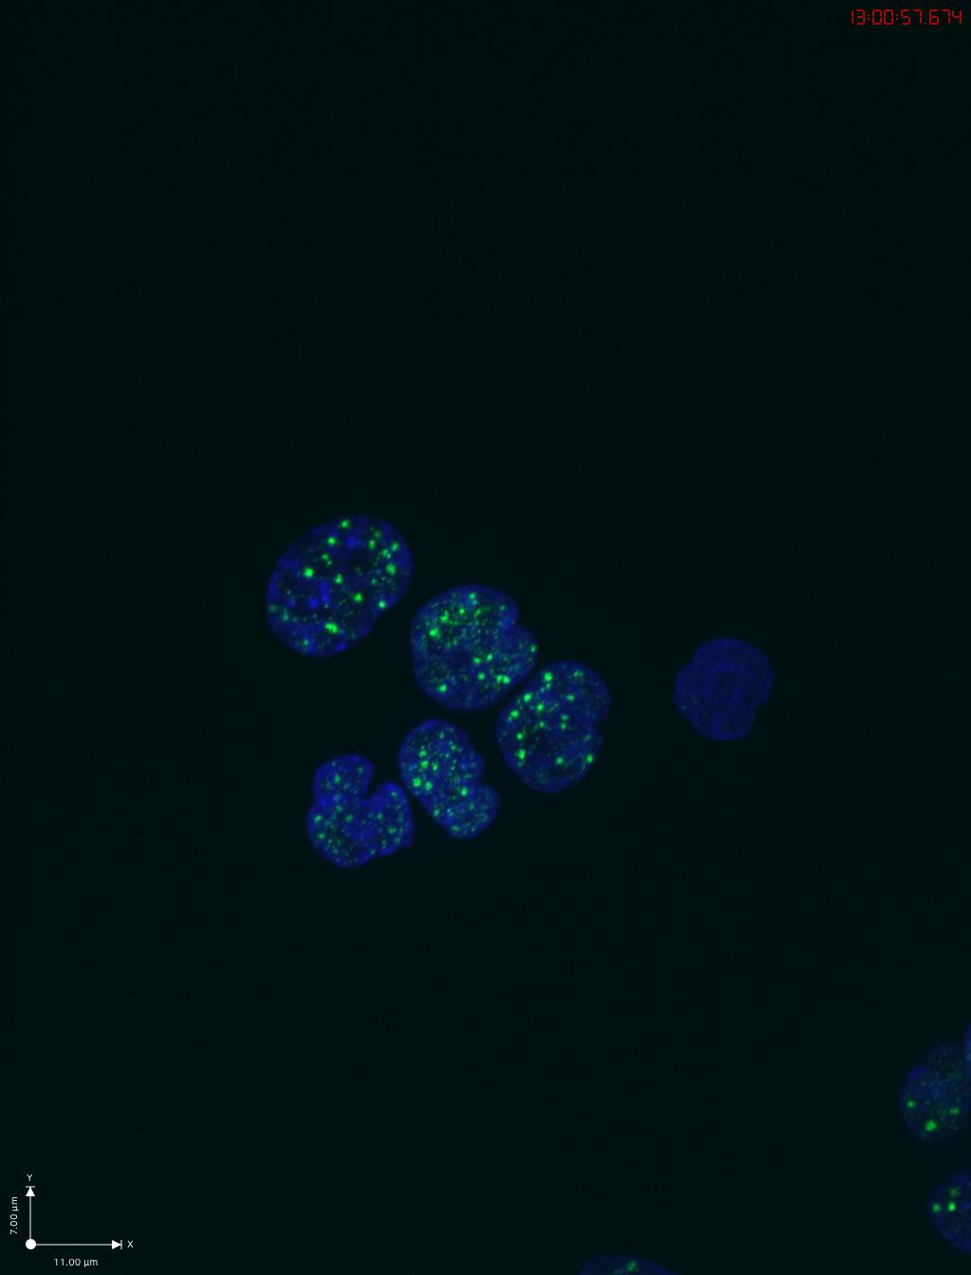
ORC2_H-5 no treatment_CENPC
ORC2_H-5 Dox+auxin_CENPC

