Slide 1
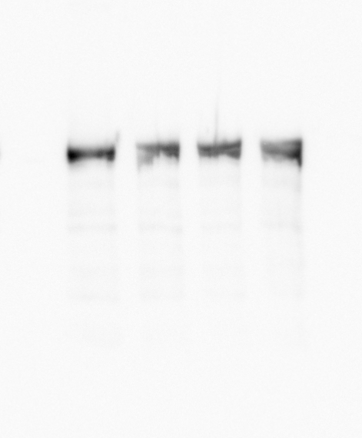
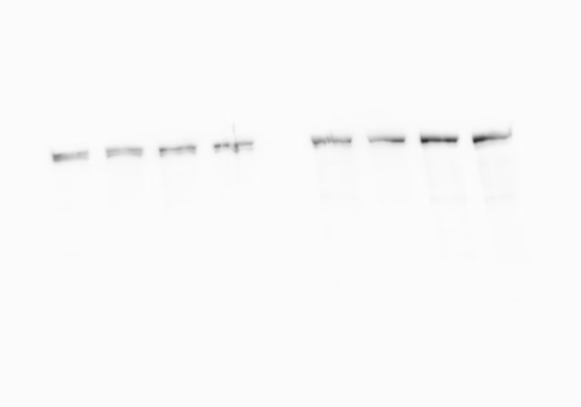
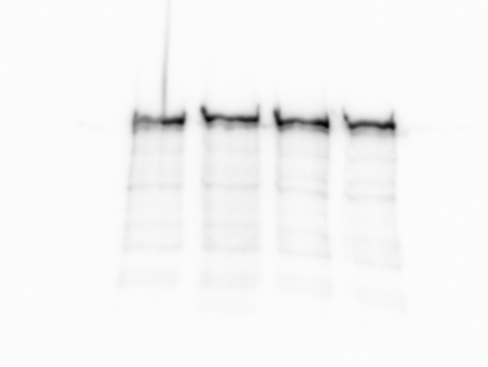
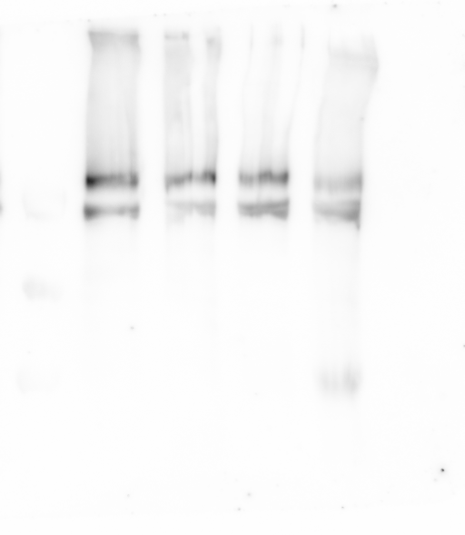
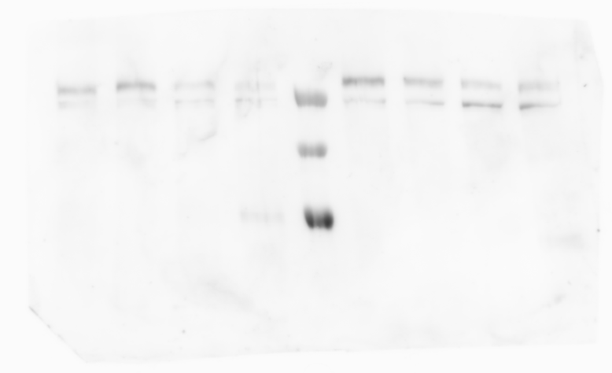
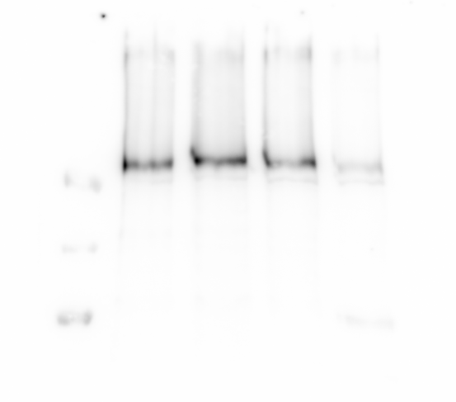
Blots for Figure 3C
Blot1
Blot2 and 3
Blot4
Spectrin
LADDER
LADDER
LADDER
96APF
72APF
48APF
Adult
96APF
72APF
48APF
Adult
96APF
72APF
48APF
Adult
96APF
72APF
48APF
LADDER
96APF
72APF
48APF
Adult
Adult
IP₃R
LADDER
96APF
72APF
48APF
LADDER
96APF
72APF
48APF
Adult
96APF
72APF
48APF
LADDER
96APF
72APF
48APF
Adult
Adult
Adult

