Slide 1
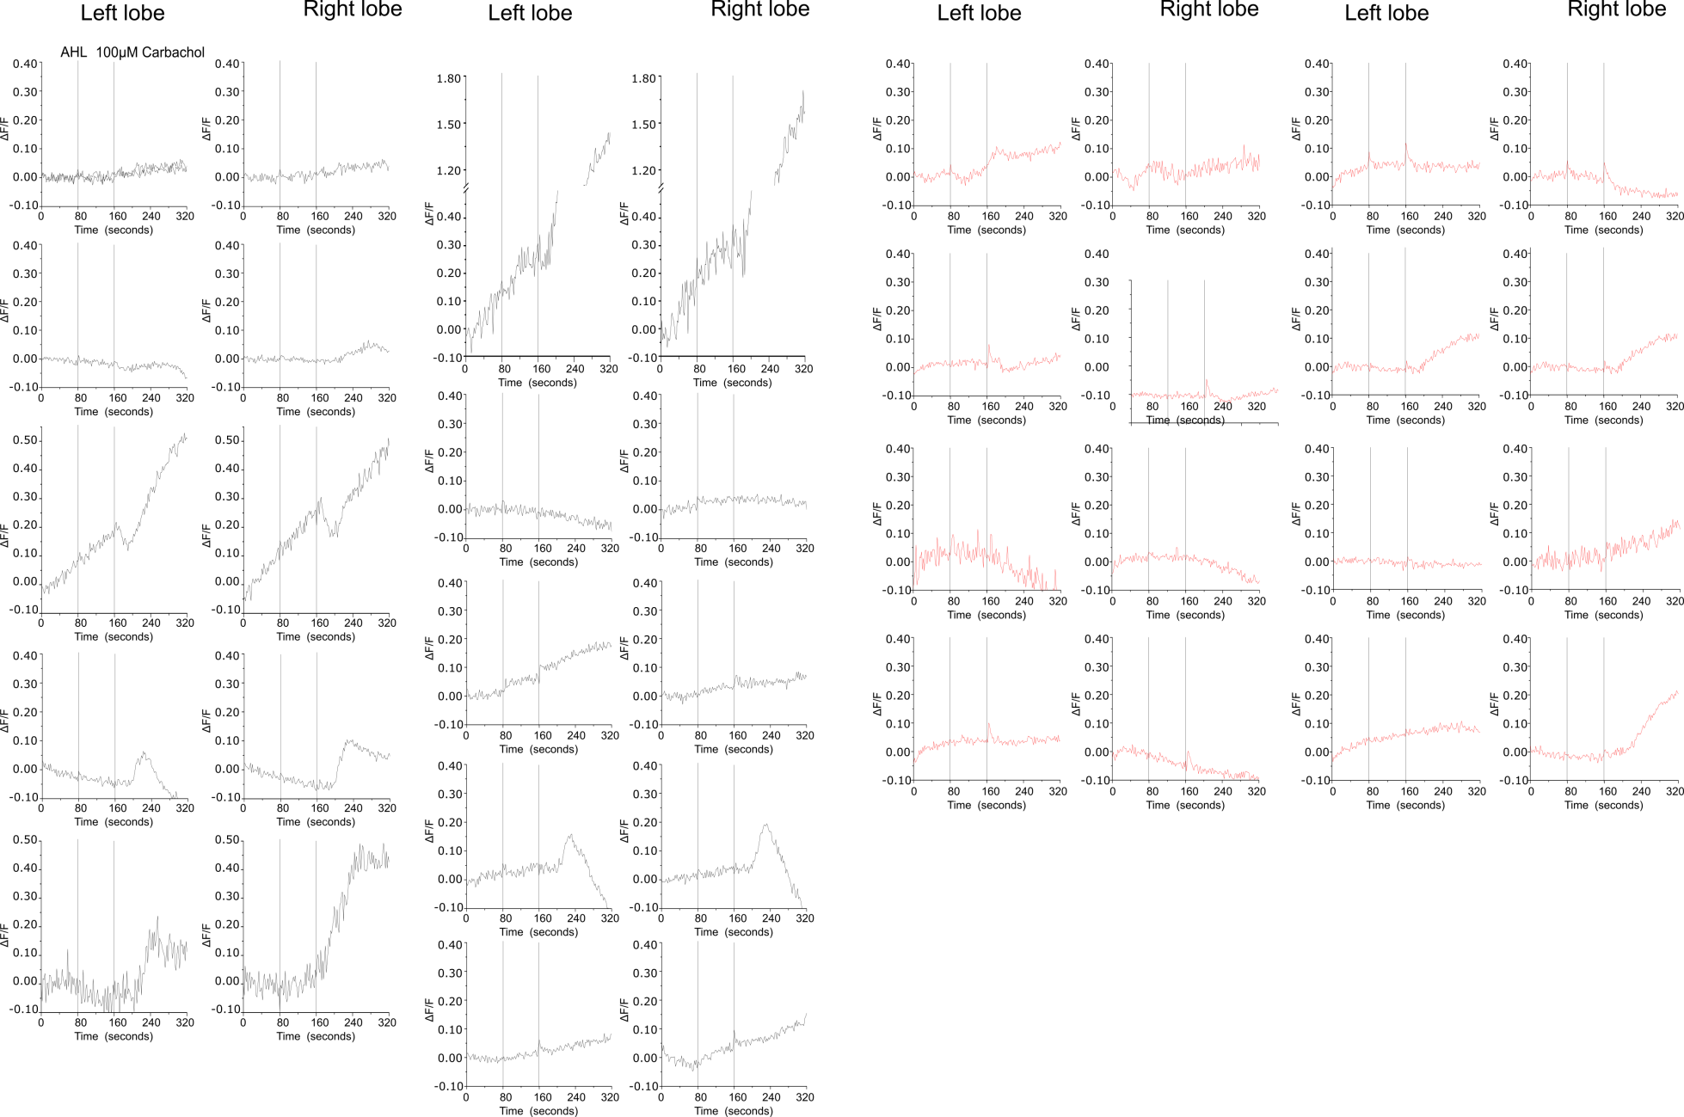
Notes:
Traces for changes in GRAB_{DA} fluorescence in left and right lobes of individual brains from MB296B GAL4 > UAS GRAB_{DA} (Black) and MB296B GAL4 > UAS Itpr^{DN}; UAS GRAB_{DA} (Red) organisms.

