Slide 1
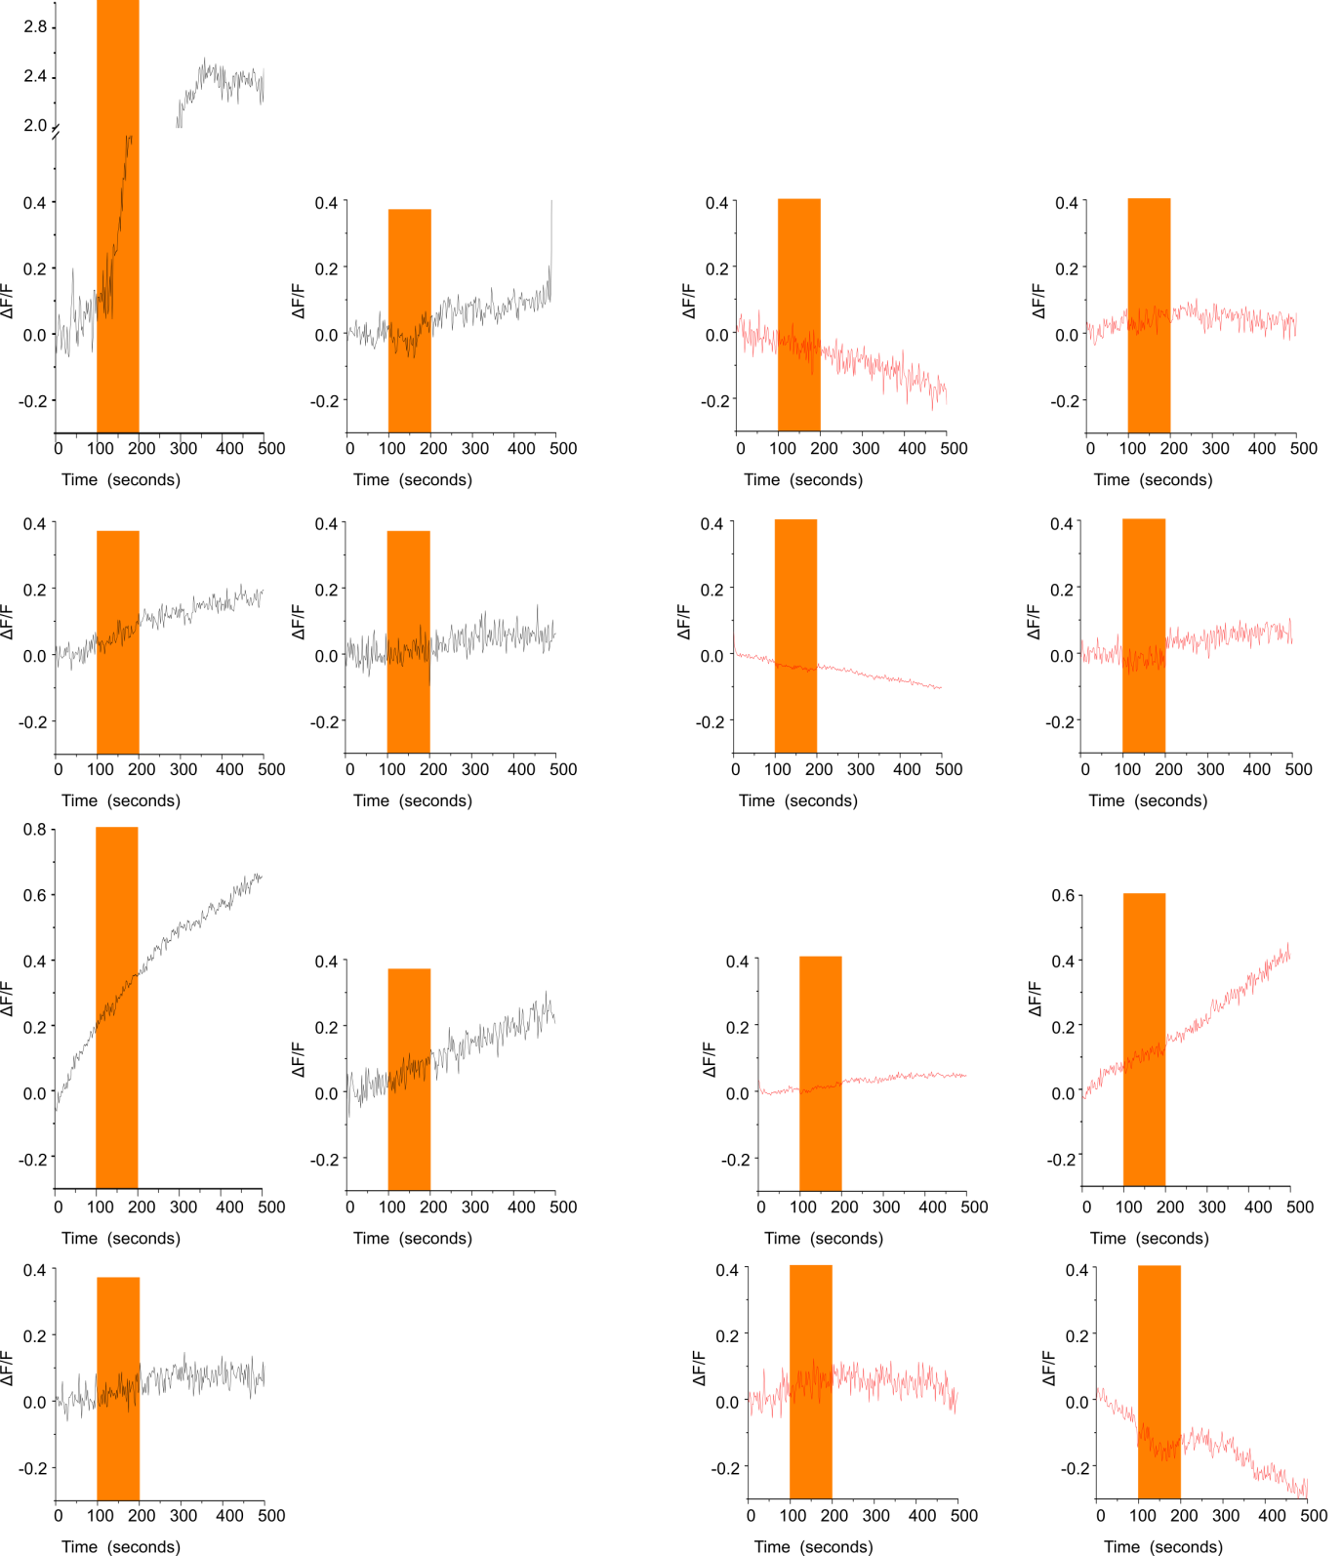
Notes:
Traces for changes in GCaMP6m fluorescence in individual brains upon Chrimson activation in MB296B GAL4 > UAS GCaMP6m (Black) and MB296B GAL4 > UAS Itpr^{DN}; UAS GCaMP6m (Red) animals.

