Slide 1
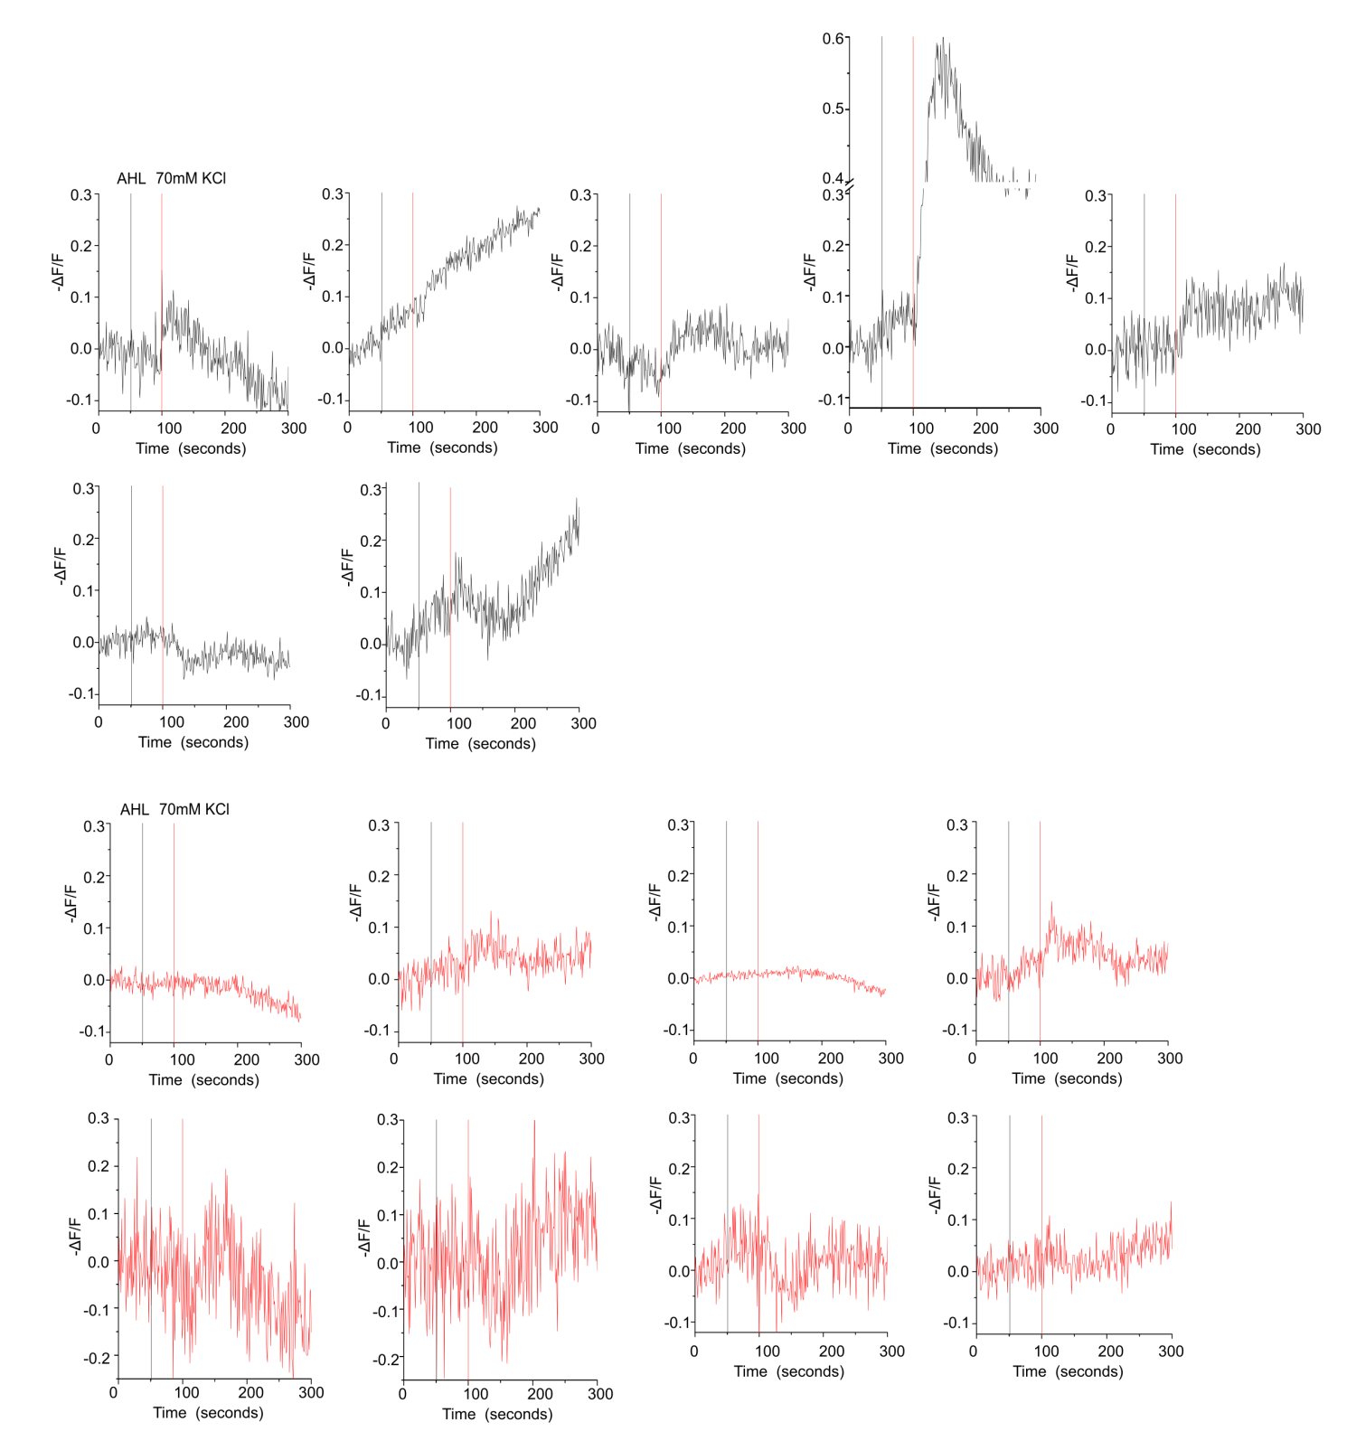
Notes:
Traces for changes in Arclight fluorescence in individual brains upon stimulation with 70mM KCl stimulation. MB296B GAL4 > UAS Arclight (Black) and MB296B GAL4 > UAS Itpr^{DN}; UAS Arclight (Red).

