Slide 1
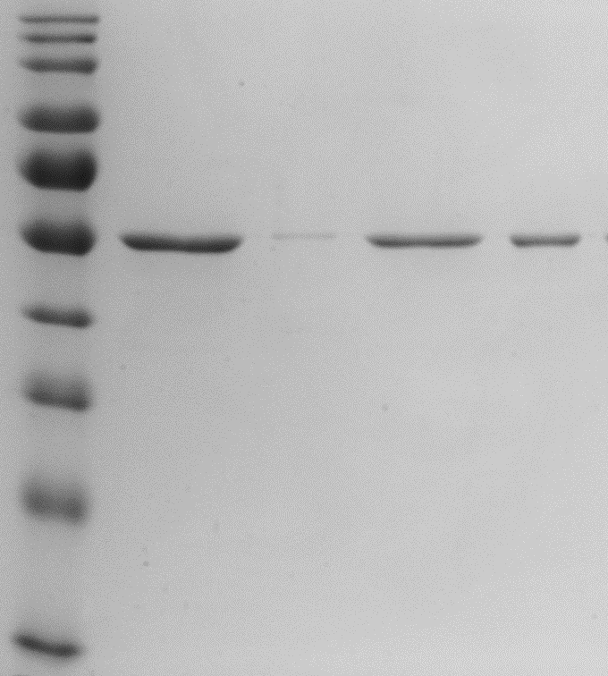
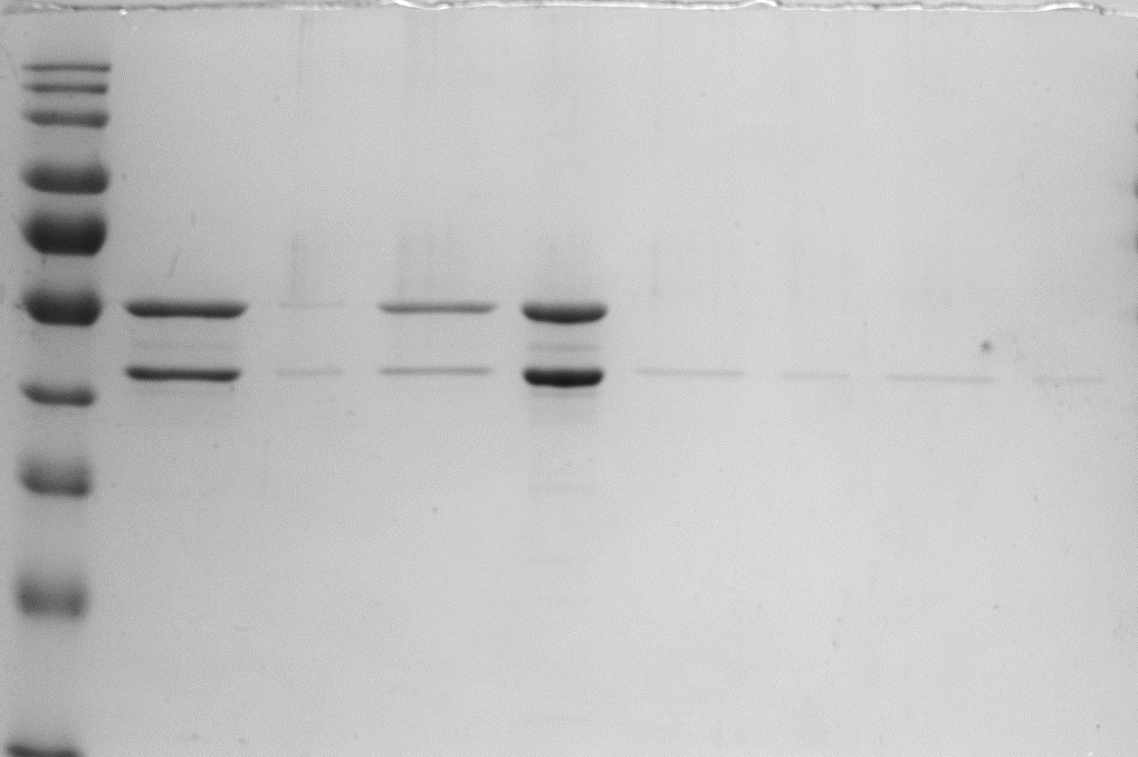
Experiment 1
FtsZ 3.5
FtsZ 3.5 : SepH 3.5
SepH 0.6
- GTP
+ GTP
- GTP
+ GTP
- GTP
+ GTP
S
P
S
P
S
P
S
P
S
P
S
P
% FtsZ in pellet
% FtsZ in pellet
2.5%
69.5%
-
-
3.7%
35.4%
-
% SepH in pellet
6.0%
84.6%
31.9%
31.3%
% SepH in pellet
-
90,000 RPM

Slide 2
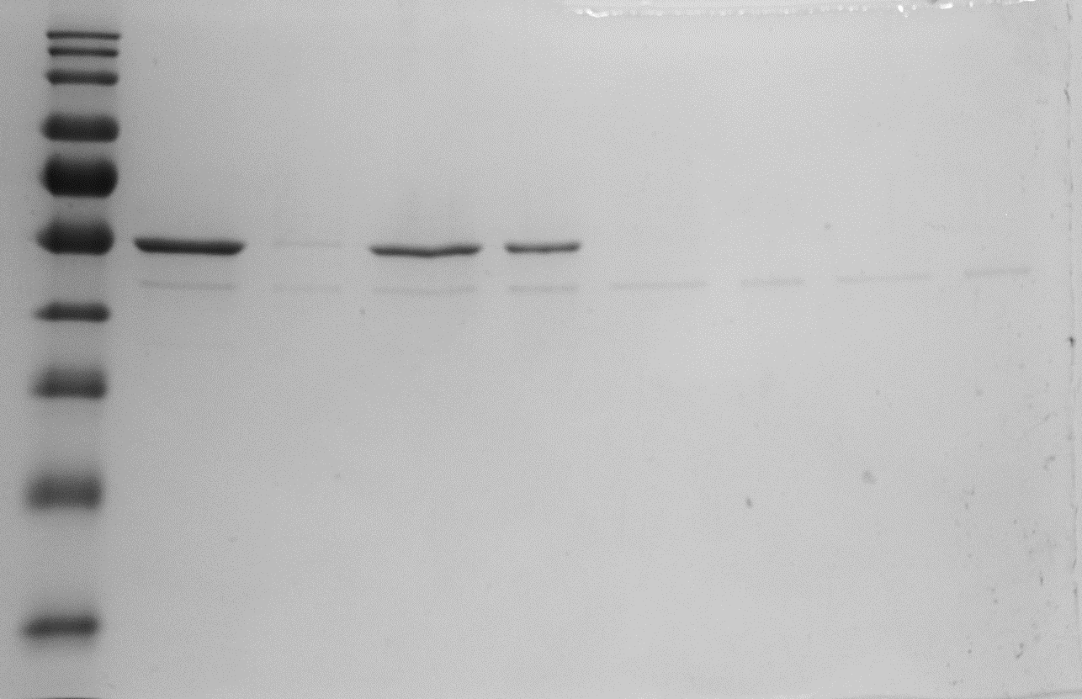
Experiment 1
FtsZ 3.5 : G79P 0.6
G79P 0.6
- GTP
+ GTP
- GTP
+ GTP
S
P
S
P
S
P
S
P
% FtsZ in pellet
2.6%
35.6%
-
-
% SepH in pellet
28.5%
50.2%
41.5%
42.5%

Slide 3
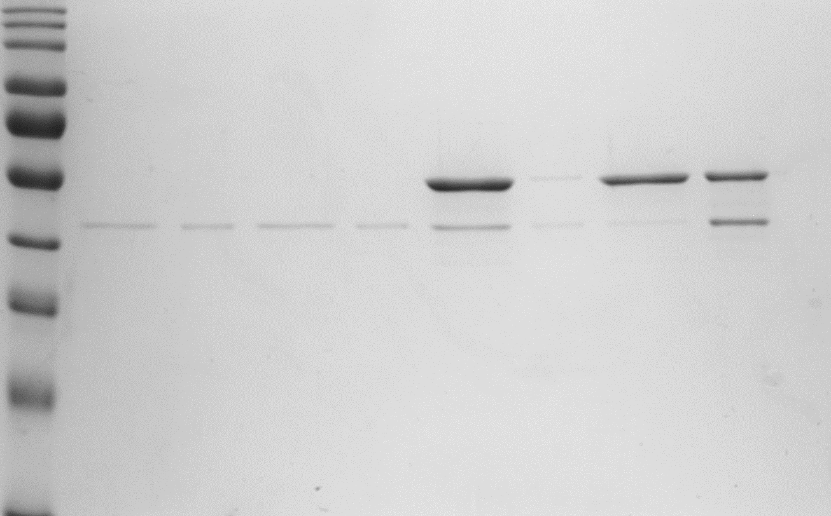
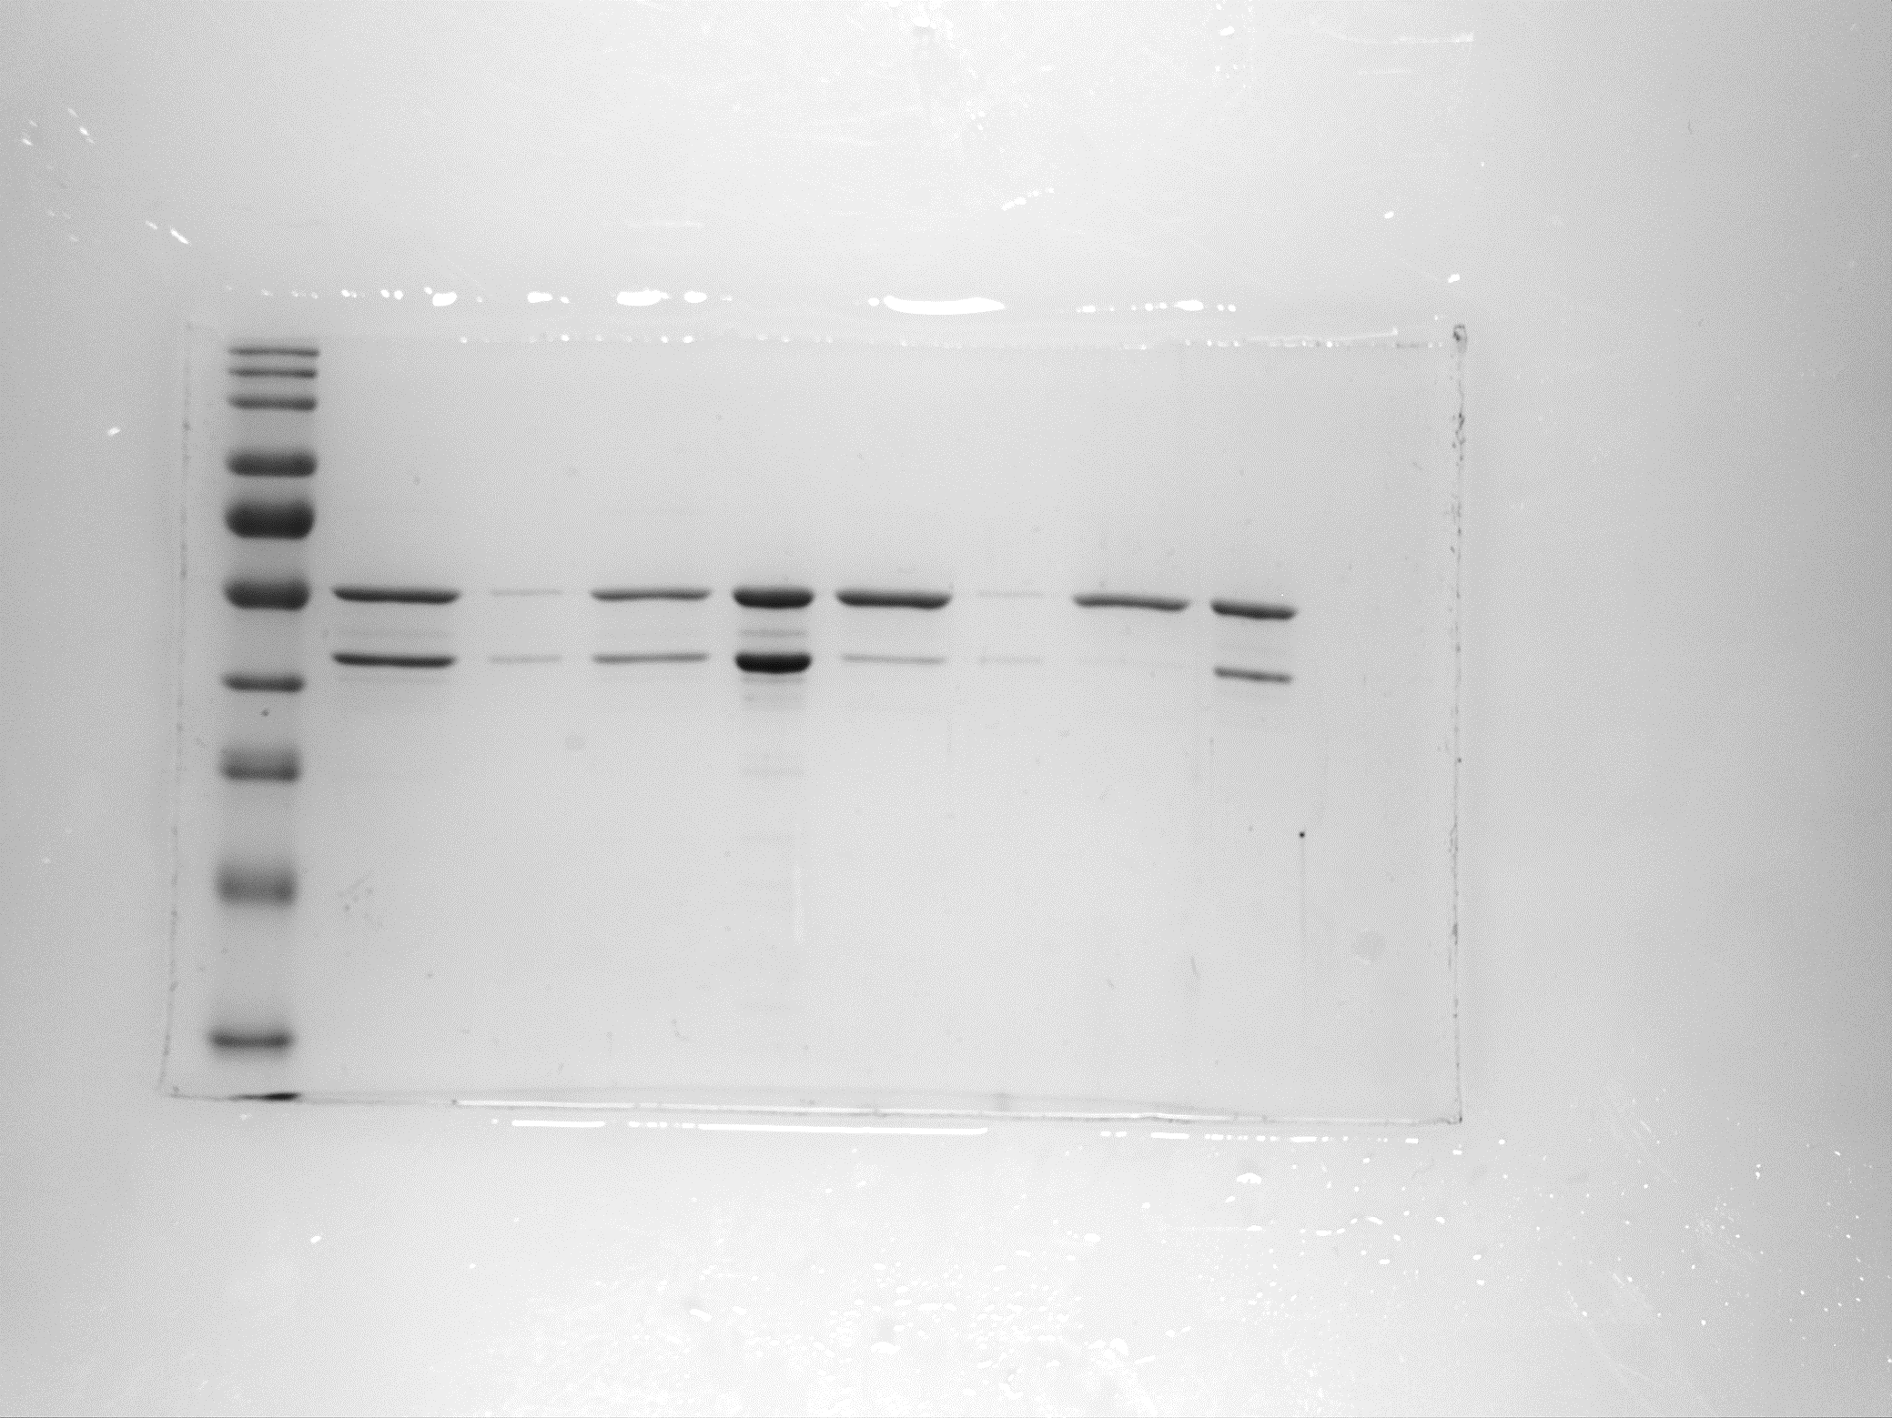
Experiment 2
SepH 0.6
FtsZ 3.5 : SepH 0.6
FtsZ 3.5 : SepH 0.6
- GTP
+ GTP
- GTP
+ GTP
- GTP
+ GTP
S
P
S
P
S
P
S
P
S
P
S
P
5.4%
50.9%
% FtsZ in pellet
2.3%
40.2%
% FtsZ in pellet
13.8%
98.2%
% SepH in pellet
40.2%
32.7%
12.0%
91.8%
% SepH in pellet
90,000 RPM

Slide 4
Experiment 2
SepH 0.6
FtsZ 3.5 : SepH 0.6
- GTP
+ GTP
- GTP
+ GTP
S
P
S
P
S
P
S
P
% FtsZ in pellet
2.3%
40.2%
40.2%
32.7%
12.0%
91.8%
% SepH in pellet
90,000 RPM

