Slide 1
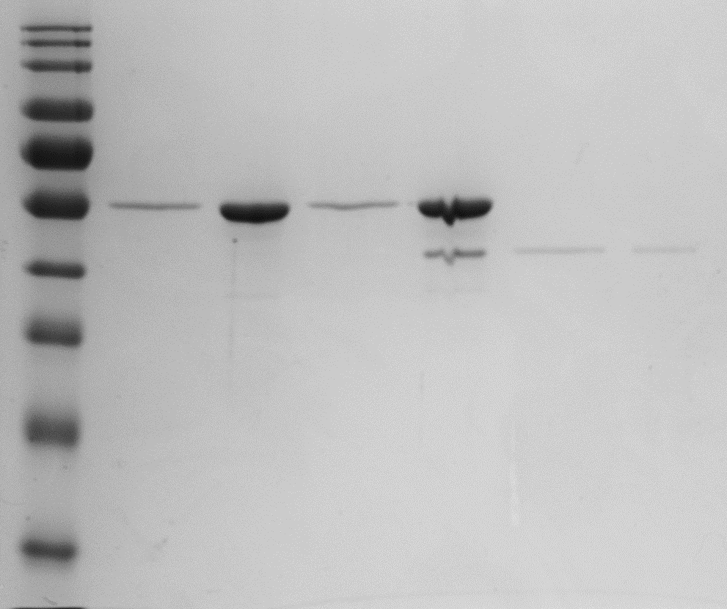
Experiment 1
FtsZ 3.5 : SepH 0.6
FtsZ 3.5
SepH 0.6
90,000 RPM
+ GMPCCP
+ GMPCCP
+ GMPCCP
S
P
S
P
S
P
83.9%
87.6%
-
% FtsZ in pellet
-
98.3%
% SepH in pellet
30.6%

Slide 2
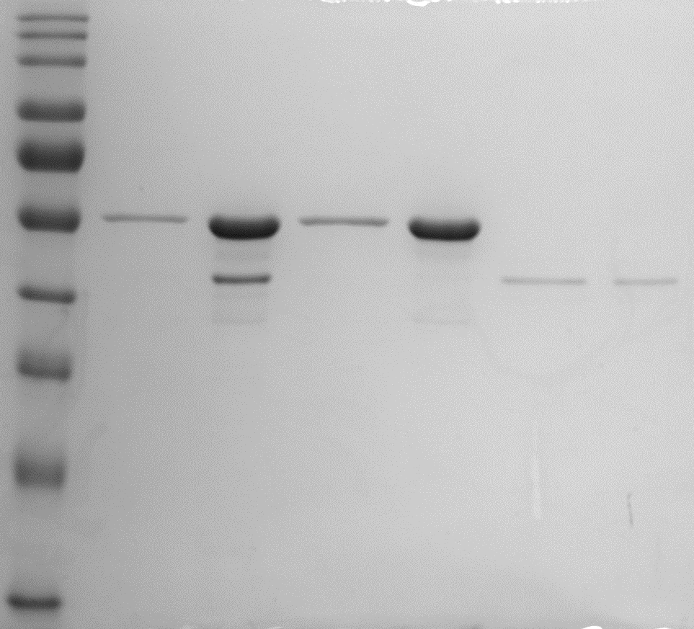
Experiment 2
FtsZ 3.5 : SepH 0.6
90,000 RPM
FtsZ 3.5
SepH 0.6
+ GMPCCP
+ GMPCCP
+ GMPCCP
S
P
S
P
S
P
GEL E
% FtsZ in pellet
87.4%
81.9%
-
% SepH in pellet
96.9%
-
36.8%

