Slide 1
Supernatant – Coomassie stain
kDa
ΔcexE
WT
ΔaatD
ΔaatP
ΔaatC
ΔaatB
ΔaatA
170
130
100
70
55
40
35
25
15

Slide 2
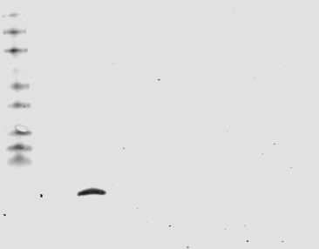
Supernatant anti-CexE western
kDa
ΔcexE
WT
ΔaatD
ΔaatP
ΔaatC
ΔaatB
ΔaatA
170
130
100
70
55
40
35
25
15

