Slide 1
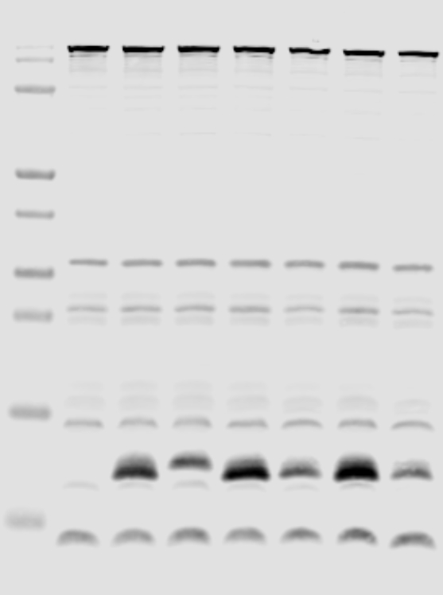
Whole cell lysate
ETEC H10407
ΔcexE
ΔaatD
ΔaatP
ΔaatC
ΔaatB
ΔaatA
kDa
170
RNAP
130
100
55
40
35
25
15
CexE
10

