Slide 1
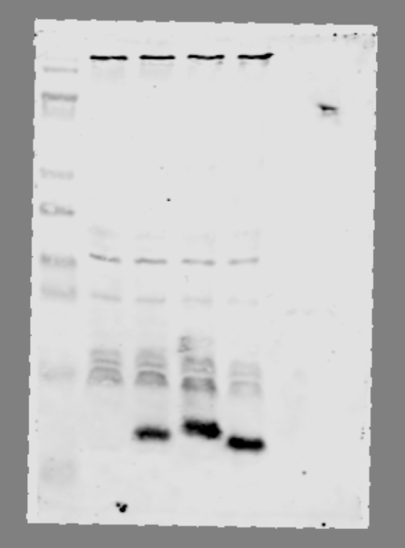
Whole cell lysate – anti-RNAP and anti-Aap western
RNAP figure panel
EAEC 042
ΔaatD pJNW
Δaap
ΔaatD
kDa
170
RNAP
130
100
55
40
35
25
15
Aap
10

