Slide 1
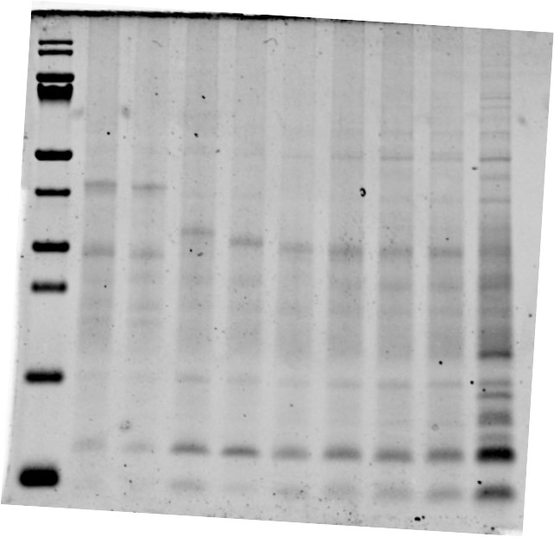
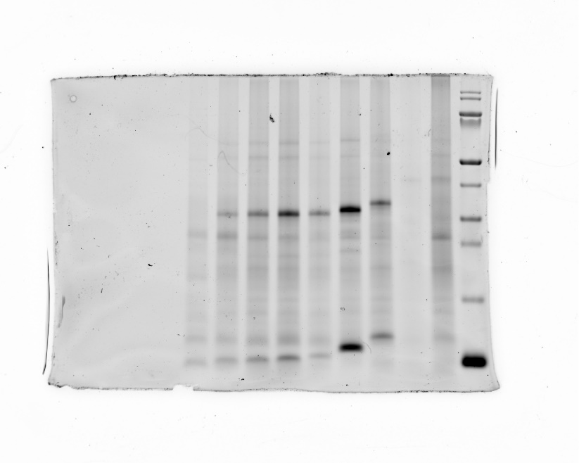
Coomassie stained gel
Cy5 fluorescence gel
First 10 aa of CexE-mCherry
First 10 aa of CexE-mCherry
CexE-mCherry 17-ODYA
CexE-mCherry 17-ODYA
CexE-mCherry DMSO
CexE-mCherry DMSO
GGGNS-mCherry
GGGN-mCherry
GGG-mCherry
GGGNS-mCherry
GG-mCherry
GGGN-mCherry
G-mCherry
GGG-mCherry
mCherry
GG-mCherry
G-mCherry
mCherry

