Slide 1
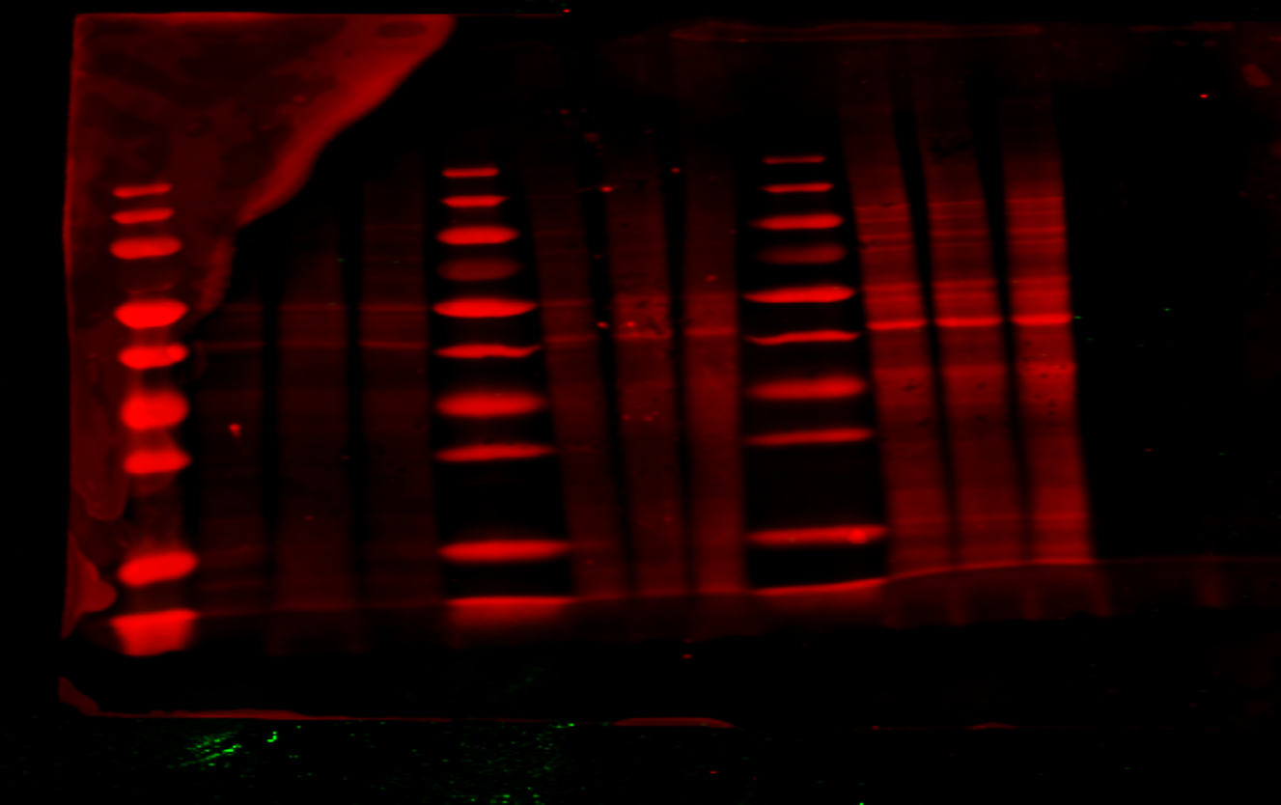
Figure 2 – Figure Supplement 4 – source data 1
Total proteins
10x2Gy + 1week
Margin +22 to +47mm
Margin -5 to +20mm
Non-irradiated
p16
1
2,86
2,42
p16 relative expression

