Slide 1
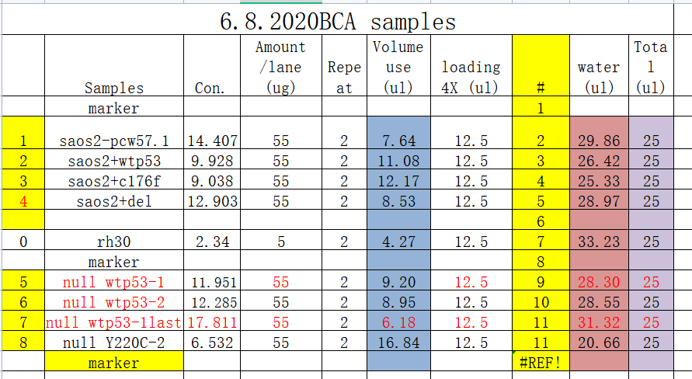
Figure 3A
TP53^{WT} tumor 1
TP53^{WT} tumor 2
Rh30
tp53^{-/-}
55kDa
p53
55kDa
β actin

Slide 2
Figure 4G
P53(53kD)
p53
GAPDH(37kD)
Rh30 cell
kRAS
kRAS+p53 ^{c176f}
kRAS+patient ^{mut}
Zebrafish:
GAPDH
p53^{null}
Rh30
+TP53^{C176F}
tp53^{-/-}
+TP53^{P153▽}
tp53^{-/-} fish with kRAS^{G12D}

Slide 3
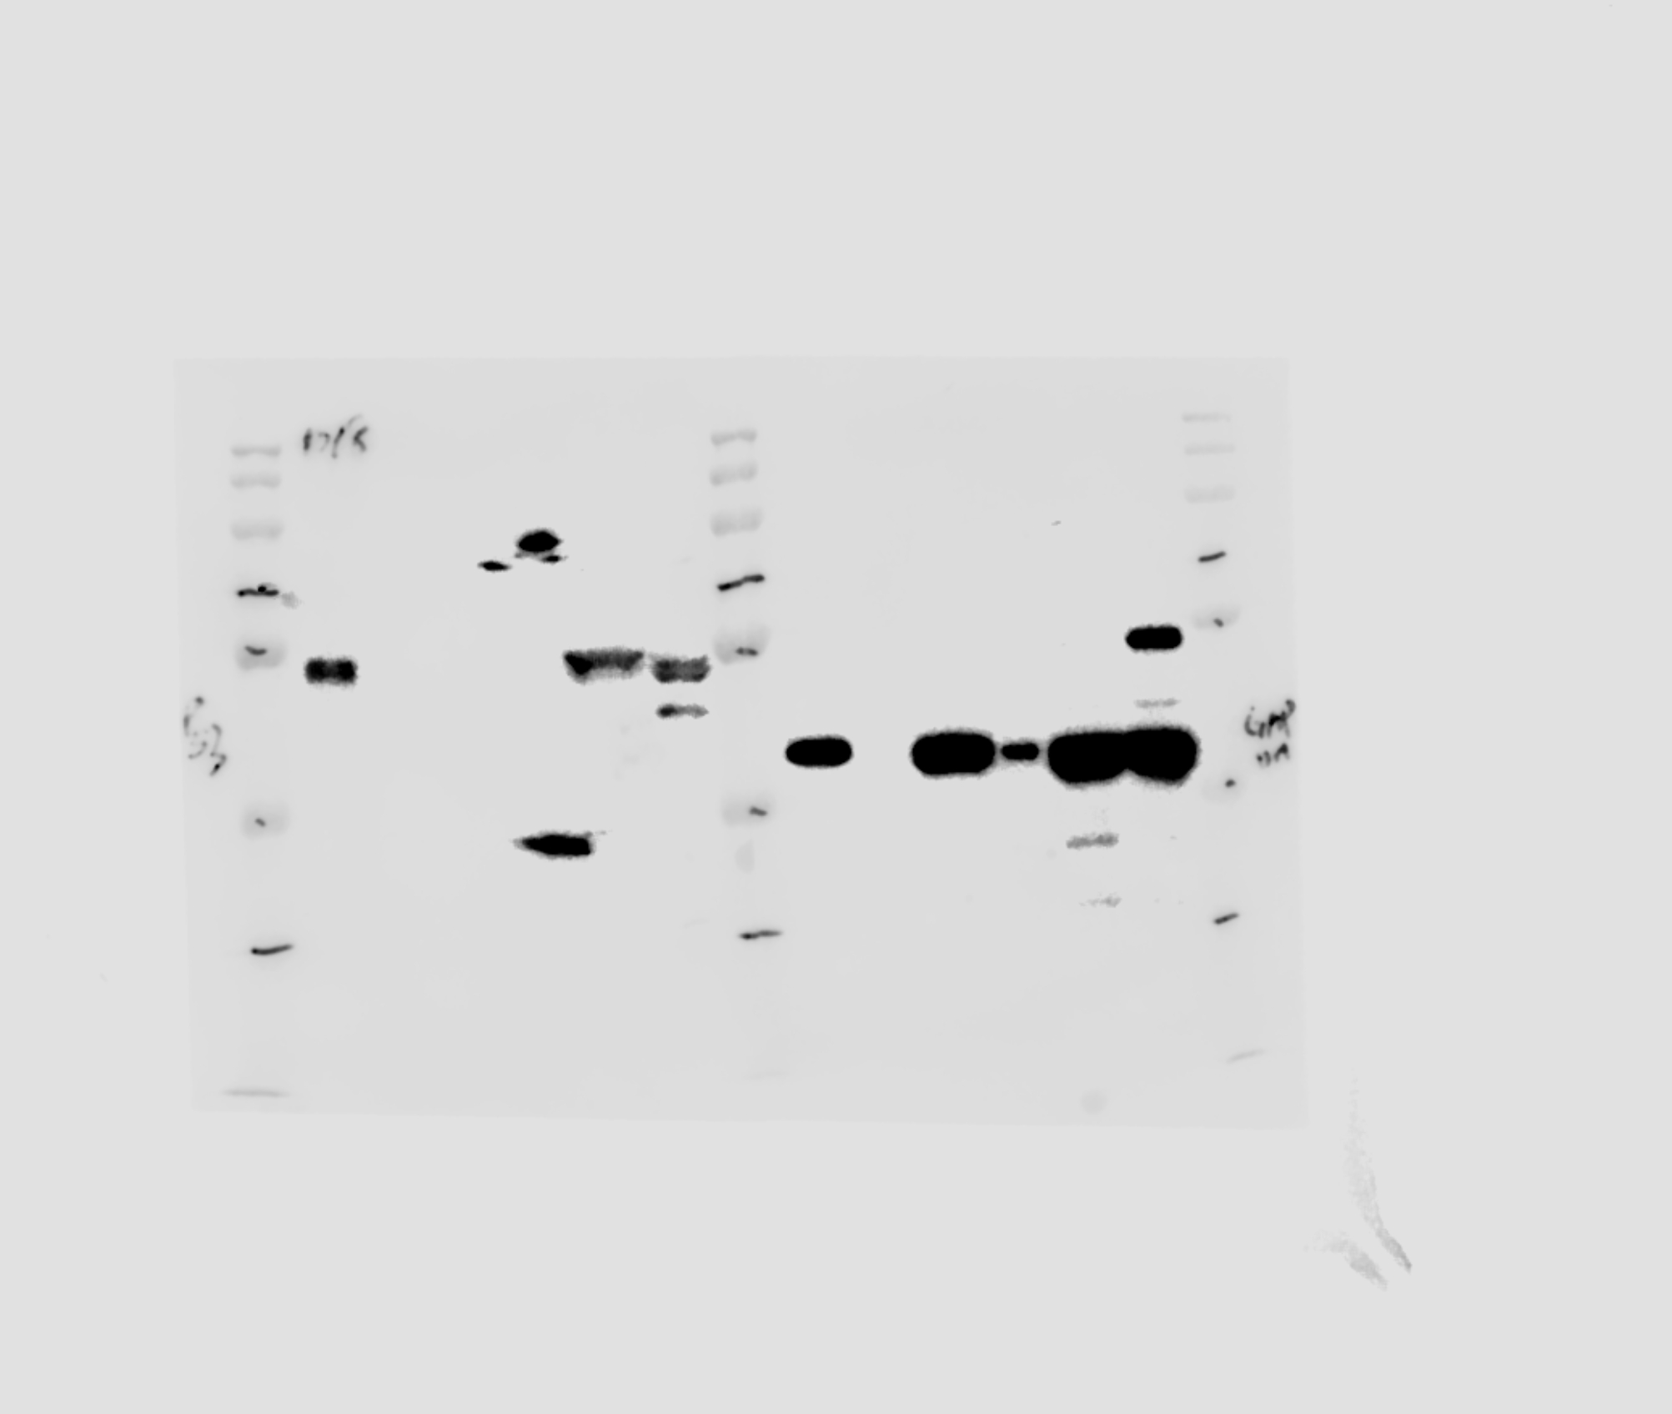
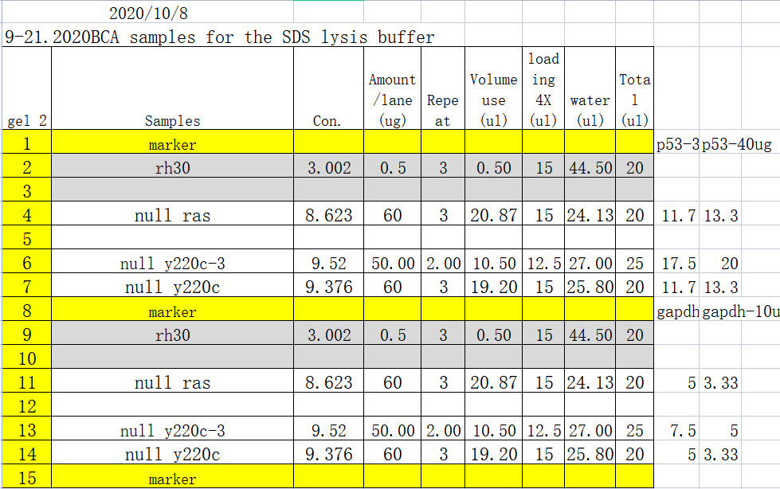
Figure 6B
p53
GAPDH
Rh30 cell
tp53 ^{-/-}
TP53 ^{Y220C}
TP53 ^{Y220C}

Slide 4
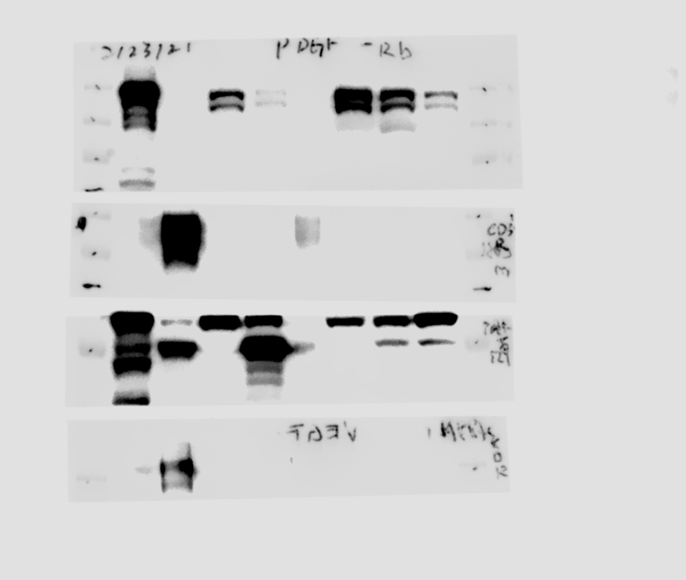
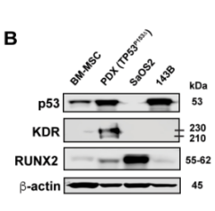
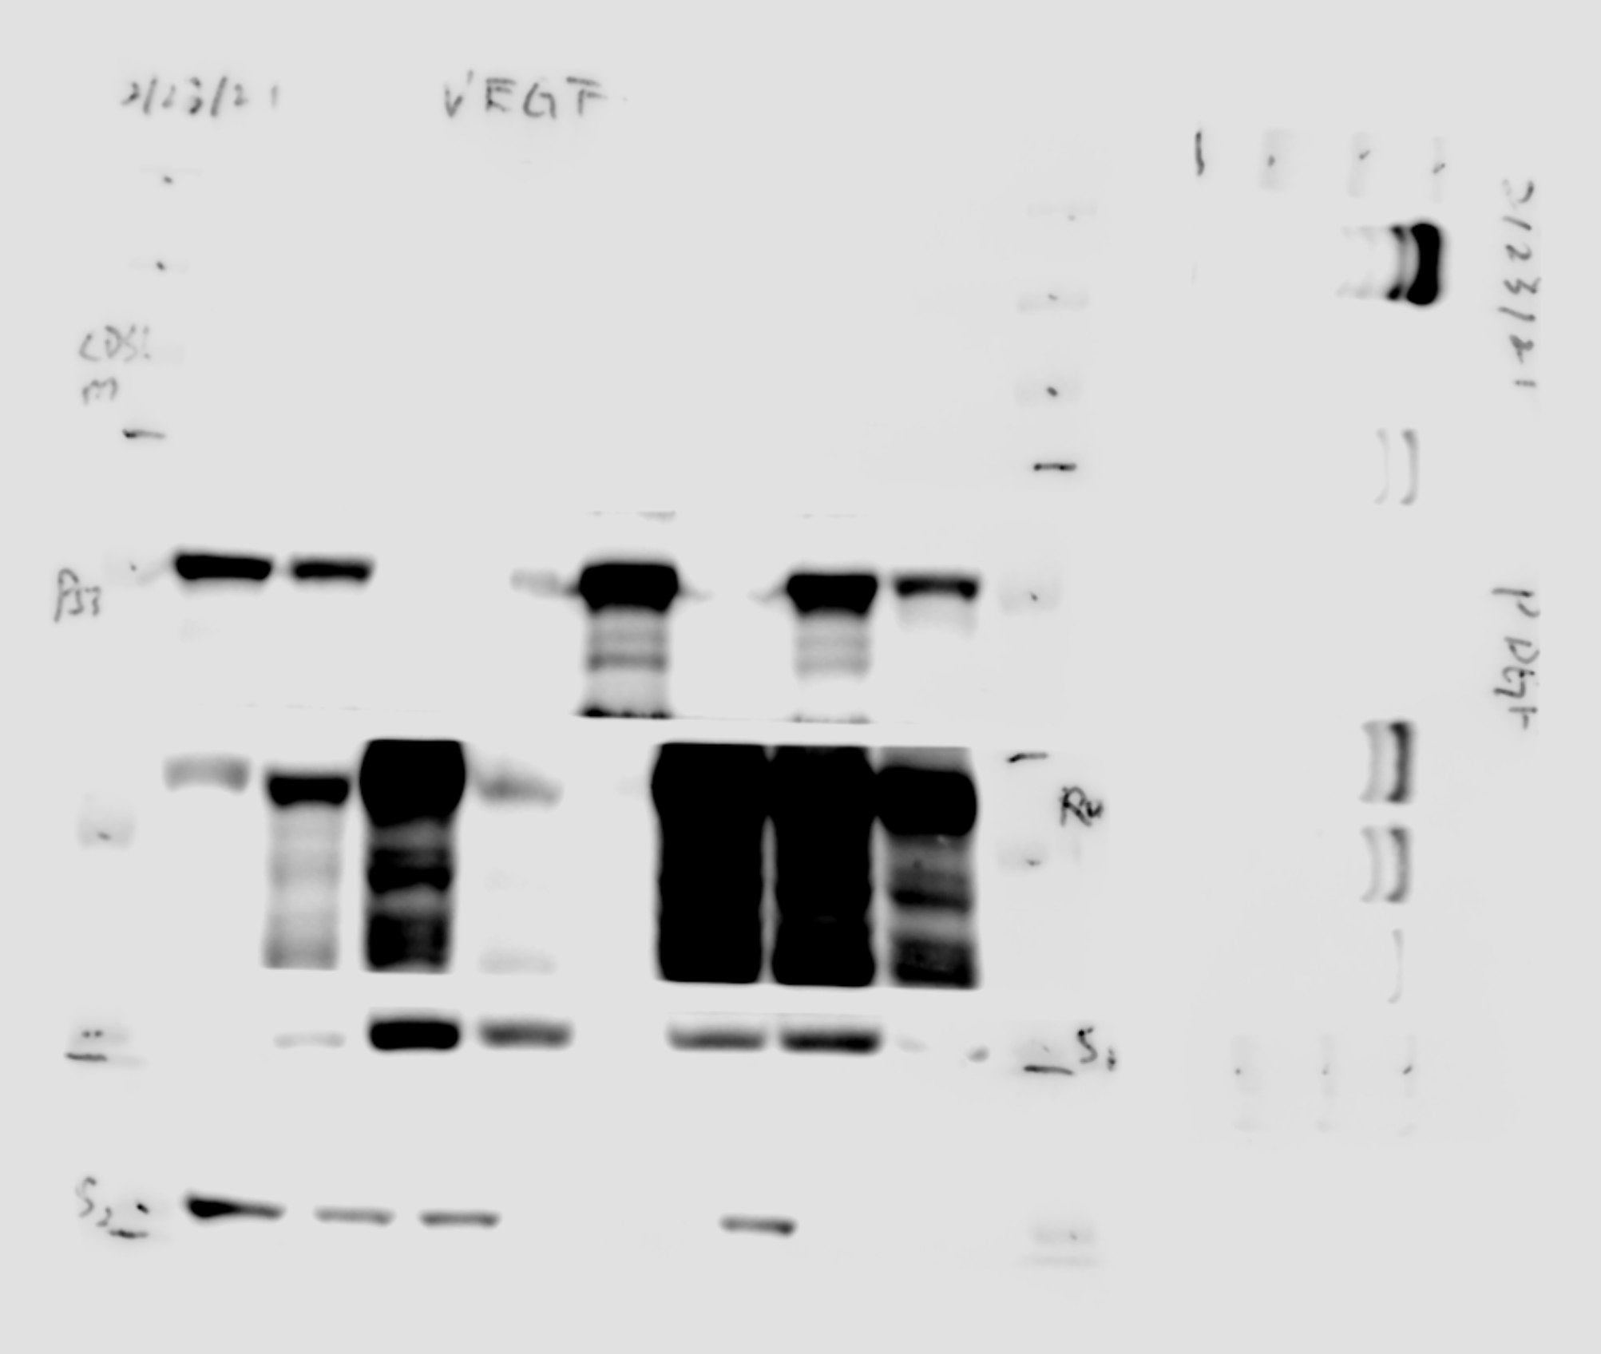
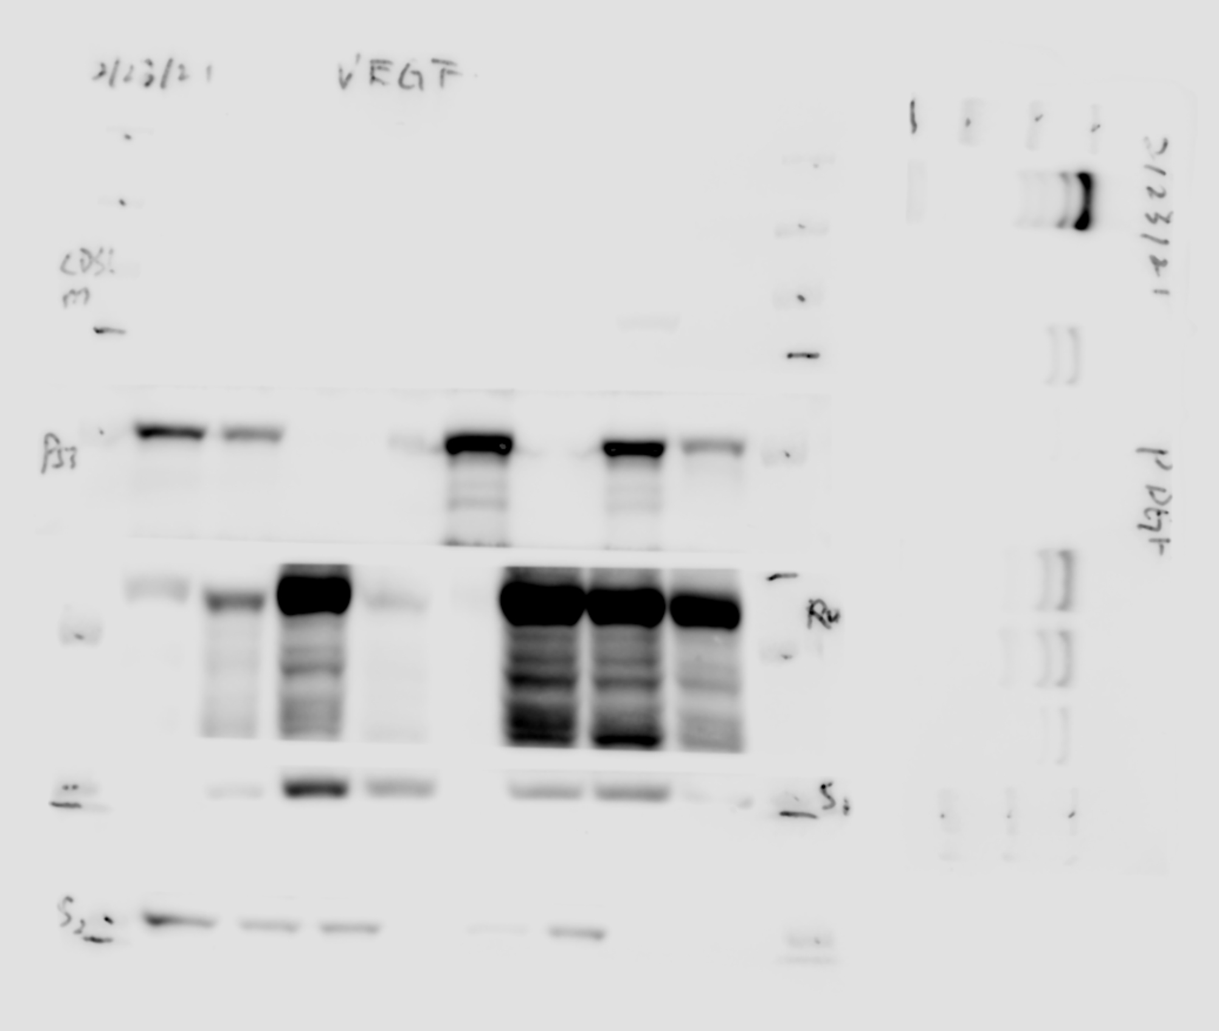
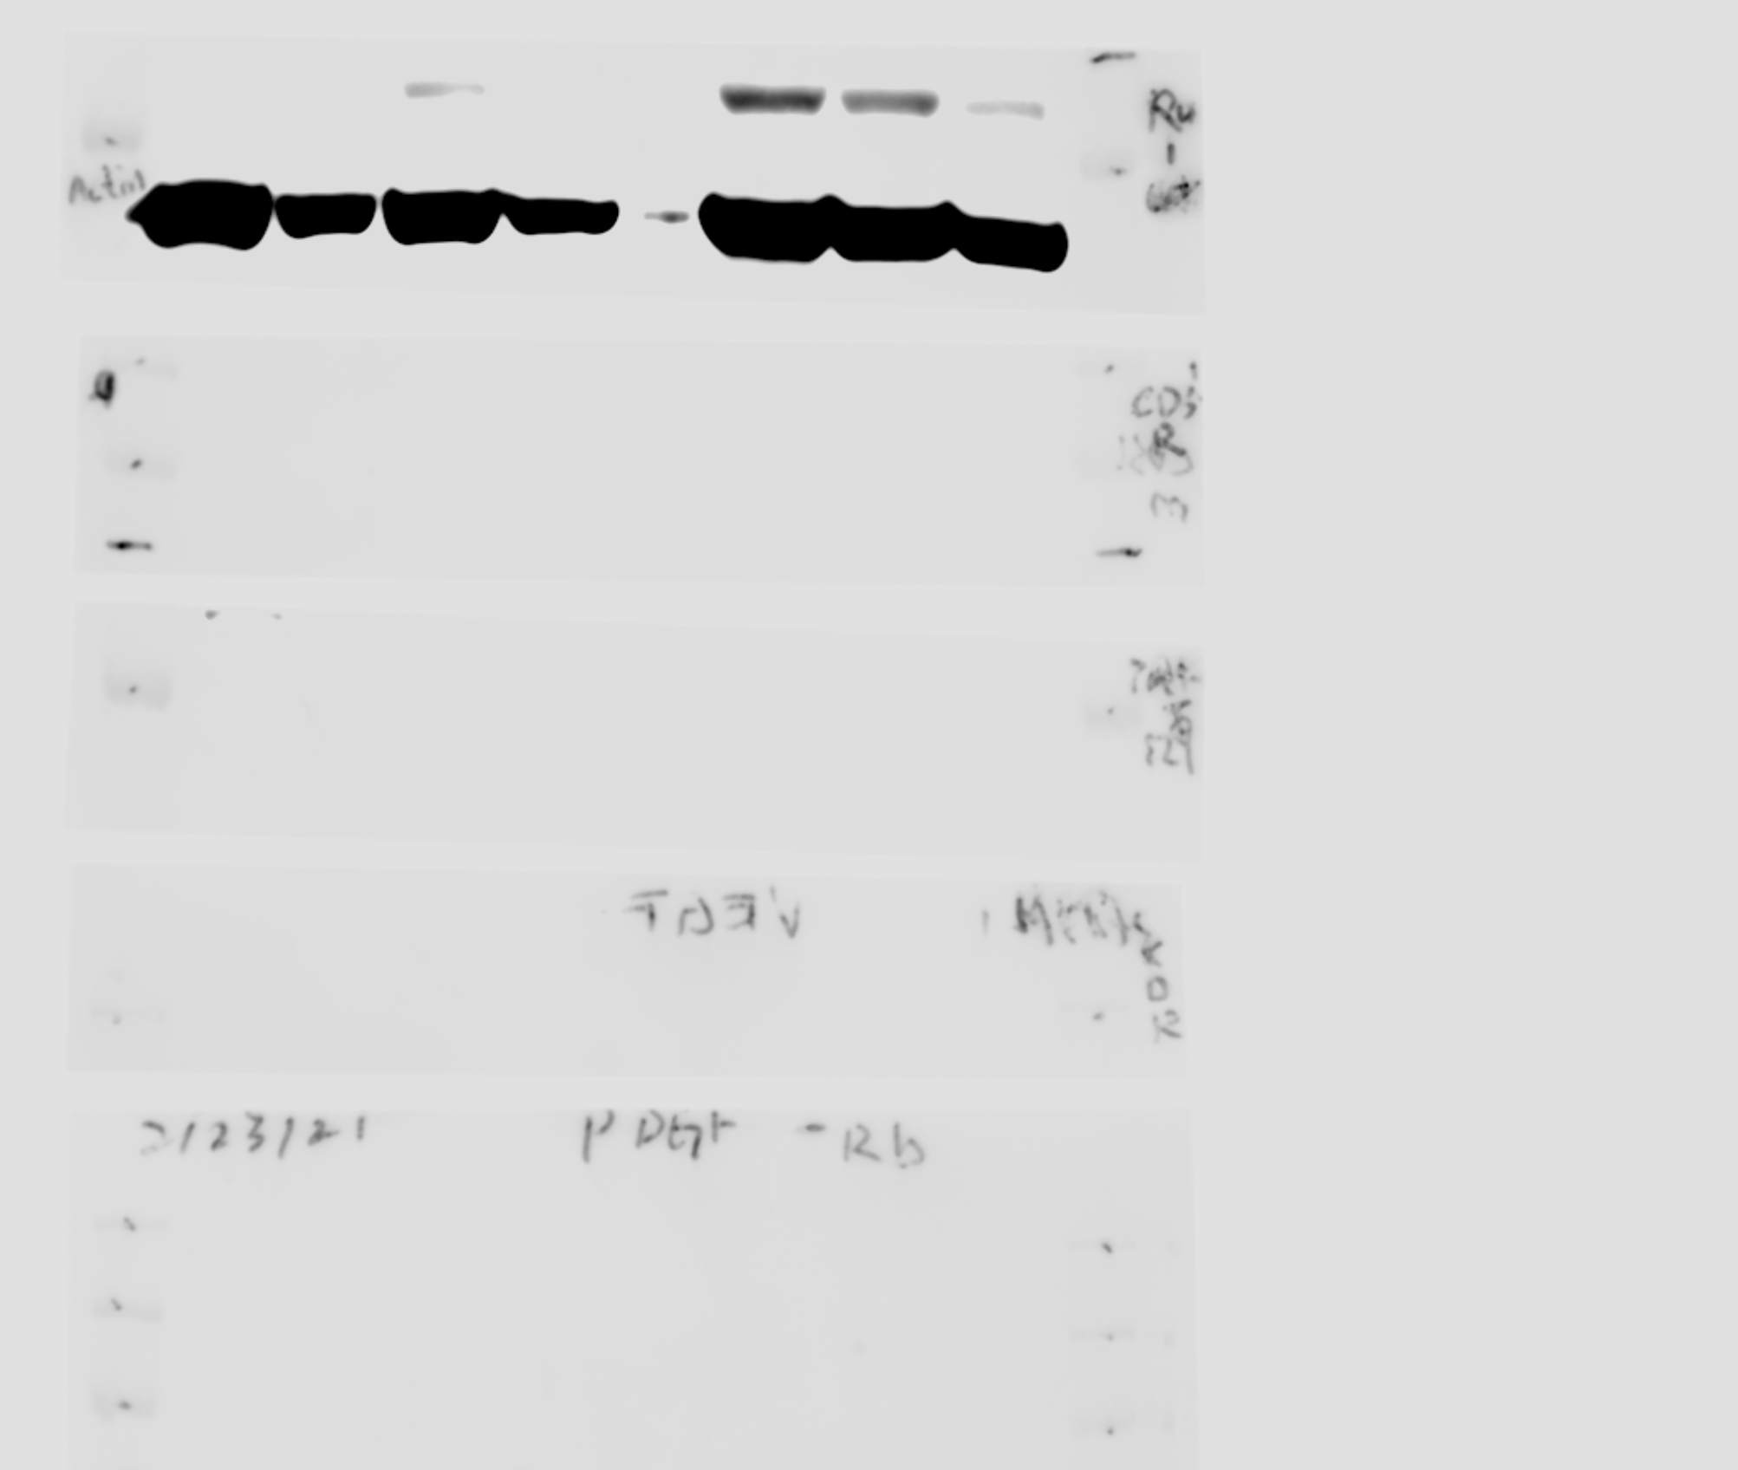
Fig. 7B

Slide 5
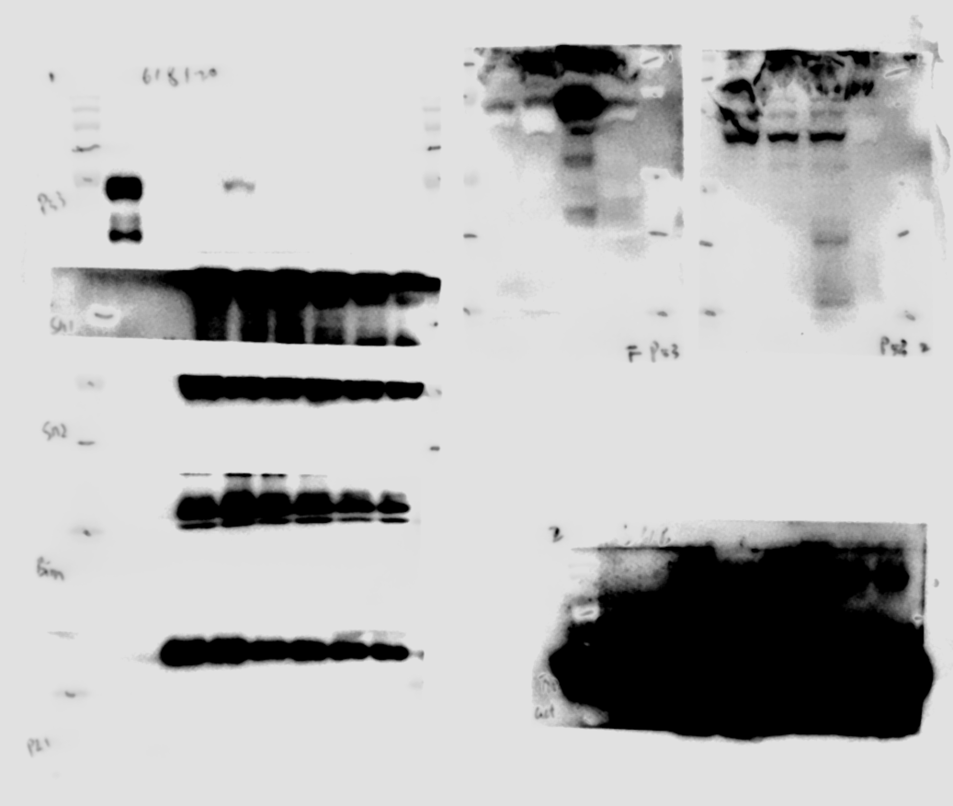
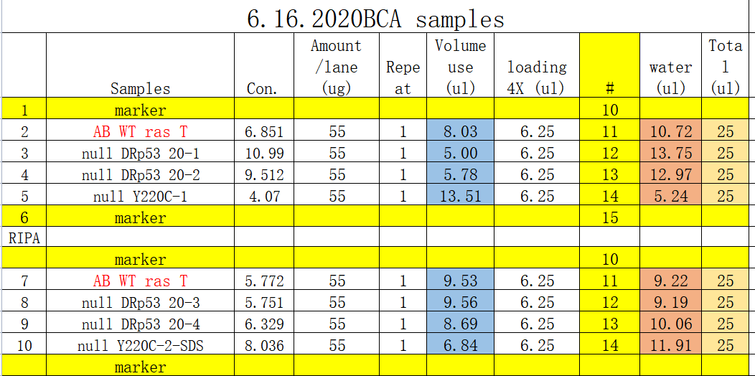
Figure 3 – Figure Supplement 4B
tp53^{-/-} + tp53 #1
tp53^{-/-} + tp53 #2
tp53^{-/-} + tp53 #3
tp53^{+/+}
Fish p53
GAPDH

Slide 6
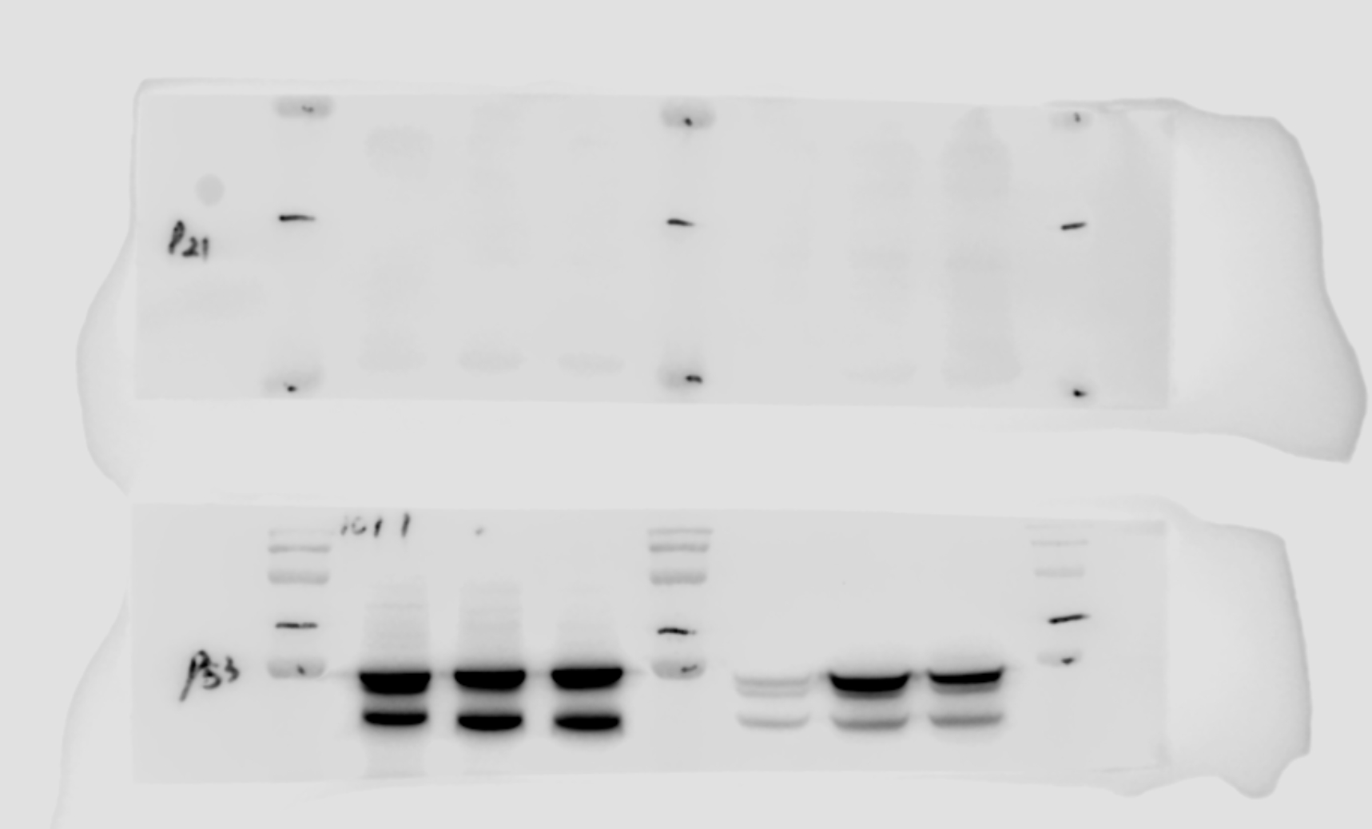
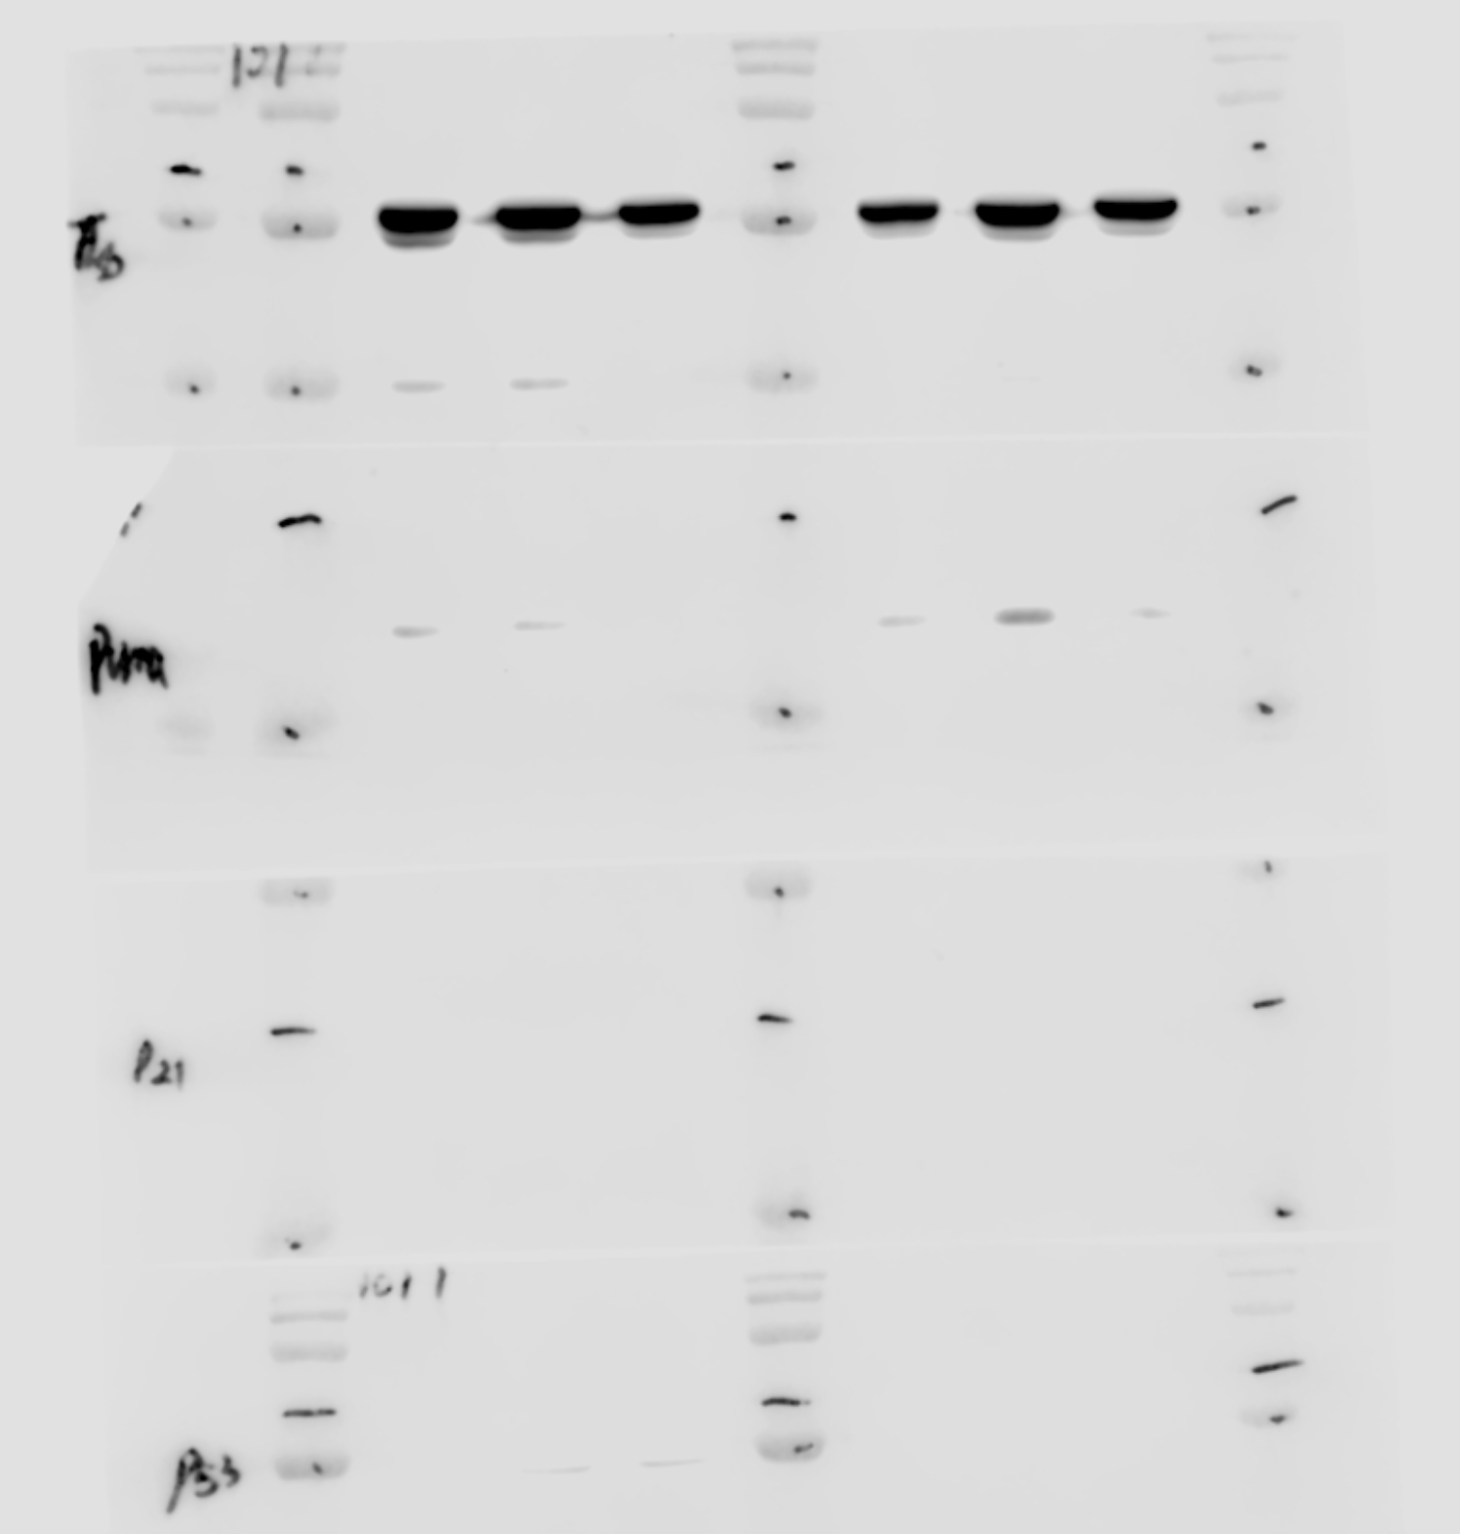
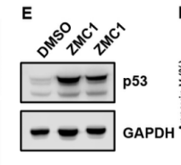
Figure 4- Figure Supplement 2E
DMSO ZMC1 ZMC1

Slide 7
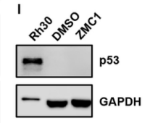
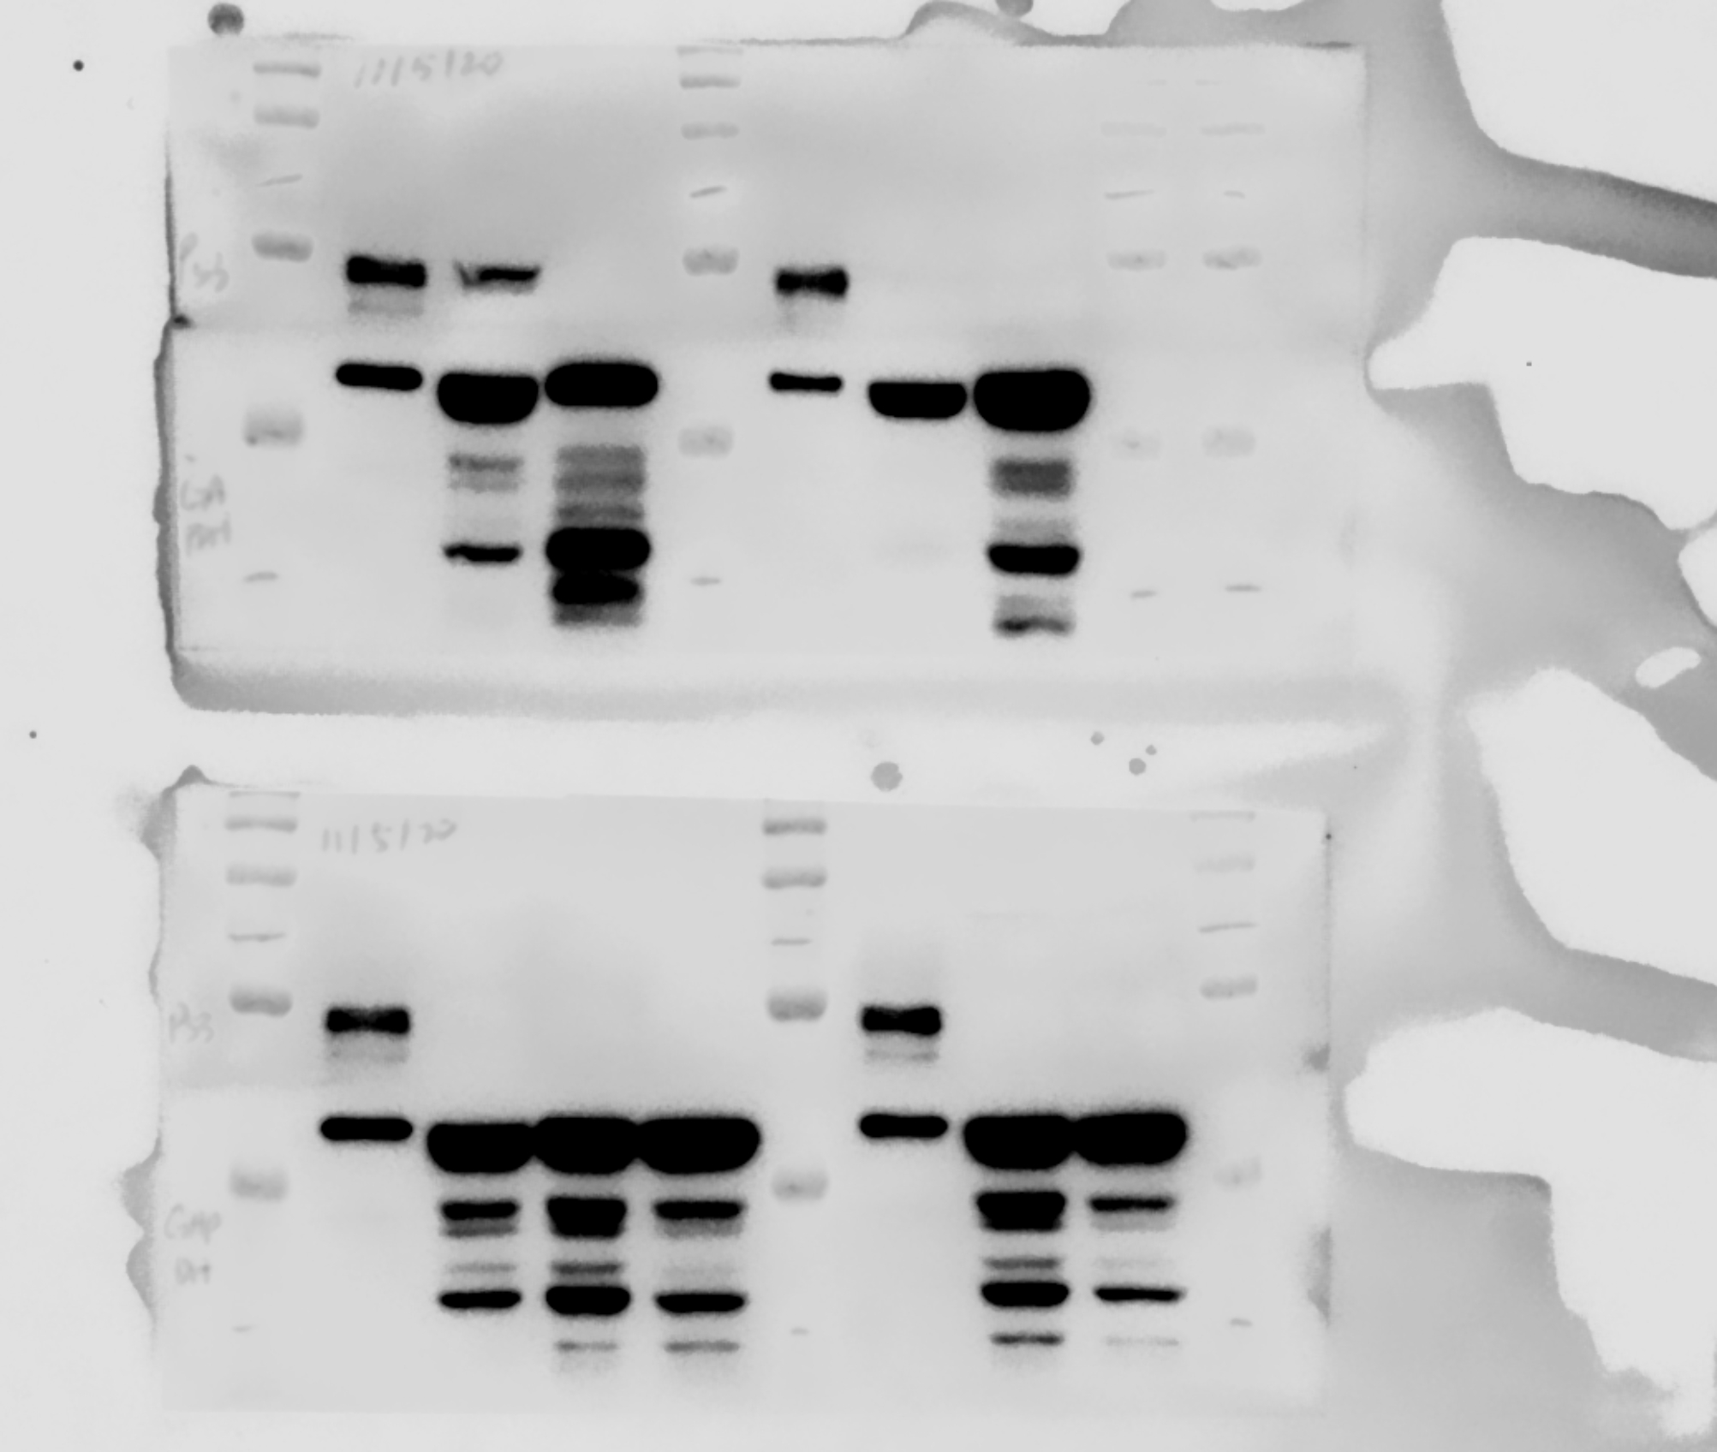
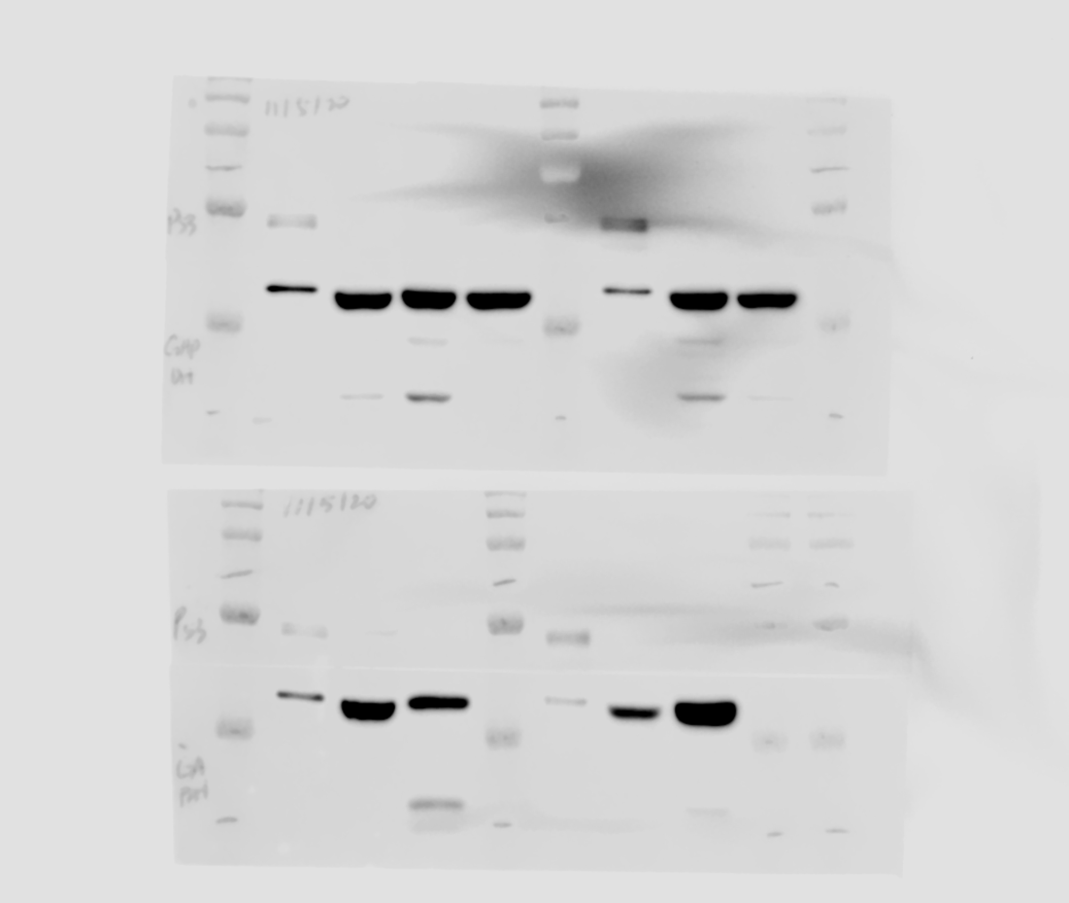
Figure 4- Figure Supplement 2I

Slide 8
Figure 7- Figure Supplement 1C

