Slide 1
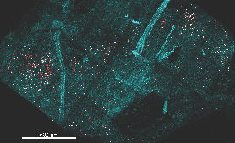
mLN
Notes:
Figure 5A, mLN
Mice containing mixed congenically distinct populations of 1M (CD90.1/.1) and 4M (CD90.1/.2) P14s were injected with bolus IV administration of CD90.1-PE (Red), and CD90.2-APC (White). Approximately 5 hours post injection, organs were isolated and 2-photon microscopy was performed on whole mLN (A-B) or iLN (C-D) explants ex vivo. The LN surrounding collagen capsule (pseudocolored blue) was captured with secondary harmonic generation (SHG)

Slide 2
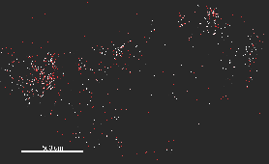
mLN
Notes:
Figure 5B, mLN
Mice containing mixed congenically distinct populations of 1M (CD90.1/.1) and 4M (CD90.1/.2) P14s were injected with bolus IV administration of CD90.1-PE (Red), and CD90.2-APC (White). Approximately 5 hours post injection, organs were isolated and 2-photon microscopy was performed on whole mLN (A-B) or iLN (C-D) explants ex vivo. The LN surrounding collagen capsule (pseudocolored blue) was captured with secondary harmonic generation (SHG)

Slide 3
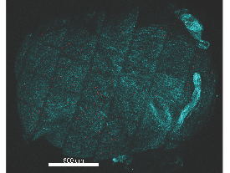
iLN
Notes:
Figure 5C, iLN
Mice containing mixed congenically distinct populations of 1M (CD90.1/.1) and 4M (CD90.1/.2) P14s were injected with bolus IV administration of CD90.1-PE (Red), and CD90.2-APC (White). Approximately 5 hours post injection, organs were isolated and 2-photon microscopy was performed on whole mLN (A-B) or iLN (C-D) explants ex vivo. The LN surrounding collagen capsule (pseudocolored blue) was captured with secondary harmonic generation (SHG)

Slide 4
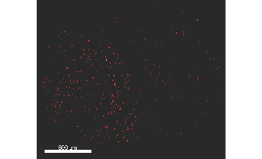
iLN
Notes:
Figure 5D, iLN
Mice containing mixed congenically distinct populations of 1M (CD90.1/.1) and 4M (CD90.1/.2) P14s were injected with bolus IV administration of CD90.1-PE (Red), and CD90.2-APC (White). Approximately 5 hours post injection, organs were isolated and 2-photon microscopy was performed on whole mLN (A-B) or iLN (C-D) explants ex vivo. The LN surrounding collagen capsule (pseudocolored blue) was captured with secondary harmonic generation (SHG)

