Slide 1
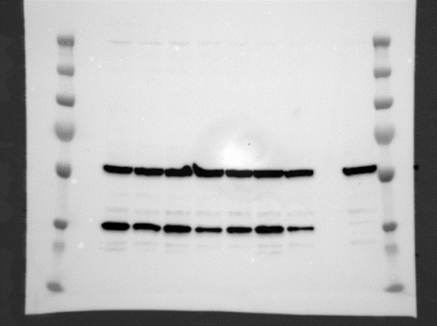
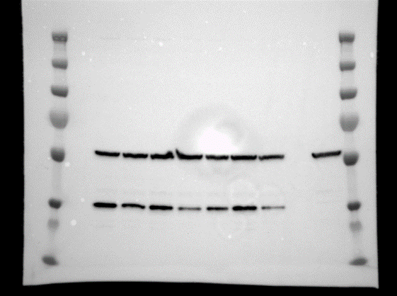
Figure 4-source data 3. Expression of the mCTFbax mutants not activated by GAP14, detected by Western blot using an anti-FLAG antibody.
FLAG exposure
β-Tubulin exposure
Construct no used in the manuscript
Construct no used in the manuscript
mCTFbax
Y1158A
R1160A
W1165A
L1166A
mCTFbax
Y1158A
T1240A
R1160A
W1165A
L1166A
T1240A
Mock
Mock
50kD
β-Tubulin
30kD
FLAG

