Slide 1
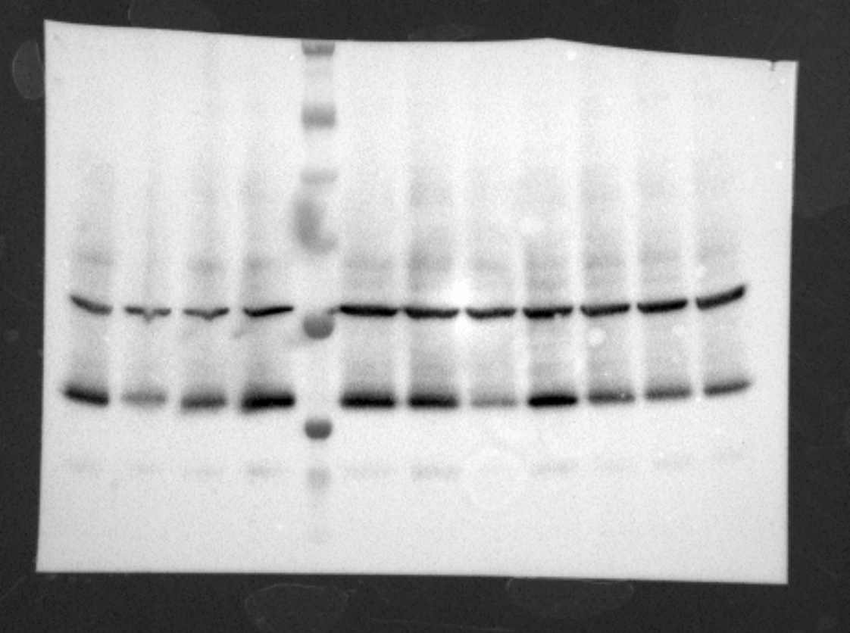
Figure 5-source data 2. Expression of hCTFbax and mutants thereof, detected by Western blot using an anti-V5 antibody.
This part of the blot
Was not used
hCTFbax
G1011K
1077QDN
1082ILCK
R1155Q
V1163A
1242FPGT
β-Tubulin
50kD
V5 tag
30kD

