Slide 1
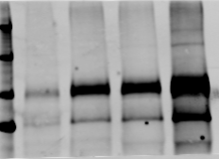
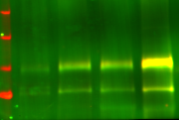
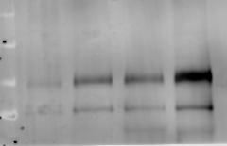
Human sperm (#2) capacitated 1h and 4h
LM
HM
1hC
4hC
Merge
Y-GIV
Y-antibody
tub
tGIV (GIVcc13+1861to1871)

