Slide 1
Fig 3B

Slide 2
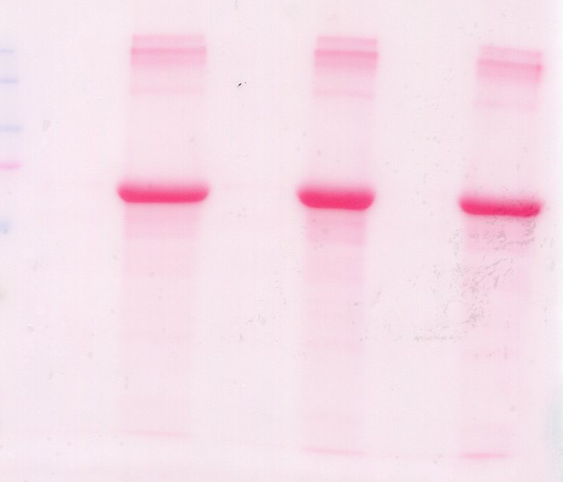



H89
DMSO
NC
C
NC
C
NC
C
GIV-Tyr
GIV-CT
Tub

