Slide 1
Fig 3E

Slide 2
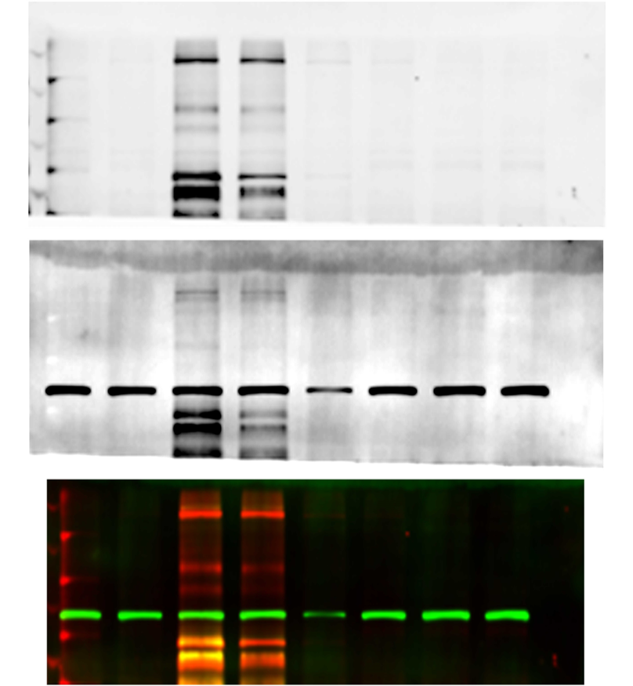

Slide 3
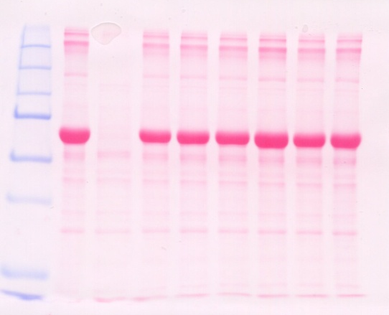
Dual Color
WT3–
samples
8-20-15
60’
H89
60’
H89
NC
60’
45’
30’
15’
10’
5’
NC
60’
45’
30’
15’
10’
5’
pY
pYGIV
pAKT Ser 473

Slide 4
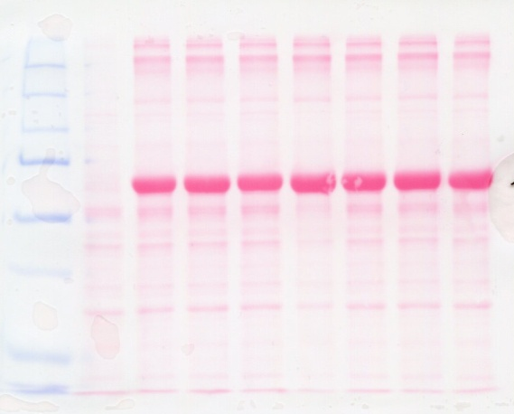
WT4
samples
Dual Color
8-20-15
60’
H89
60’
H89
NC
60’
45’
30’
15’
10’
5’
NC
60’
45’
30’
15’
10’
5’
pY
pYGIV
pAKT Ser 473

Slide 5
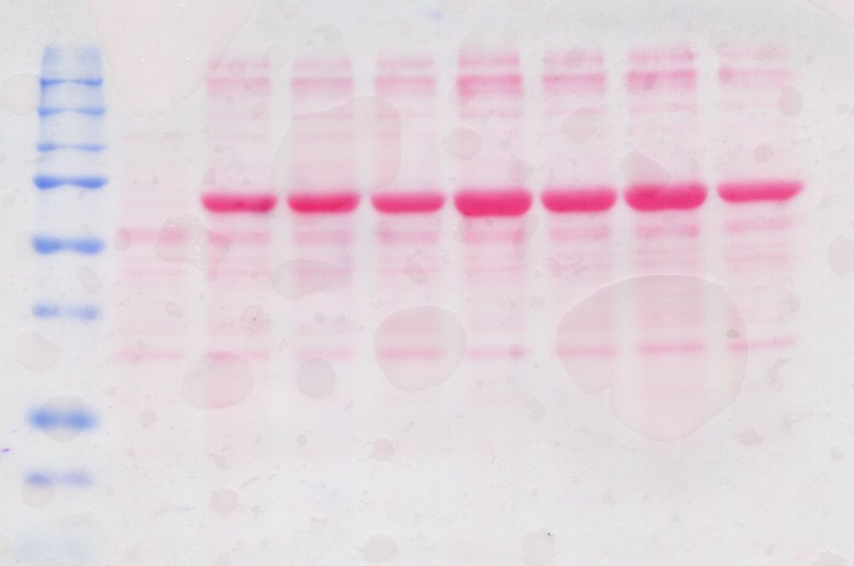
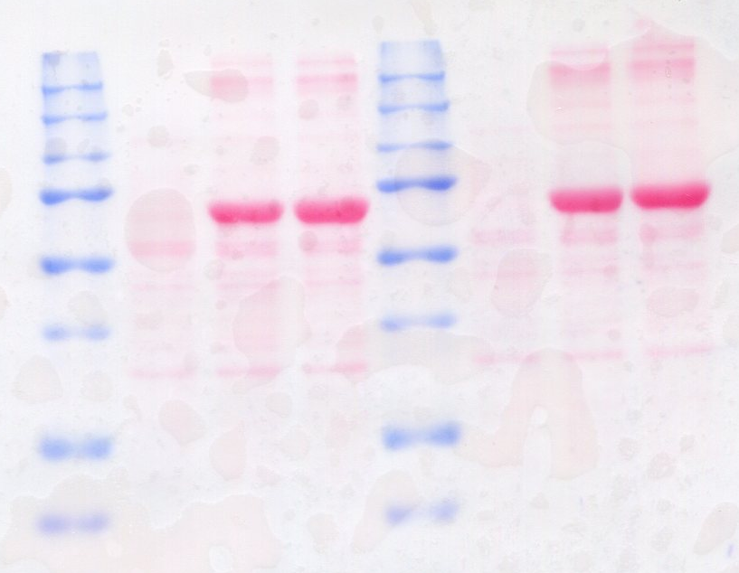
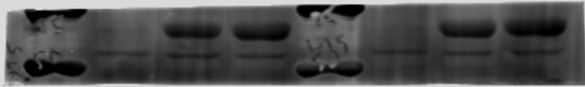
9-18-15
WT6 samples
WT5 samples
WT5 samples
Ponceau
Ponceau
Capacitated
Capacitated
Capacitated
60’
H89
60’
H89
60’
H89
NC
60’
NC
60’
NC
60’
45’
30’
15’
10’
5’
250
250
150
150
100
100
250
IB: pY GIV
250
150
150
100
IB: pY GIV
100
250
250
IB: pY
IB: pY
150
150
100
100
75
75
IB: pAKT
IB: pAKT
50
50
75
75
IB: total AKT
IB: total AKT
50
50

