Slide 1
Figure 6C

Slide 2

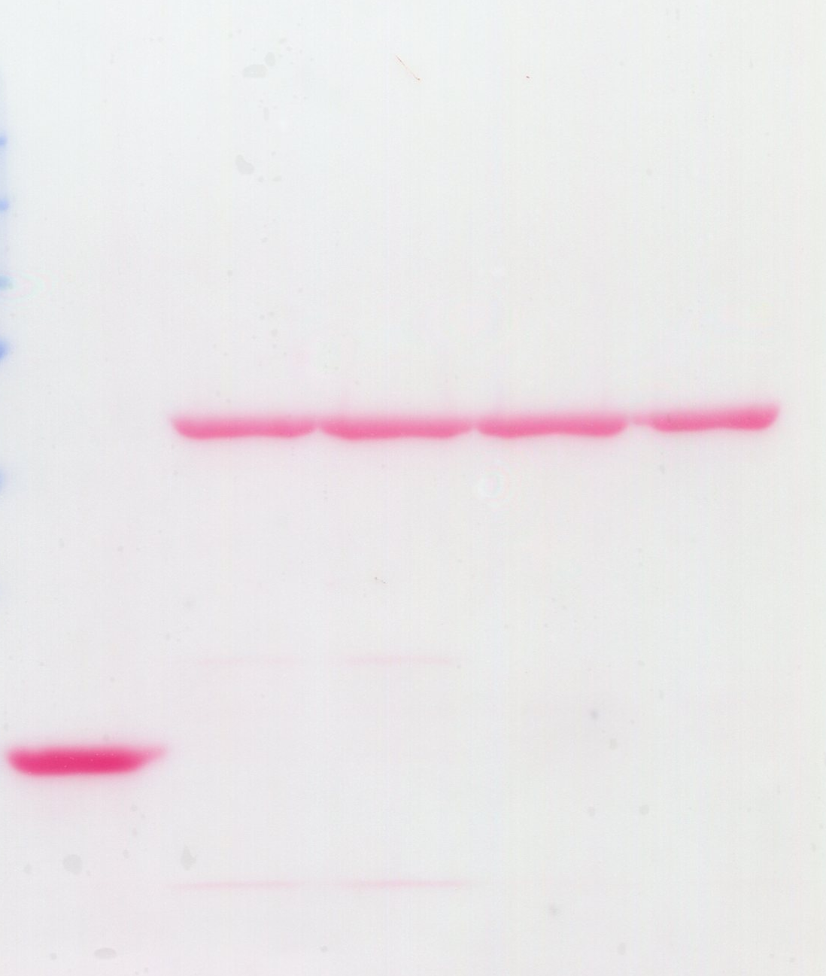

GST
GST-Gai3
TAT Peptide
Transduced sperm lysates binding to Gai3
WT
WT
WT
FA
FA
TAT-His-GIV-CT transduced sperm lysates
IB: His
25-
Bound
GST-Gai3
GST
IB: His
TAT-His-GIV-CT transduced sperm lysates
Input
25-

