Slide 1
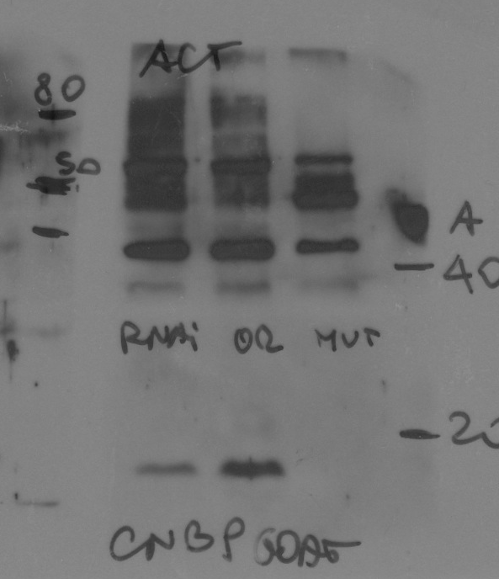
Figure 1E
Or-R
cnbp^{K}
anti-actin
anti-CNBP
Or-R
cnbp^{K}

Slide 2
Figure 1–figure supplement 1
FULL BLOT
Larval brains
Adults brains
nsybGAL4>
2XCNBP^{RNAi}
elavGAL4>
2XCNBP^{RNAi}
nsybGAL4>
2XCNBP^{RNAi}
elavGAL4>
2XCNBP^{RNAi}
No UAS
MW
Tubulin-
55
36
27
dCNBP-
15

Slide 3
Figure 2B
C179GAL4>
hCNBP-Flag
dCNBP-HA
hCNBP-Flag
dCNBP-HA
No UAS
No UAS
WT
WT
Anti-Tub
anti-tubulin
anti-Flag
anti-HA

Slide 4
Figure 3A
C179GAL4>
2X dCNBP ^{RNAi}
2X dCNBP ^{RNAi}
no UAS
no UAS
anti-Tub
anti-CNBP
anti-Odc

Slide 5
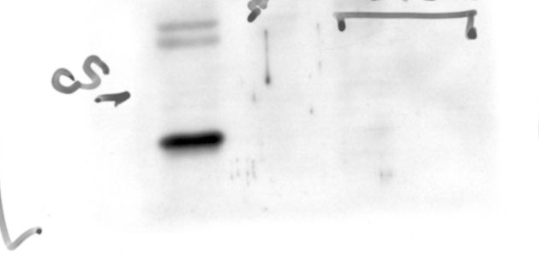
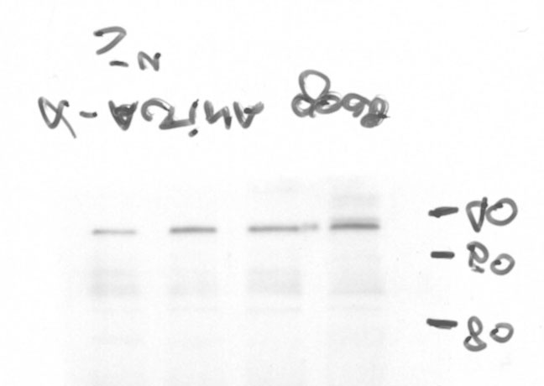
Figure 3-figure supplement 1A
WT
CNBP^{K}
WT
CNBP^{K}
WT
CNBP^{K}
ODC
CNBP
actin

Slide 6
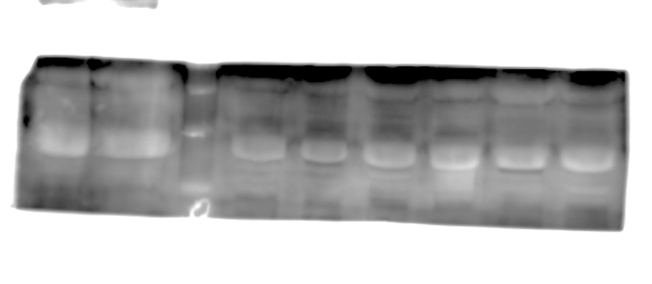
Figure 5A
CTRL
DM2
DM2
CTRL
1
2
3
1
2
3
3
2
1
3
2
1
anti-ODC
anti-CNBP
CTRL
DM2
DM2
CTRL
1
2
3
1
2
3
3
2
1
3
2
1
anti-Vinculin
for ODC
anti-Vinculin
for CNBP

Slide 7
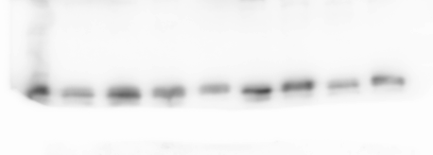
Figure 5- figure supplement 1
C179GAL4>
(CCTG)₄₇₅
(CCTG)₂₀₀
(CCTG)₅₂₅
No UAS
anti-CNBP
(CCTG)₂₀₀
No UAS
(CCTG)₄₇₅
(CCTG)₅₂₅
anti-tubulin

Slide 8
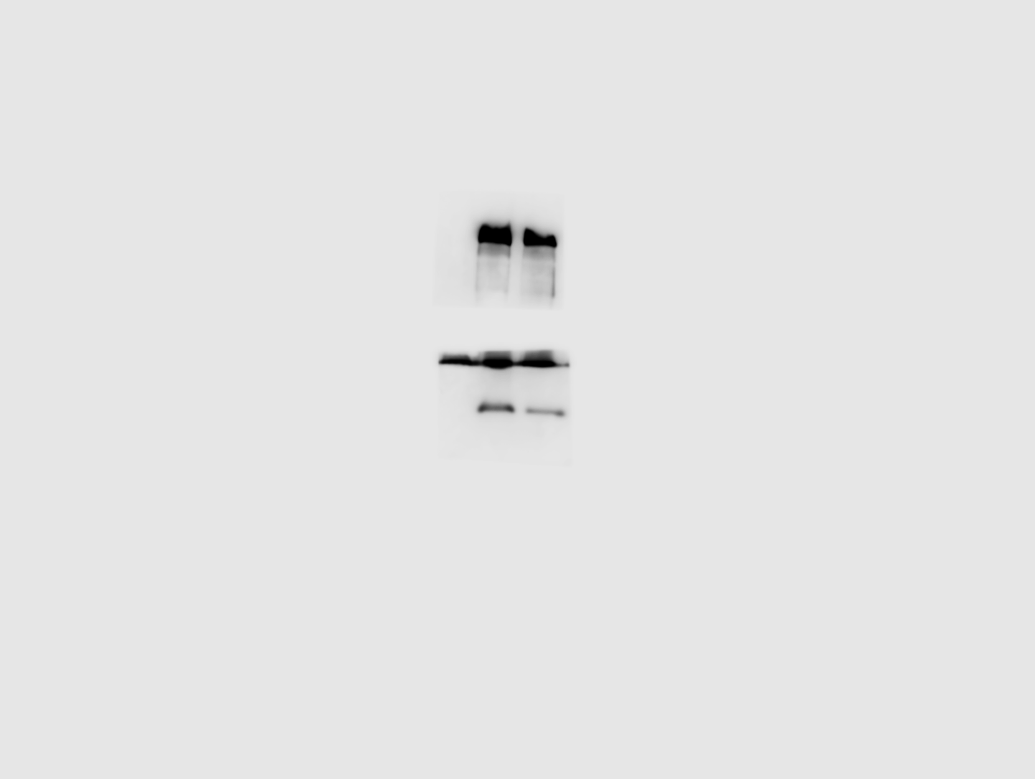
Figure 6B
C179GAL4>
No UAS
2xCNBP
anti-Tubulin
anti-CNBP
No UAS
2xCNBP

Slide 9
Figure 6D
S2 cells
CTRL
dCNBP ^{RNAi}
- anti-Tub
Unrelated experiment
- anti- CNBP

Slide 10
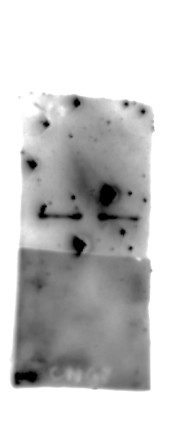
FIGURE 6-figure supplement 4
CTRL
shCNBP
CTRL
shCNBP
CTRL
shCNBP
anti Flag (ODC)
anti-actin
anti-GFP
anti-CNBP

Slide 11
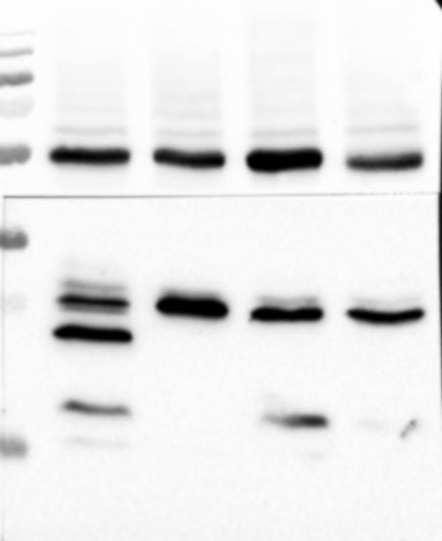
Figure 7–figure supplement 2
FULL BLOT
Mef-GAL4>
2XCNBP ^{RNAi}
dOdc1 +2XCNBP^{RNAi}
no UAS
dOdc1
55
- Tub
36
27
15
- CNBP

