Slide 1
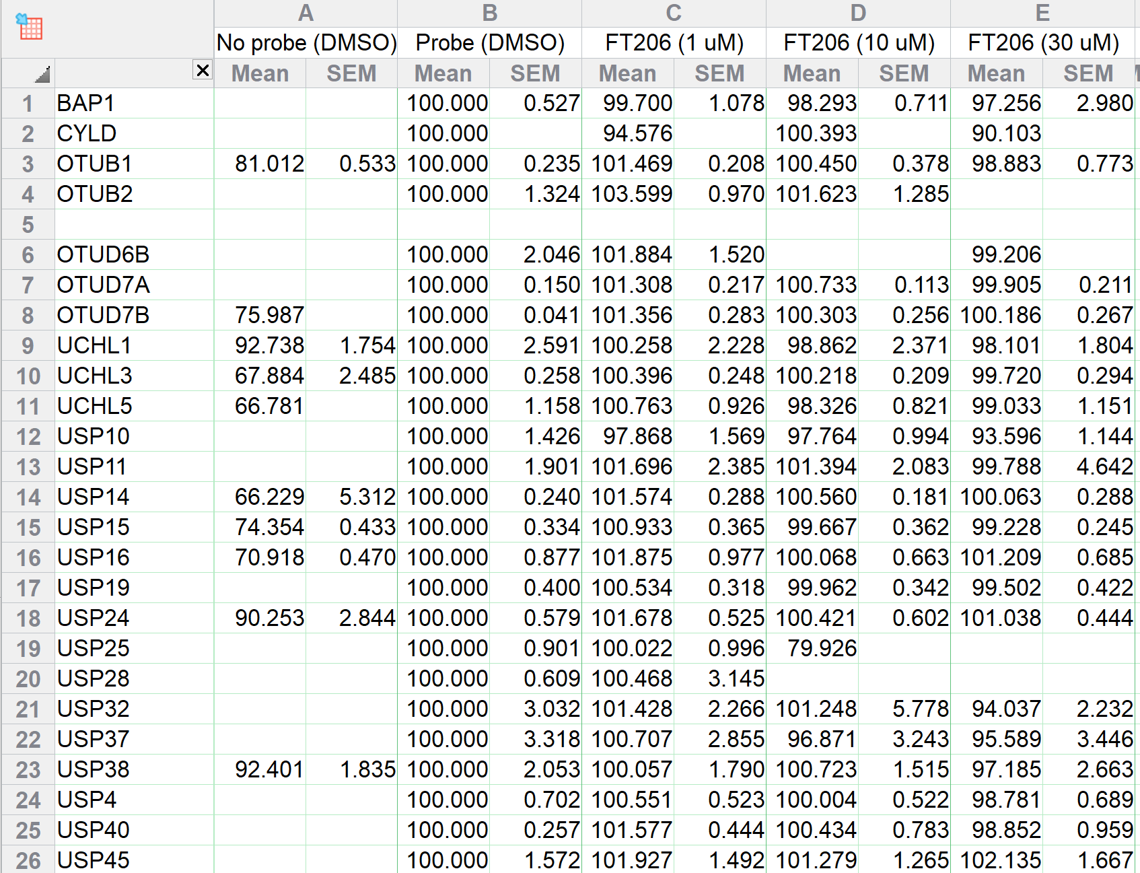
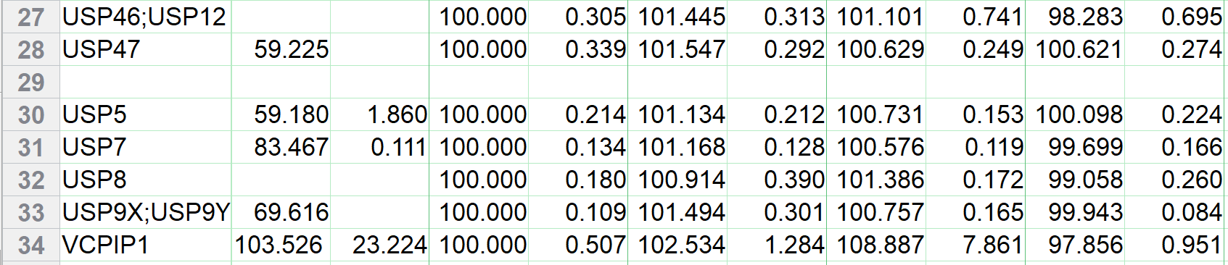
Figure 4D – Source Data: Baseline corrected of transform of Ub probe labelling in H520 cell extracts

