Slide 1
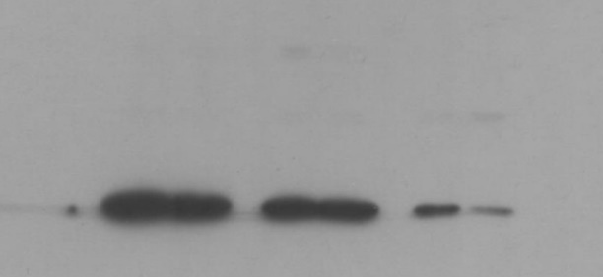
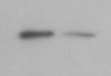
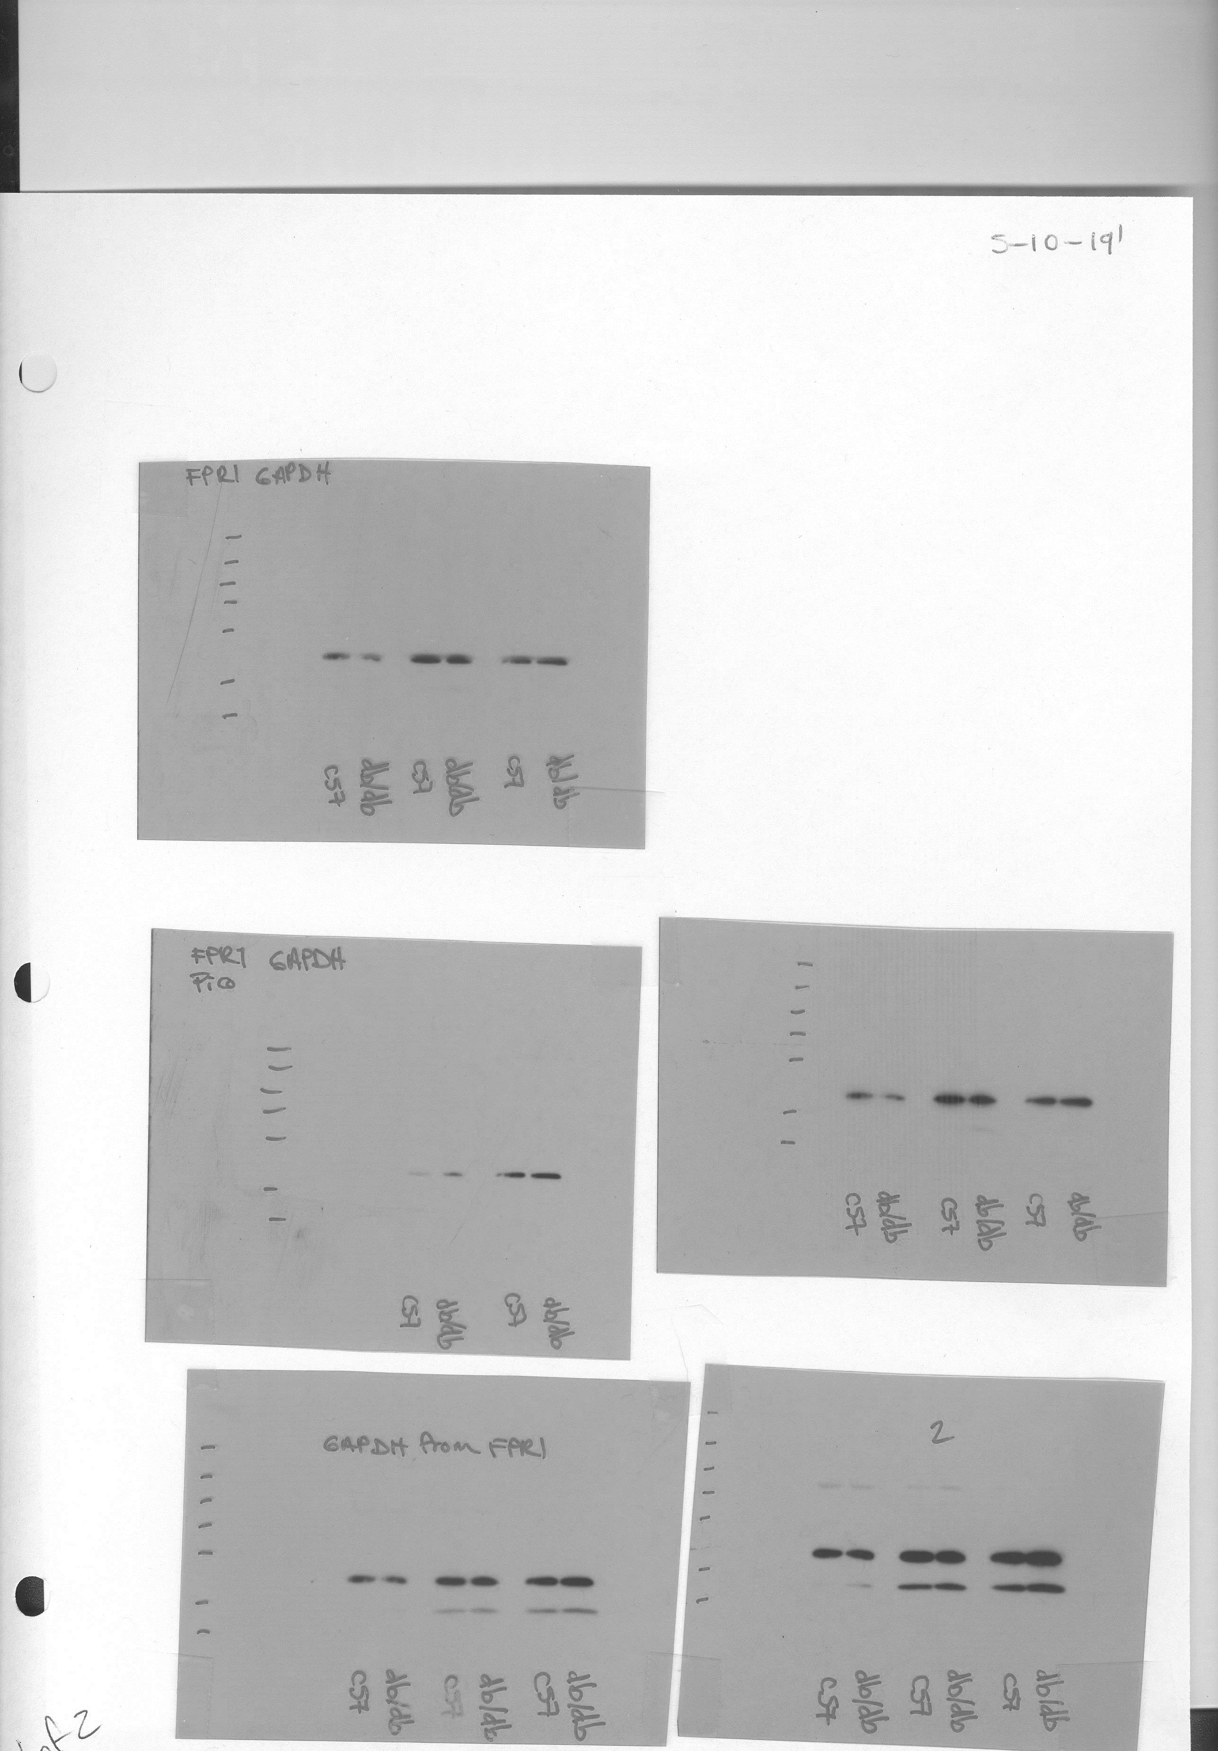
Figure 2
b
C57B
db/db
FPR1
FPR1
(40kDa)
GAPDH
(37kDa)
GAPDH
Dashed lines identify cropped area

