Slide 1
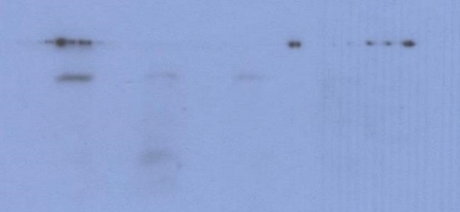


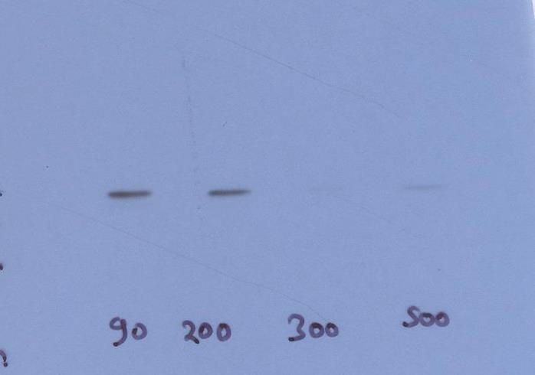

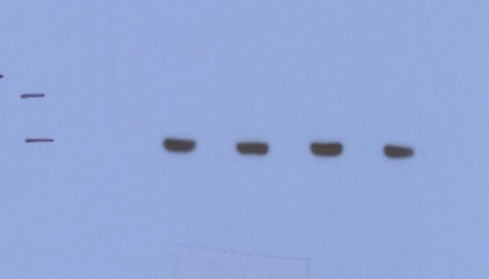
Figure 2
i
Glucose:
(mg/dL)
90
200
300
500
FPR1
(40kD)
FPR1
PLCγ
(155kDa)
GAPDH
(37kDa)
PLCγ
GAPDH
Dashed lines identify cropped area

