Slide 1
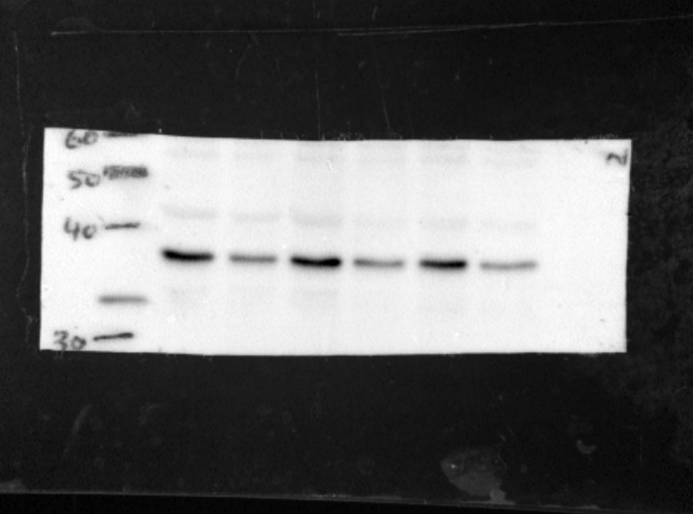
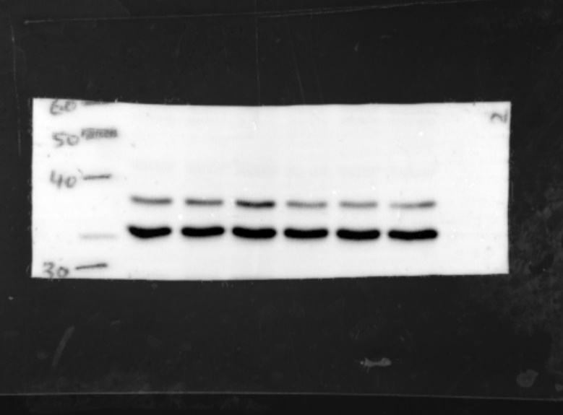
Figure 2-figure supplement 3
b
FPR2
(38kDa)
FPR2
GAPDH
(37kDa)
Glucose:
(mg/dL)
90 300 90 300 90 300
1h 2h 3h
GAPDH
Dashed lines identify cropped area

