Slide 1
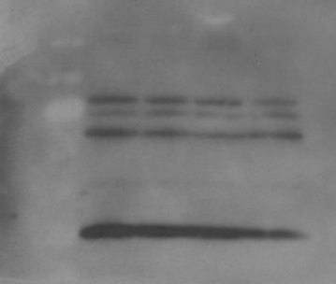
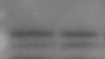
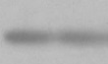
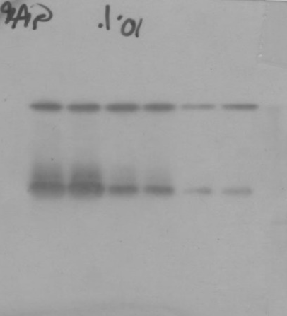
Figure 3
c
Glucose:
(mg/dL)
300
CCR1
90
CCR1
(42kDa)
GAPDH
(37kDa)
GAPDH
Dashed lines identify cropped area

