Slide 1
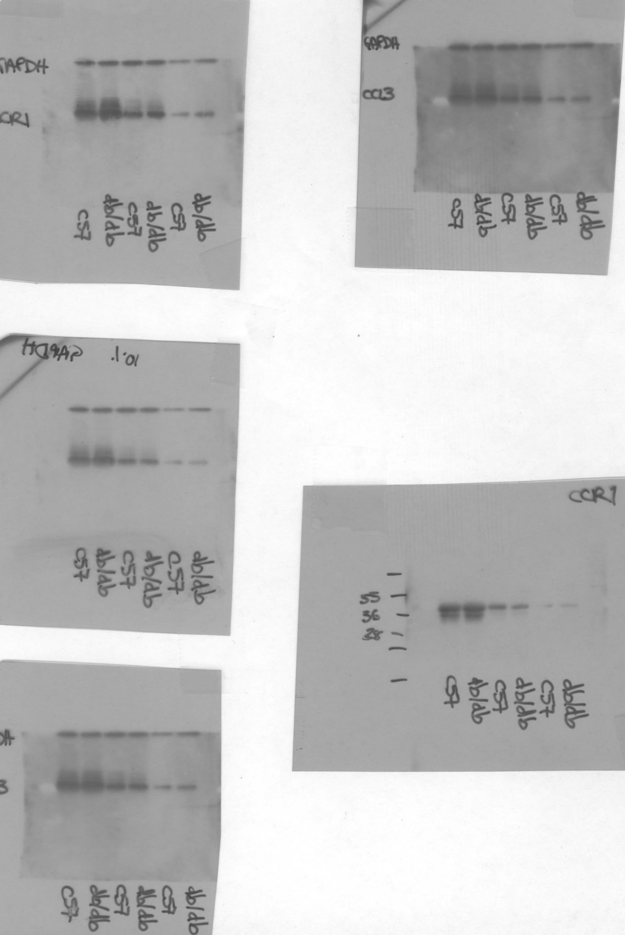
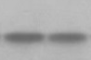
Figure 3
h
db/db
C57B
CCR1
(42kDa)
CCR1
GAPDH
(37kDa)
GAPDH
Dashed lines identify cropped area

