Slide 1
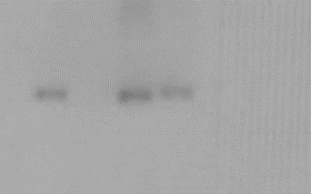
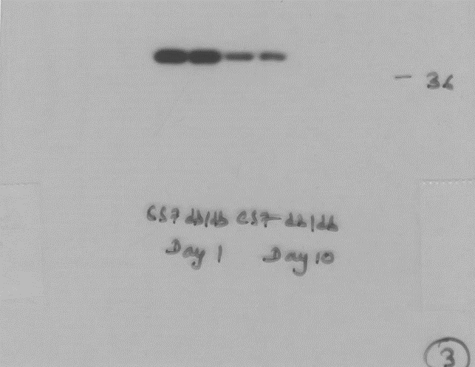
Figure 4
b
CCL3
Wound Tissue
(8kDa)
GAPDH
(37kDa)
CCL3
(8kDa)
db/db
Day 1:
C57B
GAPDH
db/db
C57B
Dashed lines identify cropped area

