Slide 1
Figura 4-source data 1
MCF7
HSC70
FTH1
MCF7shFTH1/ PCDNA₃FTH1
MCF7 shFTH1 PCDNA₃
MCF7 shRNA

Slide 2
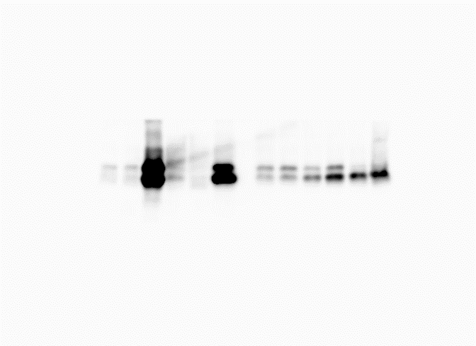
Figura 4-source data 1
H460
HSC70
FTH1
H460 shFTH1/ PCDNA₃FTH1
H460 shFTH1/ PCDNA₃FTH1
H460 shFTH1 PCDNA₃
H460 shFTH1 PCDNA₃
H460 shRNA
H460 shRNA

