Slide 1
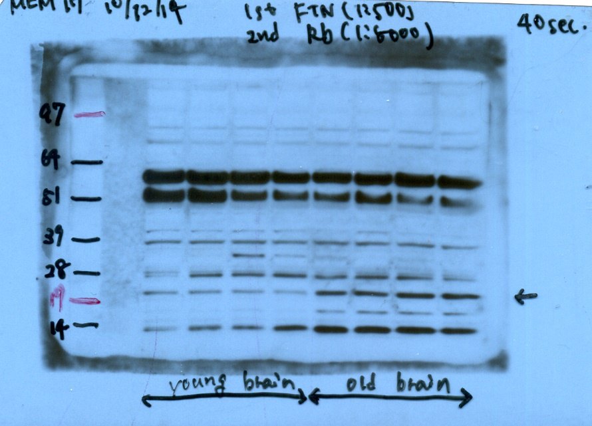
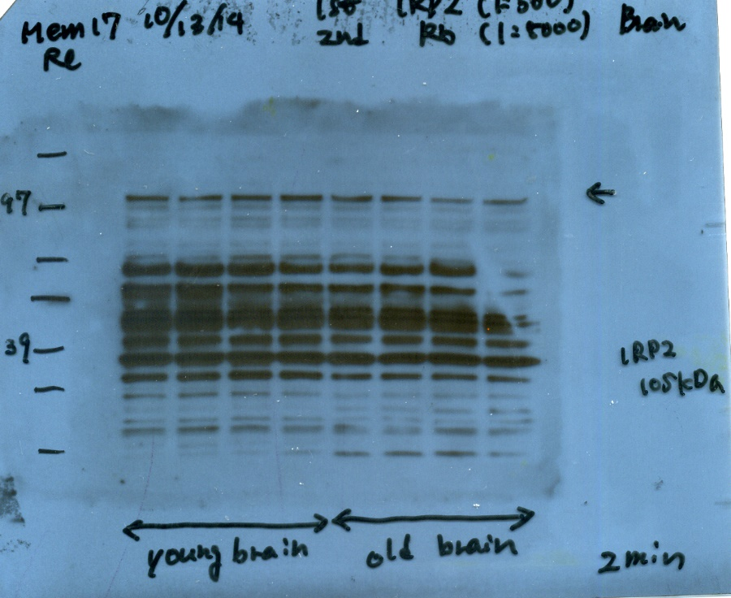
Full length blots in Figure 1
GAPDH
FTN (L+H)
IRP2
SDHA
HPRT

