Slide 1
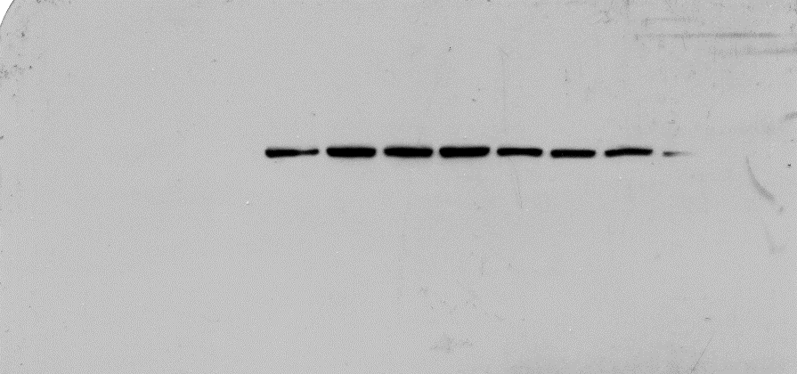
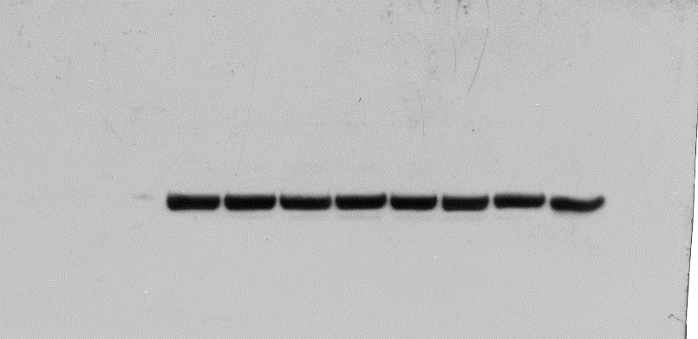
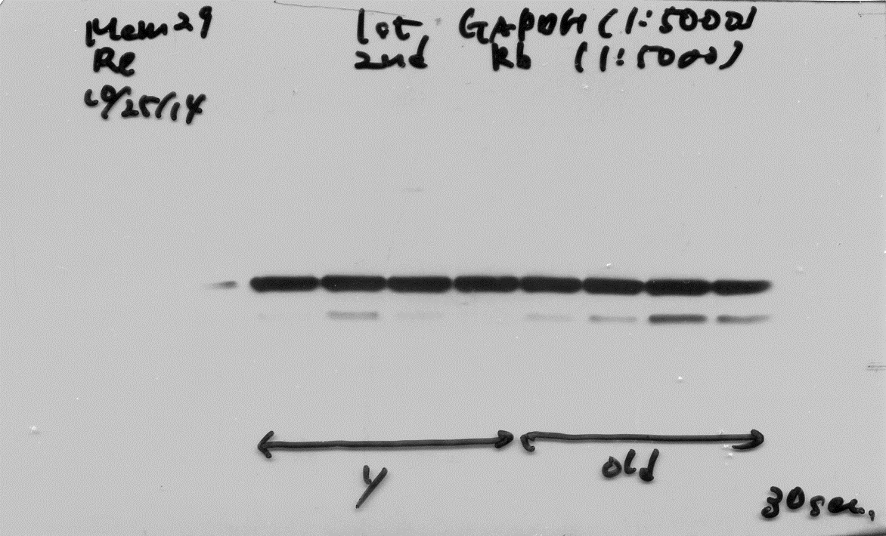
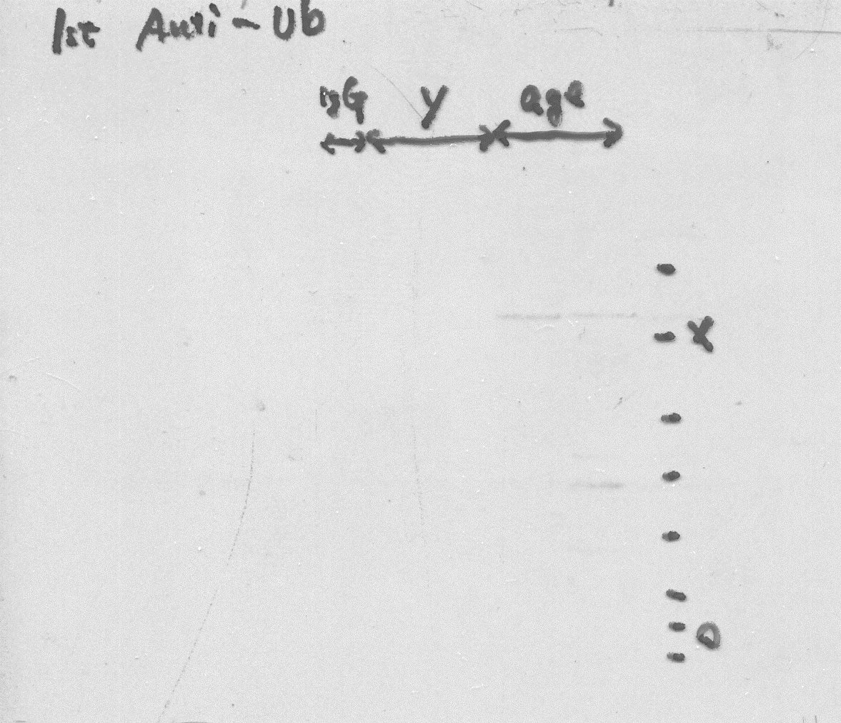
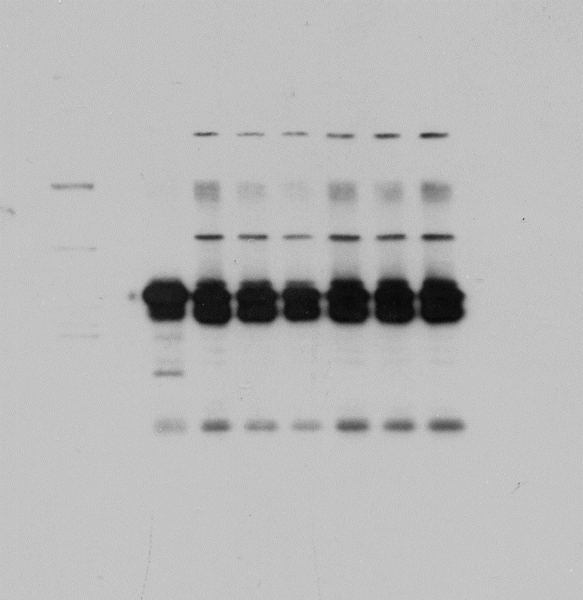
Full length blots in Figure 3
FPN1
TfR1
GAPDH
Single band at 90kDa
Single band at 62kDa
We unintentionally omitted blots of both ends because of some lack in signals in FPN1 immunoblot.
IP:FPN1 / IB:Ubiquitin
IP:FPN1 / IB:FPN1

