Slide 1
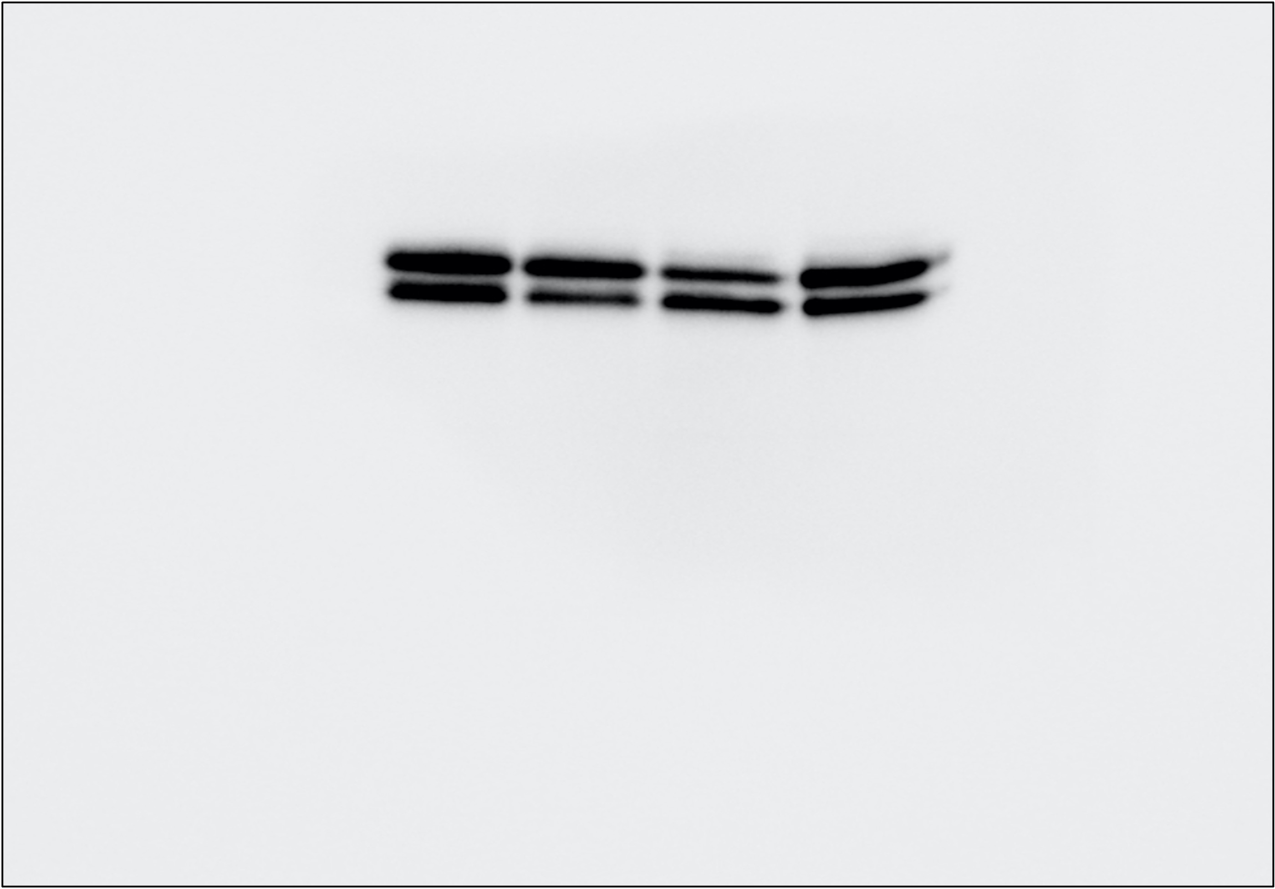
iKras*3
KPC7940
KPCMT3
Dox
+
–
–
–
ERK

Slide 2
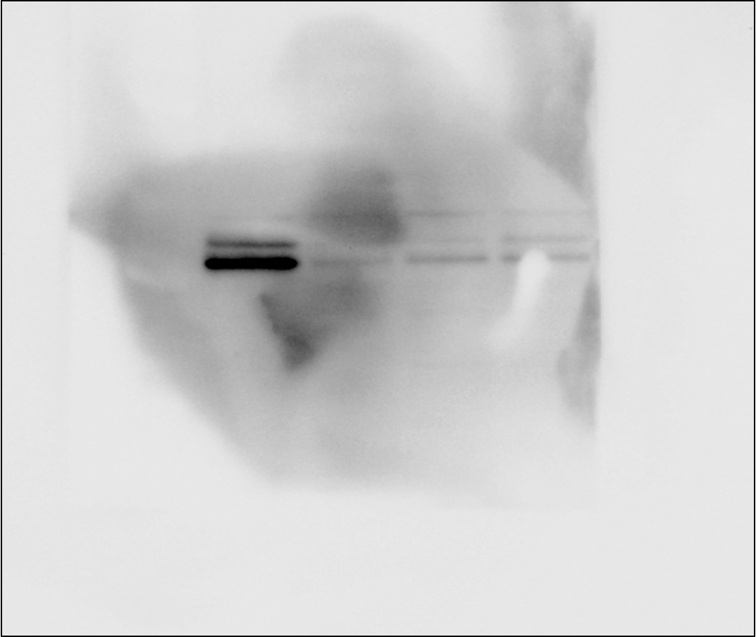
iKras*3
KPC7940
KPCMT3
Dox
+
–
–
–
p-ERK

Slide 3
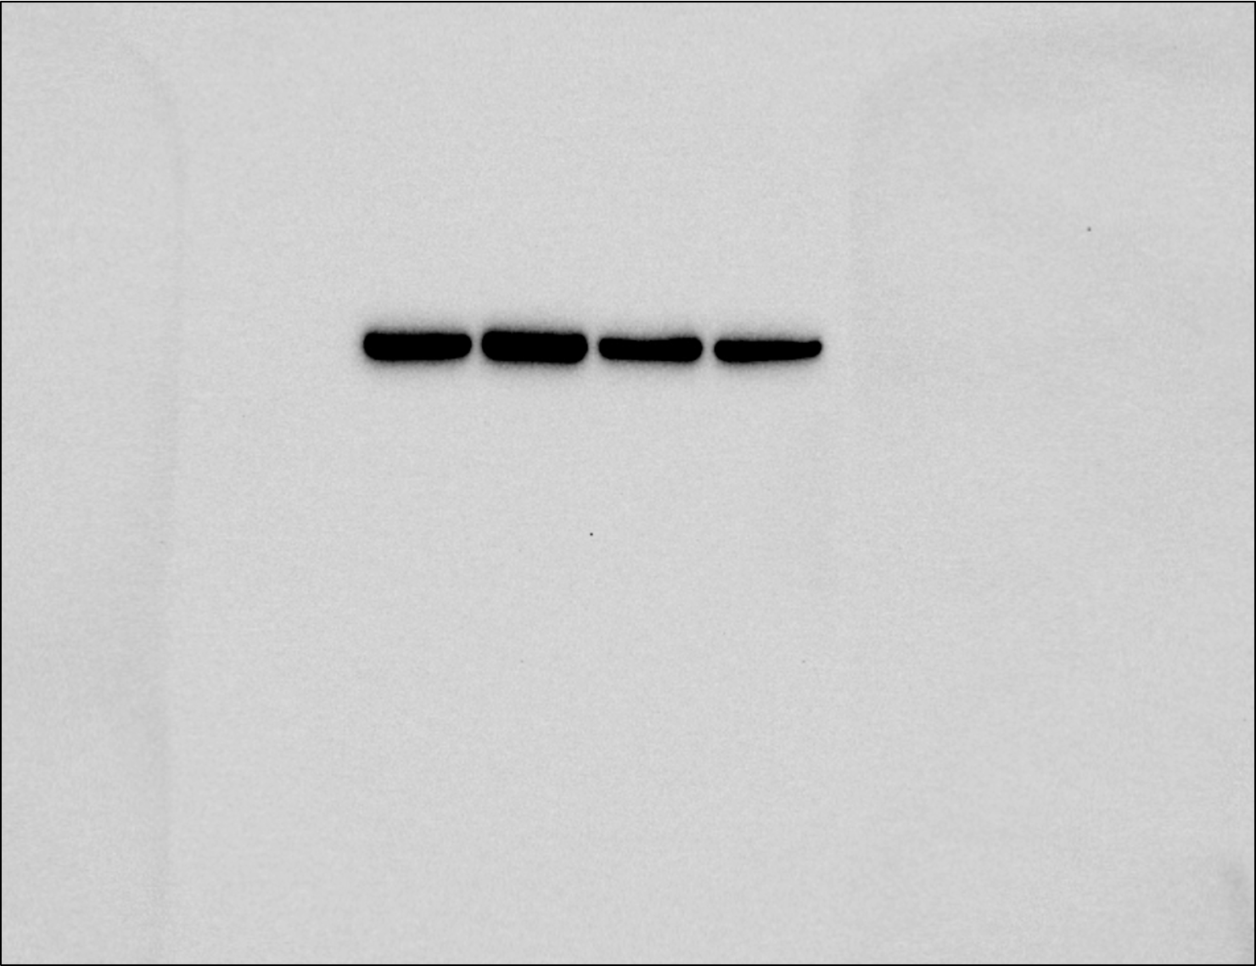
iKras*3
KPC7940
KPCMT3
Dox
+
–
–
–
Vinculin

Slide 4
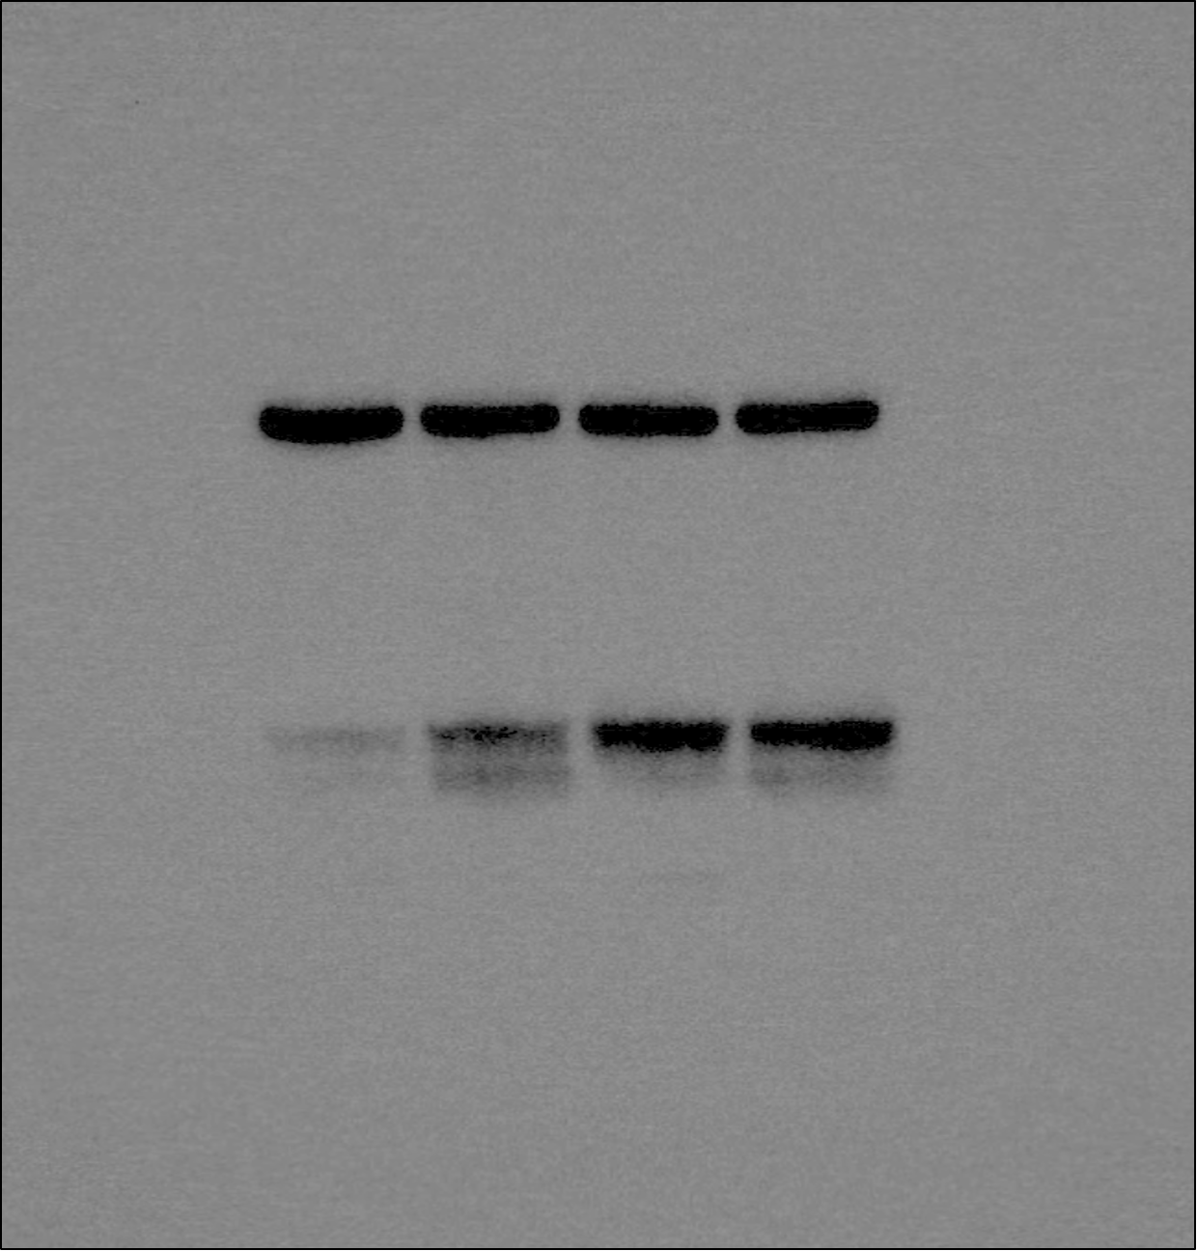
M-CSF
mock
MK-2206
BKM120
iKras*3 CM
–
+
+
+
Vinculin
TXNIP

Slide 5
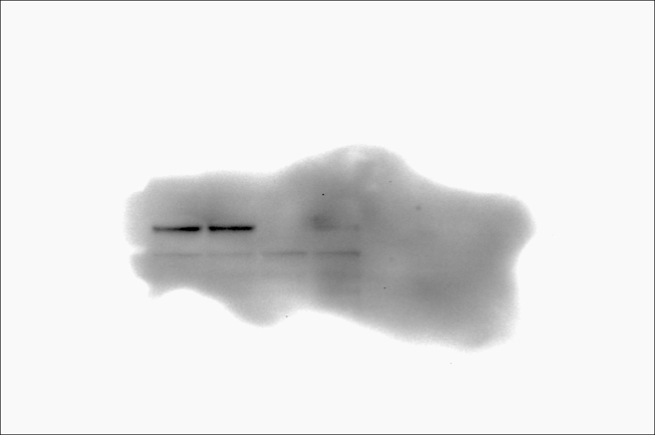
M-CSF
mock
MK-2206
BKM120
iKras*3 CM
–
+
+
+
pAKT

Slide 6
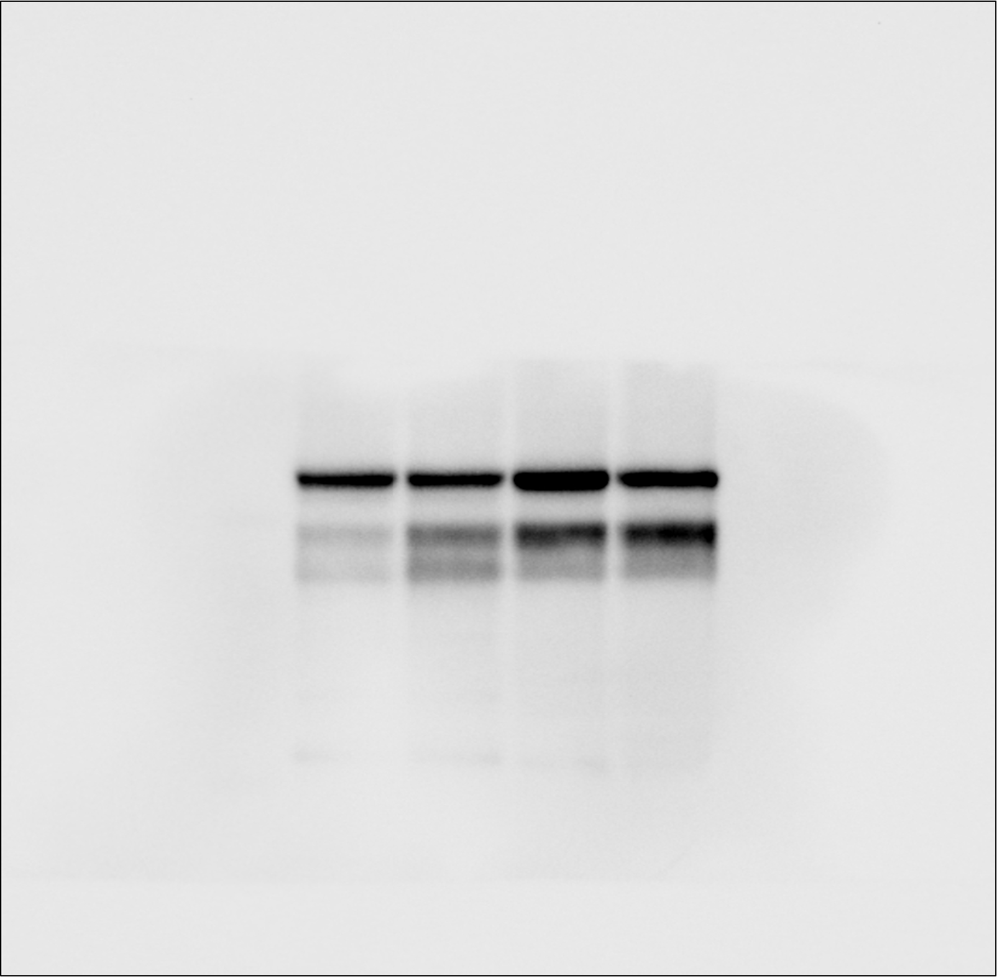
M-CSF
mock
MK-2206
BKM120
iKras*3 CM
–
+
+
+
AKT
TXNIP

Slide 7
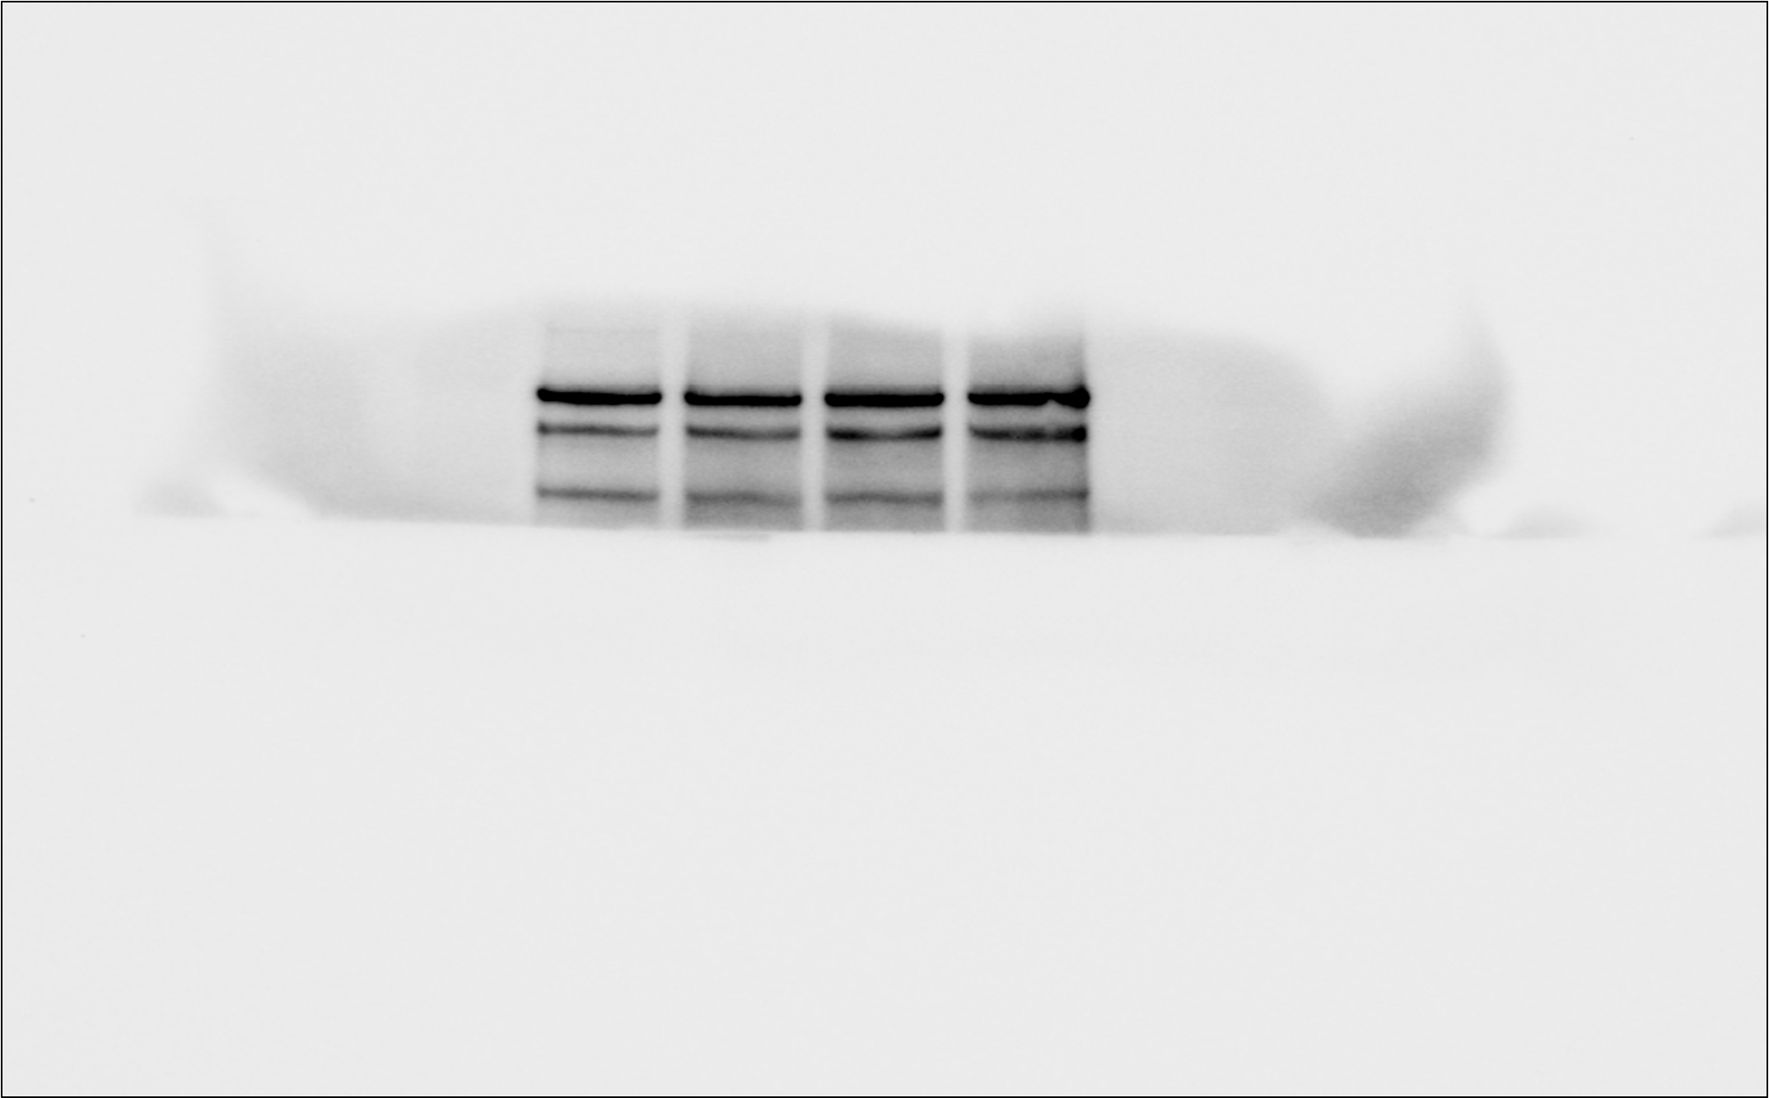
M-CSF
mock
MK-2206
BKM120
iKras*3 CM
–
+
+
+
ACLY

Slide 8
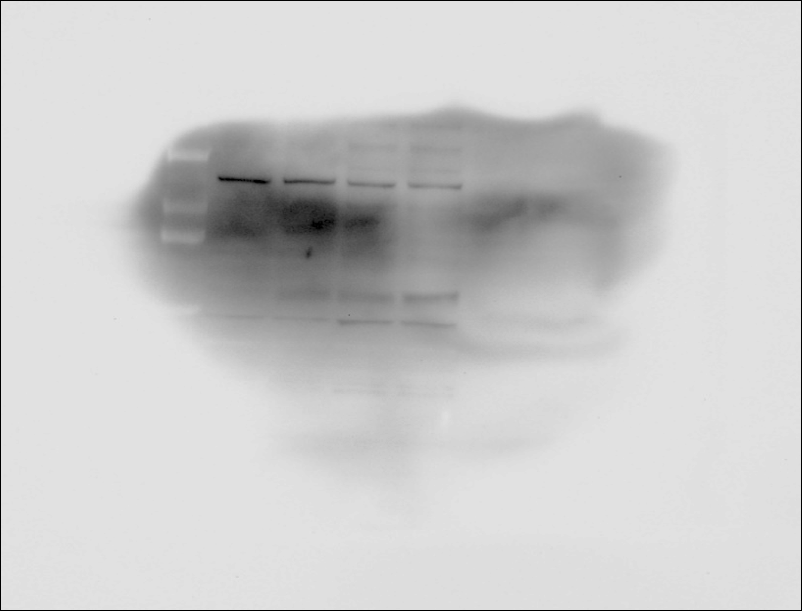
M-CSF
mock
MK-2206
BKM120
iKras*3 CM
–
+
+
+
pACLY

Slide 9
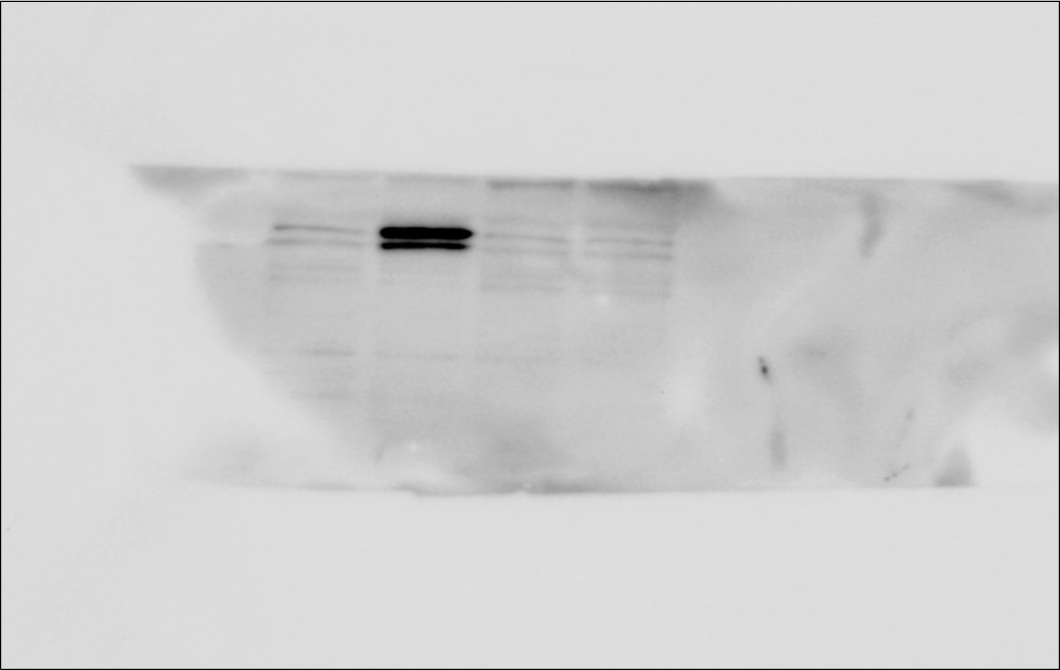
M-CSF
mock
MK-2206
BKM120
iKras*3 CM
–
+
+
+
ARG1

Slide 10
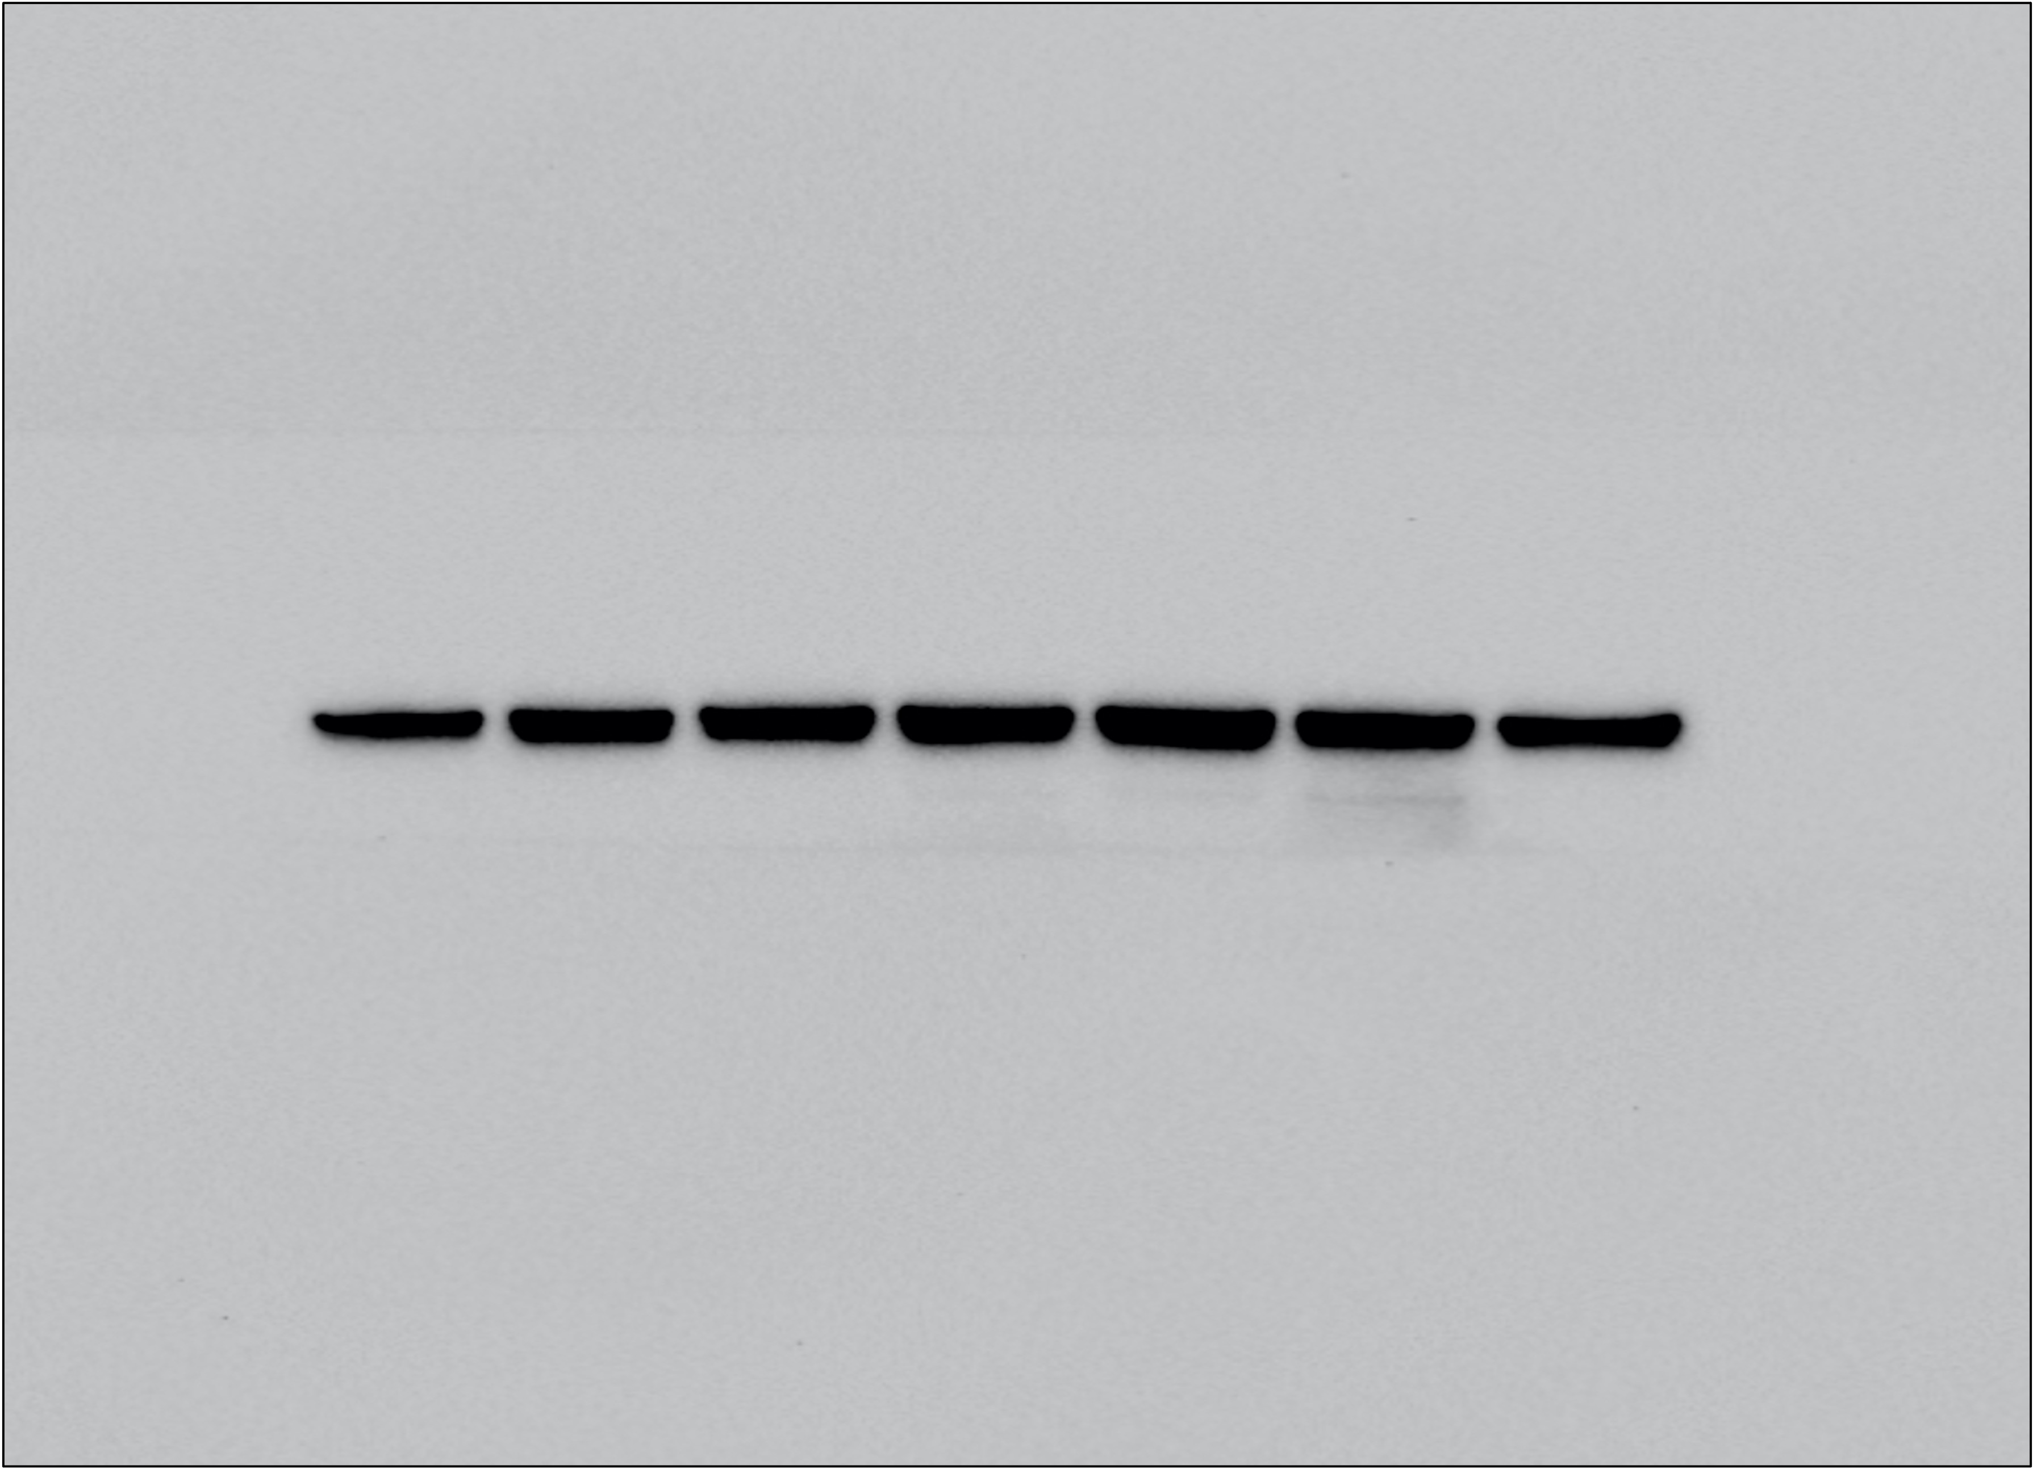
anti-GMCSF (1𝛍g/mL)
anti-GMCSF (5𝛍g/mL)
M-CSF
mock
MK-2206
BKM120
IgG
iKras*3 CM
–
+
+
+
+
+
+
Vinculin

Slide 11
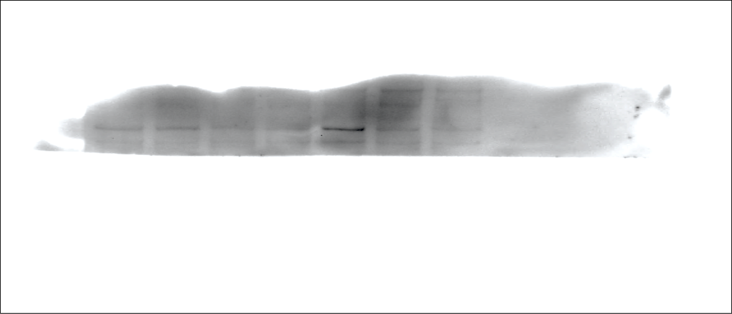
anti-GMCSF (1𝛍g/mL)
anti-GMCSF (5𝛍g/mL)
M-CSF
mock
MK-2206
BKM120
IgG
iKras*3 CM
–
+
+
+
+
+
+
pACLY

Slide 12
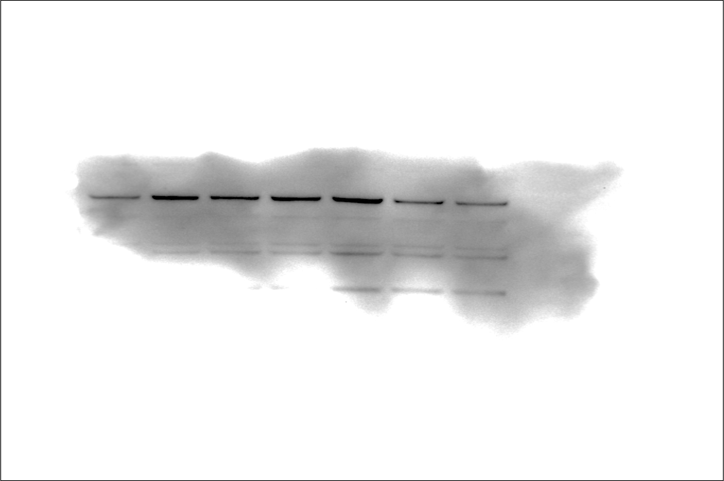
anti-GMCSF (1𝛍g/mL)
anti-GMCSF (5𝛍g/mL)
M-CSF
mock
MK-2206
BKM120
IgG
iKras*3 CM
–
+
+
+
+
+
+
ACLY

Slide 13
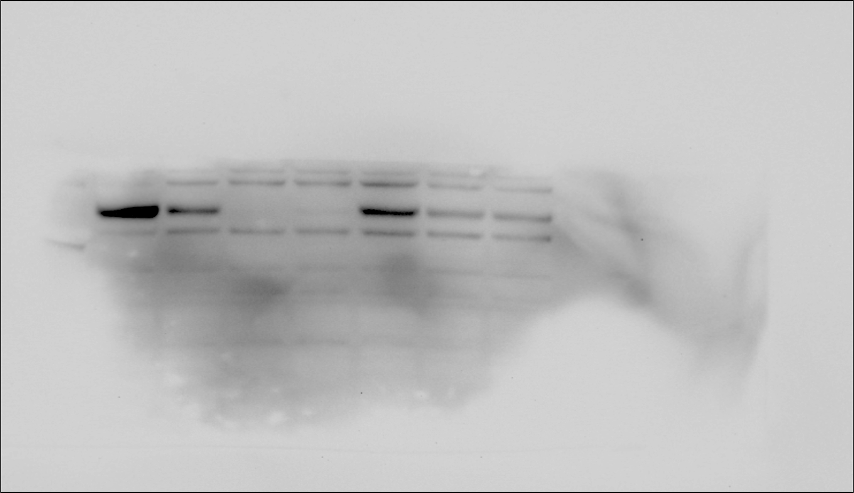
anti-GMCSF (1𝛍g/mL)
anti-GMCSF (5𝛍g/mL)
M-CSF
mock
MK-2206
BKM120
IgG
iKras*3 CM
–
+
+
+
+
+
+
pAKT

Slide 14
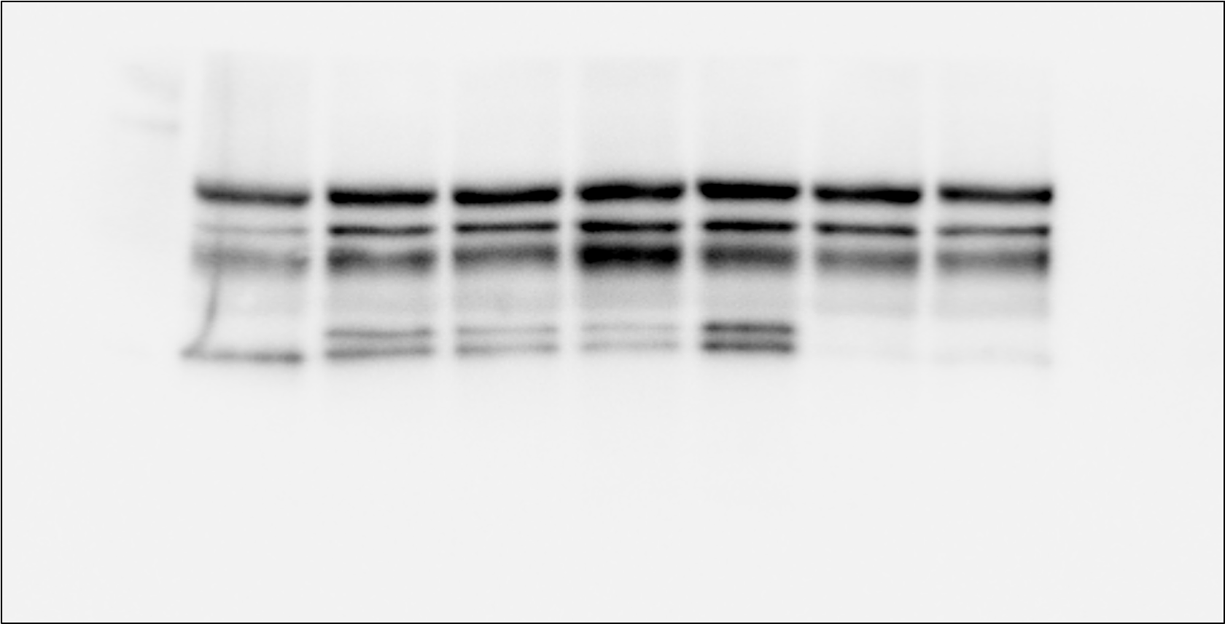
anti-GMCSF (1𝛍g/mL)
anti-GMCSF (5𝛍g/mL)
M-CSF
mock
MK-2206
BKM120
IgG
iKras*3 CM
–
+
+
+
+
+
+
AKT
TXNIP
ARG1

Slide 15
anti-GMCSF (1𝛍g/mL)
anti-GMCSF (5𝛍g/mL)
M-CSF
mock
MK-2206
BKM120
IgG
iKras*3 CM
–
+
+
+
+
+
+
TXNIP

Slide 16
anti-GMCSF (1𝛍g/mL)
anti-GMCSF (5𝛍g/mL)
M-CSF
mock
MK-2206
BKM120
IgG
iKras*3 CM
–
+
+
+
+
+
+
TXNIP

