Slide 1
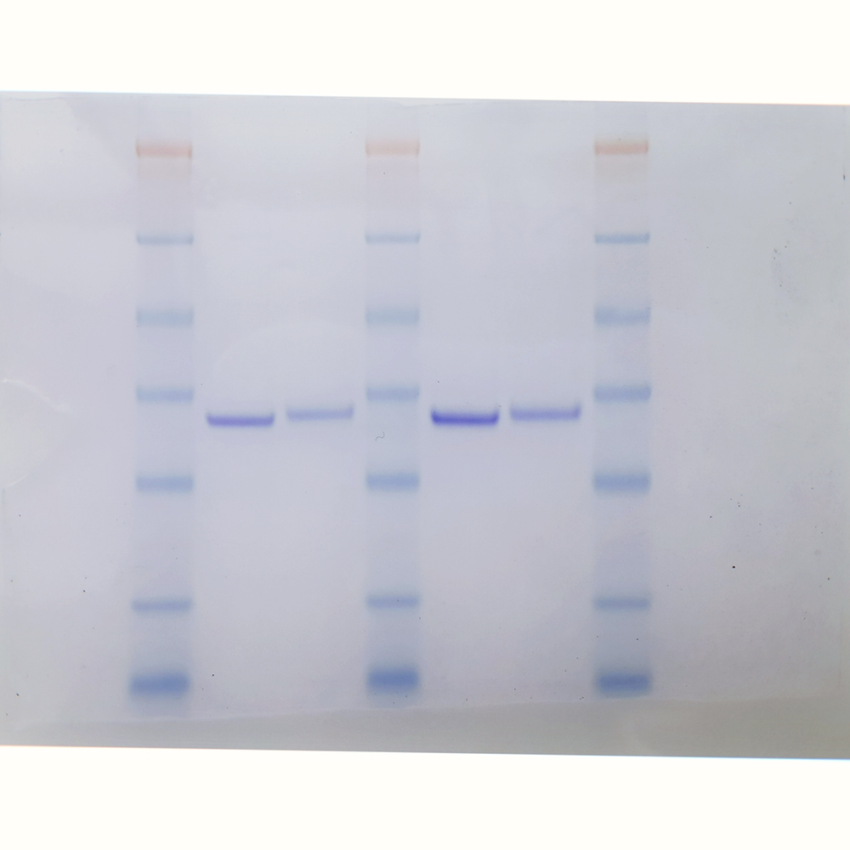
Figure 1a - uncropped
PTPN22wt PTPN22^{C129S}
98
62
49
38
28
14
6

