Slide 1
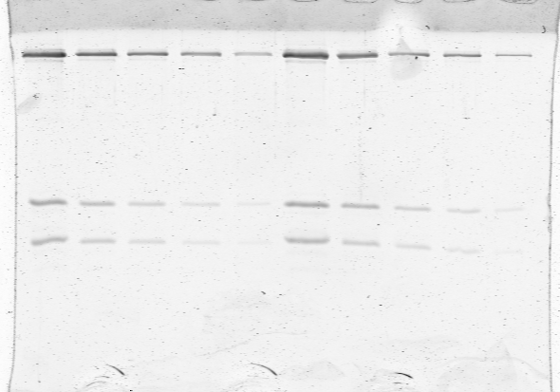
Notes:
Uncropped, unlabeled gel

Slide 2
Myosin heavy chain
Essential light chain
Regulatory light chain
Notes:
Uncropped, labeled gel

