Slide 1
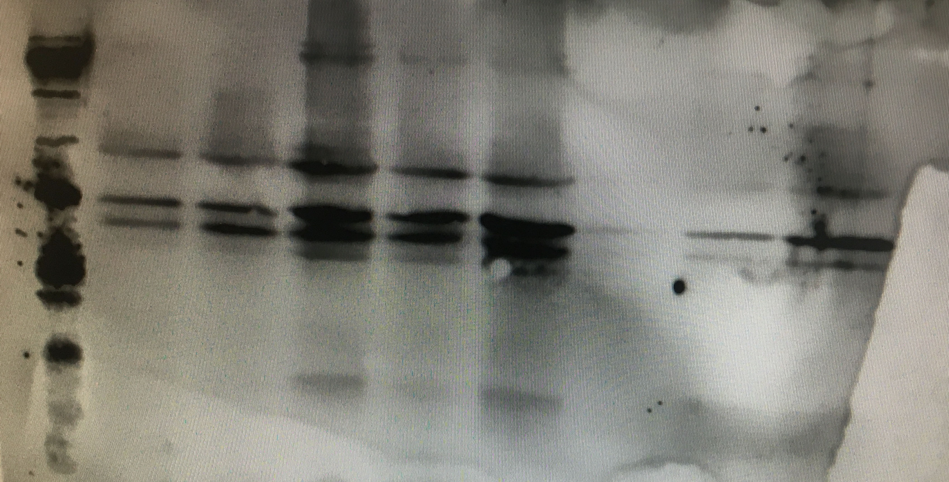
HA-hTCL1
15kDa
10kDa
Figure 3B- source data 1. Western blot of MEF stable clones expressing HA-tagged human TCL1.

