Slide 1
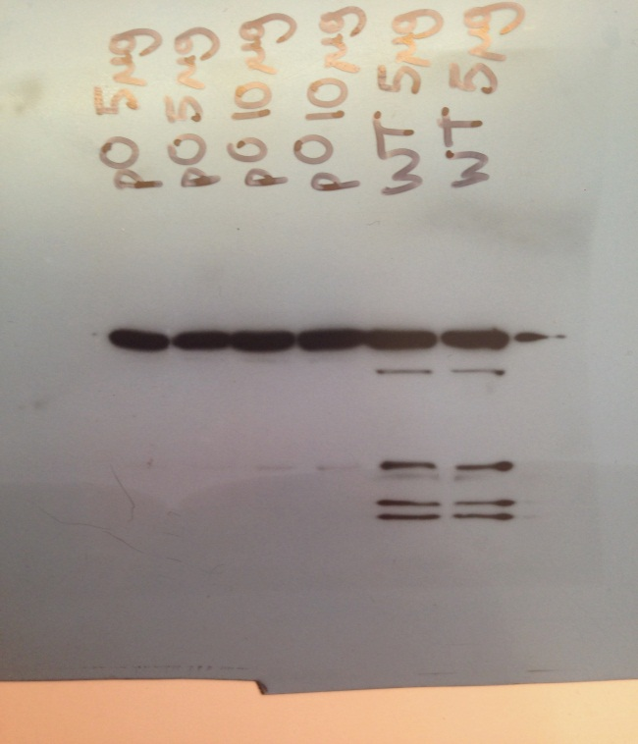
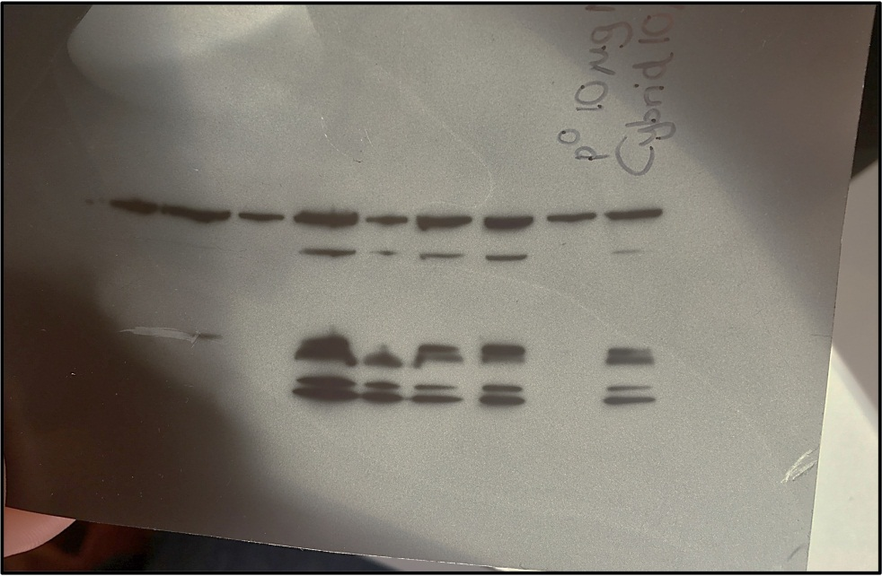
(nDNA) ATP Synthase – 54 kDa
(nDNA) Complex III – 48 kDa
(nDNA) Complex II – 29 kDa
(mtDNA) Complex IV – 22 kDa
(nDNA) Complex I – 18 kDa
Cybrid 10
p⁰
WT
p⁰

