Slide 1
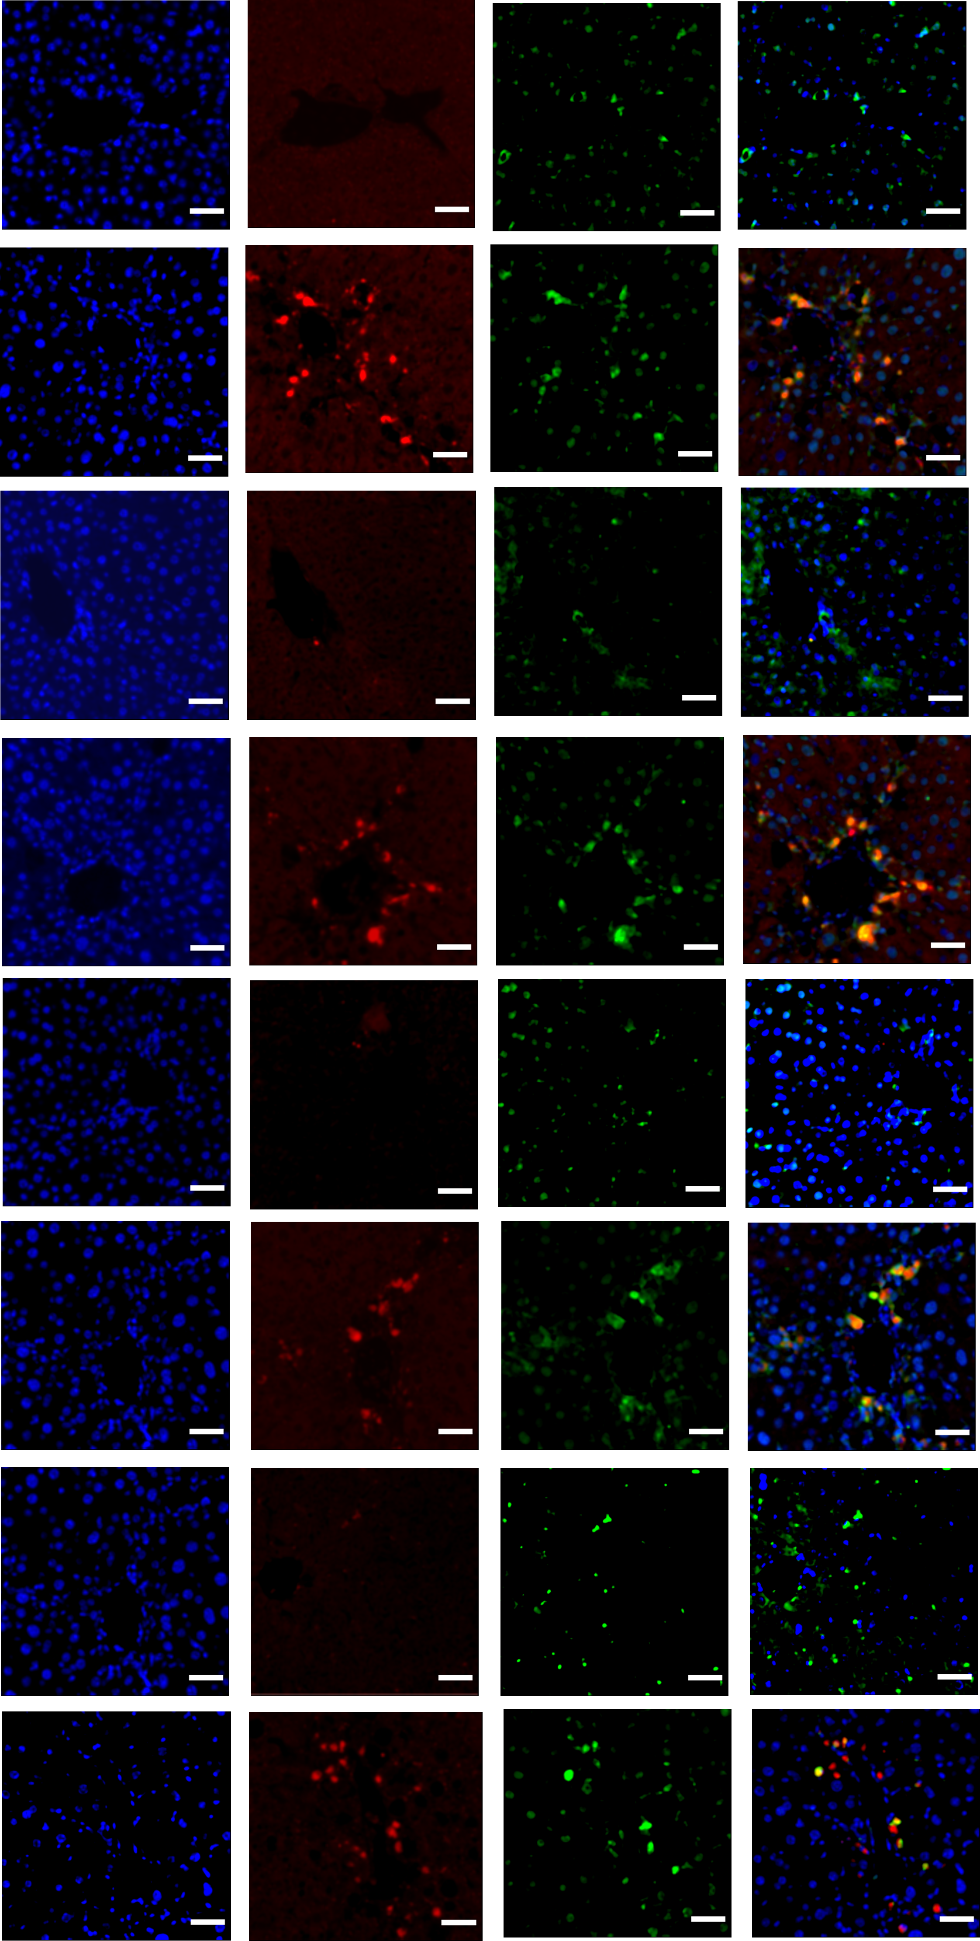
Figure1-source data 2
PLA
DAPI
P-AKAP12
DESMIN
MERGE
OIL
CCL₄
OIL
CCL₄
OIL
CCL₄
OIL
CCL₄

Slide 2
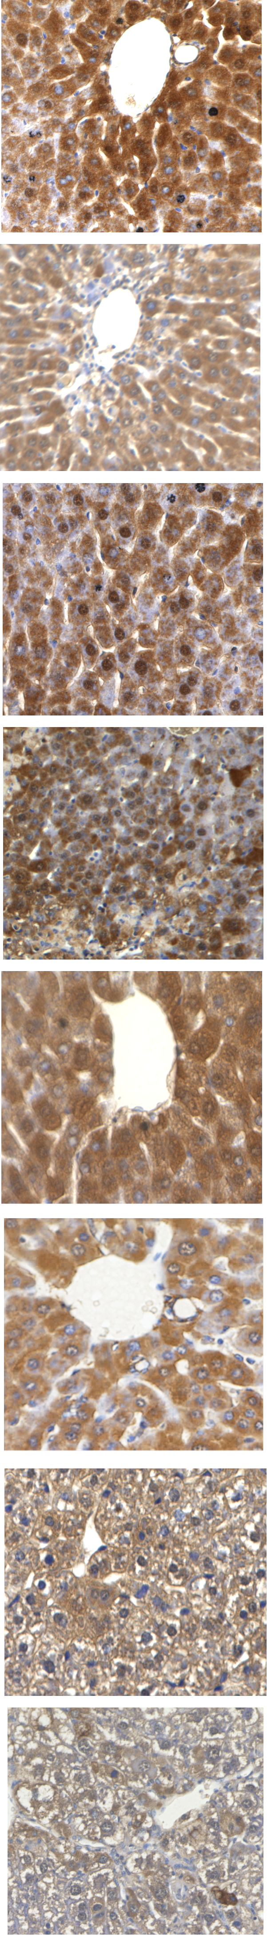
Figure1-source data 2
IHC staining
OIL
CCL₄
OIL
CCL₄
OIL
CCL₄
OIL
CCL₄

