Slide 1
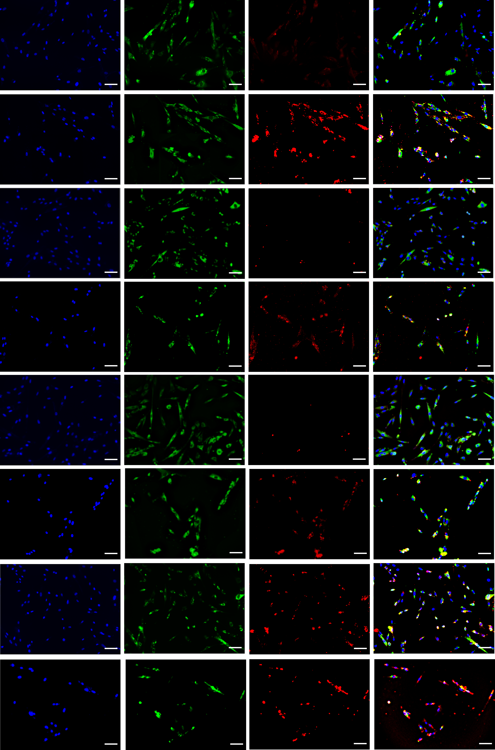
Figure 2-source data 3
CALRETI-
-CULIN
AKAP12-
HSP47
MERGE
DAPI
WT
1
HDR
WT
2
HDR
WT
3
HDR
WT
4
HDR
Scale bar=80µm

Slide 2
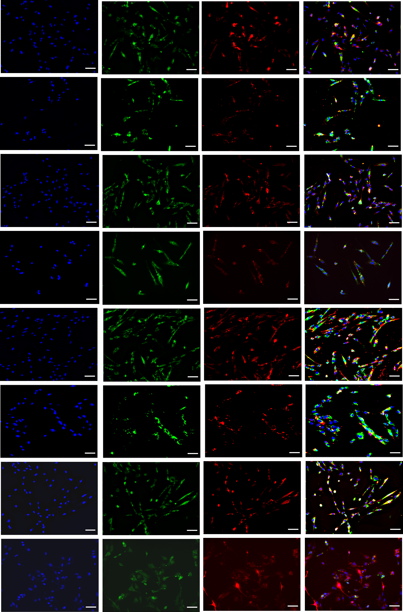
Figure 2-source data 3
CALRETI-
-CULIN
Collagen-
HSP47
MERGE
DAPI
WT
1
HDR
WT
2
HDR
WT
3
HDR
WT
4
HDR
Scale bar=80µm

